Slide 1
Communications Toolkit

Slide 2
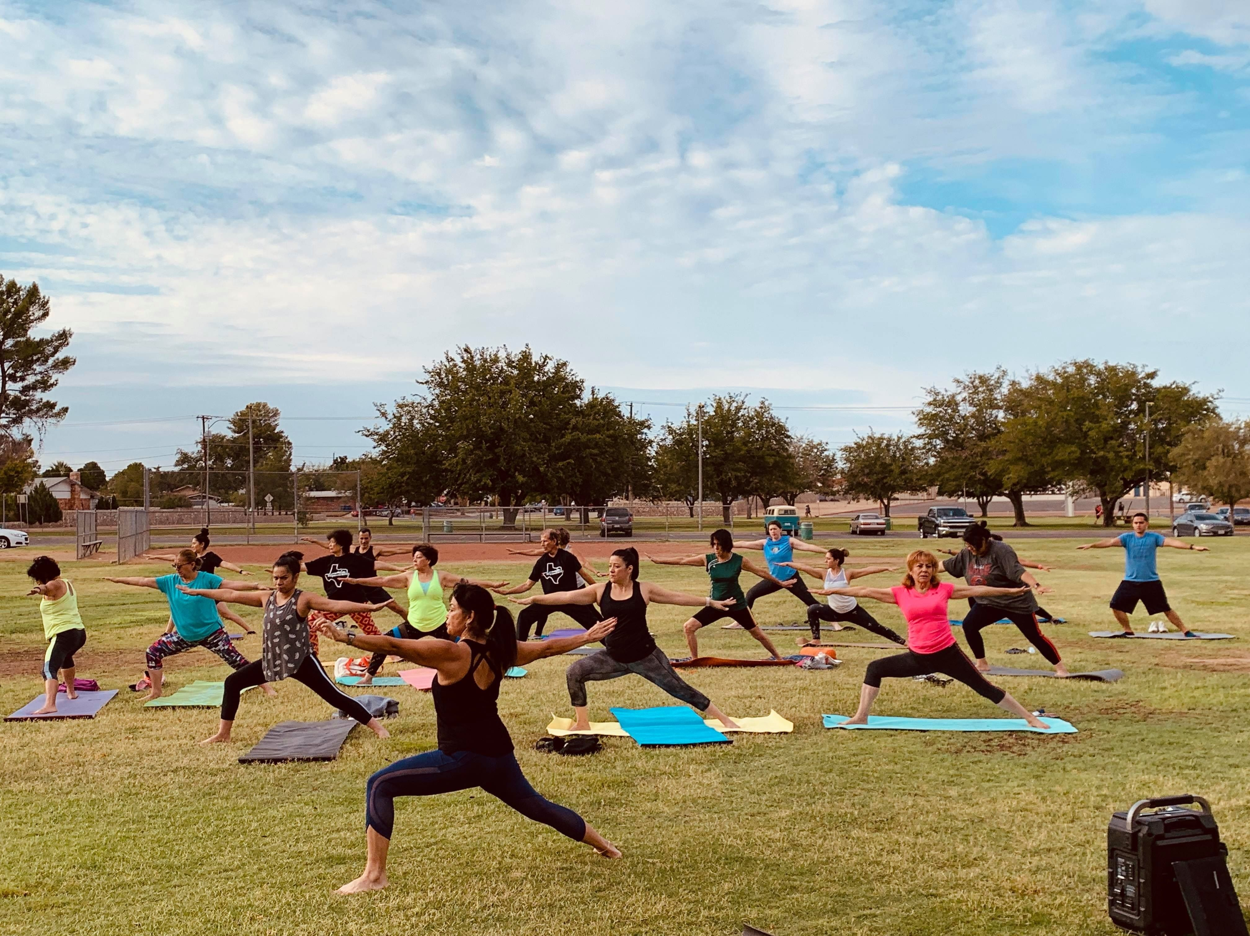
The new Active Parks! Increasing Physical Activity Through Parks, Trails, and Greenways recommendation indicates that public health and park and recreation professionals can increase physical activity and the use of parks, trails, and greenways by combining 1) essential infrastructure improvements with 2) additional activities like community engagement, programming, public awareness, and other access enhancements.¹
Active Parks! Recommendation
Notes:
1. https://www.thecommunityguide.org/findings/physical-activity-park-trail-greenway-infrastructure-interventions-combined-additional-interventions
Photo Credit: Community members participate in a yoga class held by El Paso Parks and Recreation. Photo courtesy of El Paso Parks and Recreation, El Paso, TX.

Slide 3
Active Parks! Recommendation
To increase the use of parks, trails, and greenways for safe physical activity and physical, mental, and social health benefits, professionals can combine infrastructure improvements that expand equitable access to parks, trails, and greenways with additional activities such as:
Notes:
Trust for Public Land. 10-Minute Walk. Retrieved from https://www.tpl.org/10minutewalk
Moore, L. V., Roux, A. V. D., Evenson, K. R., McGinn, A. P., & Brines, S. J. (2008). Availability of recreational resources in minority and low socioeconomic status areas. American journal of preventive medicine, 34(1), 16-22 Retrieved from https://www.ncbi.nlm.nih.gov/pmc/articles/ PMC2254179/
National Recreation and Park Association. (2021). Equity in Parks and Recreation. Retrieved from https://storymaps.arcgis.com/ stories/5727e40084614c559bf0440dc5a21f7f

Slide 4
What’s in the Active Parks! Implementation Resource Guide?
Translation of the Community Preventive Services Task Force Active Parks! recommendation
Description of why centering community members and people who have historically been excluded from parks is critical to advancing health equity
Descriptions, definitions, and examples of key terminology including parks, trails, greenways, and additional activities
A step-by-step process guide to help public health and park and recreation professionals partner and equitably implement the recommendation
Sample actions that public health and park and recreation professionals can take in the short, medium and long-term to implement the recommendation
Case studies from four projects aligned with the recommendation, documenting the process of implementation and the impact on community members

Slide 5
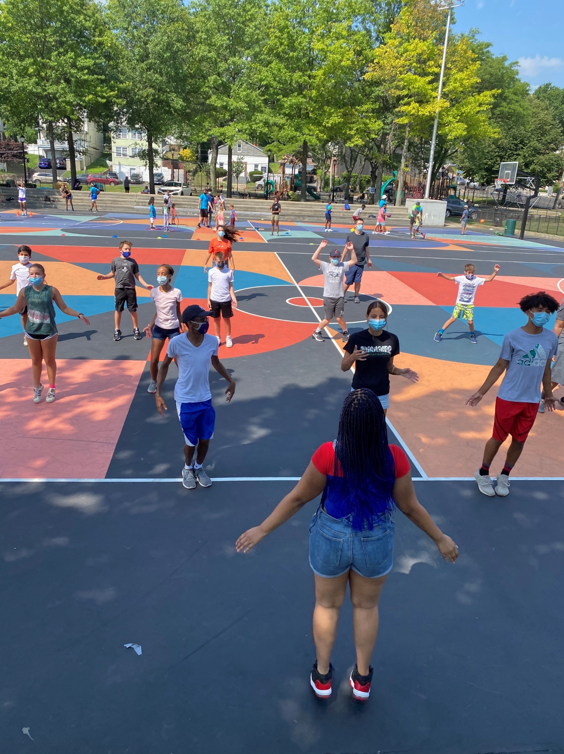
Advancing Health Equity through Active Parks!
Parks, trails, and greenways are vital to the health and well-being of communities. People who live near parks are physically and mentally healthier than those who do not. Yet, significant inequities remain:
In the United States more than 100 million people, or 30 percent of the population, lack access to a park or trail within a 10-minute walk of their home.¹
Black and Hispanic people and people with lower incomes are 50 percent less likely to have one recreational facility in their community compared to white and high-income persons.²
Many historically marginalized groups, such as people with lower incomes, people who identify as LGBTQ+, and people with disabilities, lack the opportunity to experience parks, trails, and/or greenways — because either these resources do not exist near them, or if they do, they are not safe, welcoming, nor inclusive.³
Notes:
Trust for Public Land. 10-Minute Walk. Retrieved from https://www.tpl.org/10minutewalk
Moore, L. V., Roux, A. V. D., Evenson, K. R., McGinn, A. P., & Brines, S. J. (2008). Availability of recreational resources in minority and low socioeconomic status areas. American journal of preventive medicine, 34(1), 16-22 Retrieved from https://www.ncbi.nlm.nih.gov/pmc/articles/ PMC2254179/
National Recreation and Park Association. (2021). Equity in Parks and Recreation. Retrieved from https://storymaps.arcgis.com/ stories/5727e40084614c559bf0440dc5a21f7f
Photo Credit: Park and recreation staff in New Rochelle, New York, formed “Outside the Box in Our Parks” during the COVID-19 pandemic to provide safe recreation and fun activities for youth when almost all other activities were canceled. Photo courtesy of Sam Gomez, New Rochelle Parks and Recreation, New York.

Slide 6
Advancing Health Equity through Active Parks!
Through the Active Parks! recommendation, public health and park and recreation professionals can take action to address and improve the inequities in the built and social environment (e.g., transportation, land use, housing, safety) where people are born, grow, live, work, and age.
Prioritizing the people who have historically been excluded from the physical, environmental, mental, and social health benefits that parks, trails, and greenways provide can decrease health disparities, address disinvestment, and advance health equity.
Decreasing health inequities improves the health of all individuals and their communities and creates greater community cohesion and potential for economic gains.¹
Engaging community members, especially the people who historically have been excluded, most impacted by disinvestment and unfair policies, and have lacked access to resources like parks, trails, and greenways, is critical to equitably implementing the Active Parks! recommendation.
Notes:
1. Office of Disease Prevention and Health Promotion. Healthy People 2030 Framework. Retrieved from https://health.gov/healthypeople/about/ healthy-people-2030-framework

Slide 7
Implementing the
Active Parks! Recommendation
Public health and park and recreation professionals can follow these steps to implement the recommendation. Keep in mind that every community starts in a different place. The process is not a one-size-fits-all approach, but a flexible and adaptable guide.

Slide 8
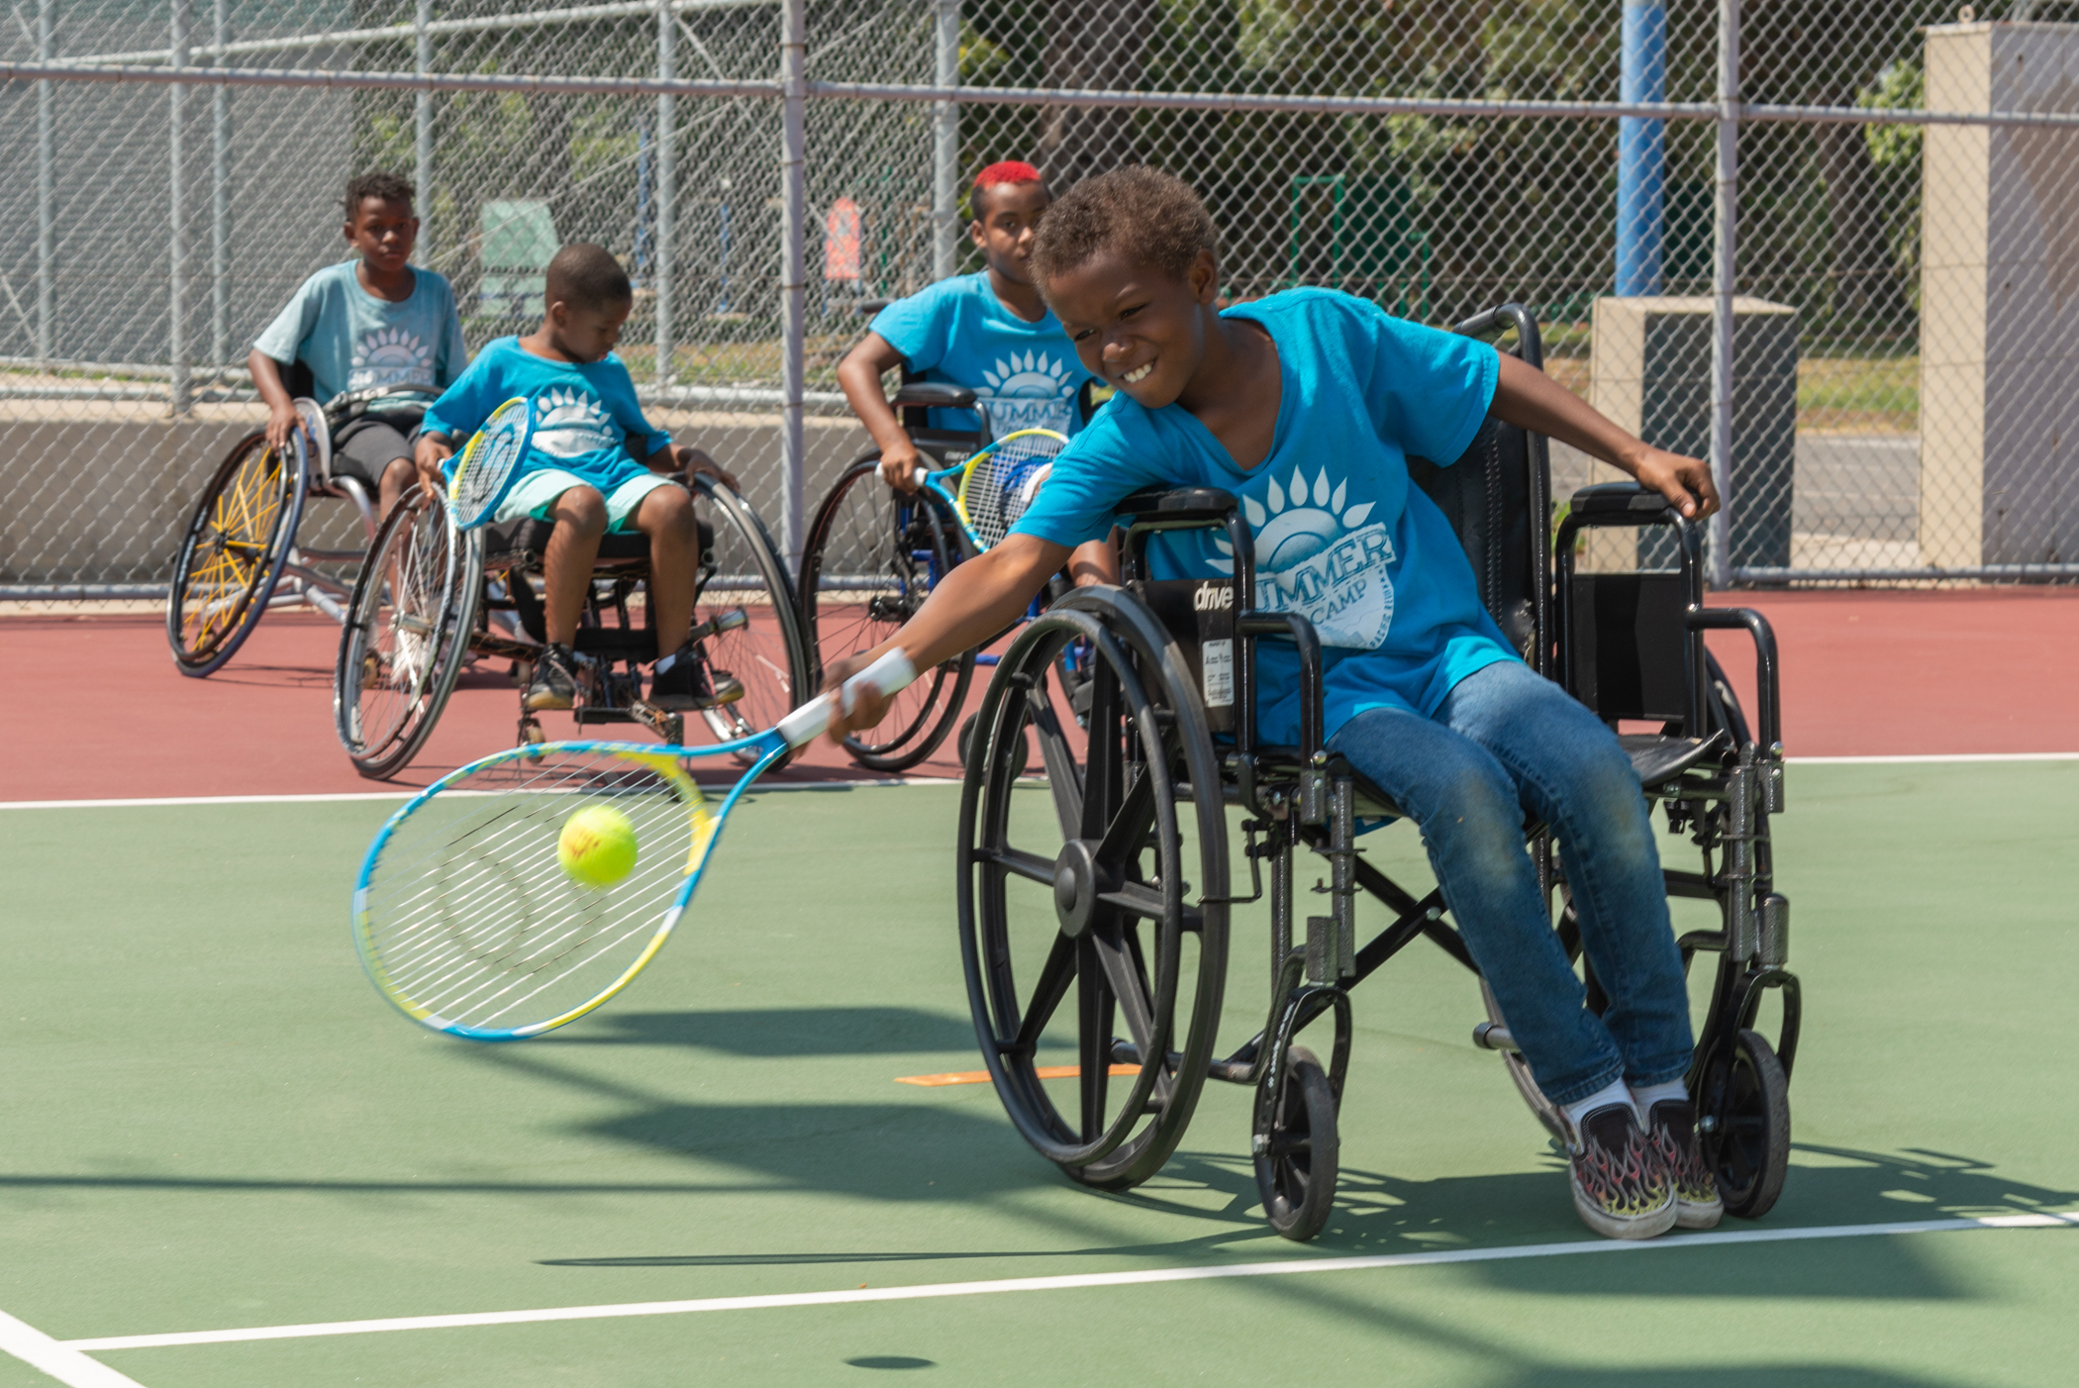
Sample Twitter Promotion for the
Active Parks! Recommendation
Tweet: Physical activity is one of the best things people can do to improve their health. Use newly released guidance developed in partnership with @NRPA_news to increase the use of parks, trails, and greenways for safe physical activity. #ActivePeople #ActiveParks
Tweet: All people deserve access to ​programs and facilities that promote health and wellbeing. Public health and park and recreation professionals can expand access to parks, trails, and greenways plus increase the use of these spaces for safe physical activity. #ActivePeople #ActiveParks
Tweet: Infrastructure Improvements + Additional Activities = Active Parks! Encourage physical activity by combining park, trail, or greenway infrastructure with activities like community engagement, programming, access enhancements, and public awareness. #ActivePeople #ActiveParks
Notes:
Photo Credit: Photo courtesy of Juan Carlos Chan, City of Los Angeles Department of Recreation and Parks

Slide 9
Sample Facebook Promotion for the
Active Parks! Recommendation
Post: All people deserve access to park and recreation programs, facilities, places, and spaces – including parks, trails, and greenways – that promote health and wellbeing. As leaders in their communities, public health and park and recreation professionals can expand equitable access to parks, trails, and greenways plus increase the number of community members using these spaces for safe physical activity. #ActivePeople #ActiveParks
Post: Physical activity is one of the best things people can do to improve their health. In partnership with @National Recreation and Park Association, the Active People, Healthy NationSM Initiative has developed guidance to support public health and park and recreation professionals increase the use of parks, trails, and greenways for safe physical activity. Access the guide here. #ActivePeople #ActiveParks
Post: Infrastructure Improvements + Additional Activities = Active Parks! Research shows that when you combine essential infrastructure improvements at parks, trails, and greenways with additional activities like community engagement, programming, access enhancements, and public awareness, community members are more likely to use these spaces for physical activity. Learn how to play a role in expanding equitable access to parks, trails, and greenways using this guide. #ActivePeople #ActiveParks

Slide 10
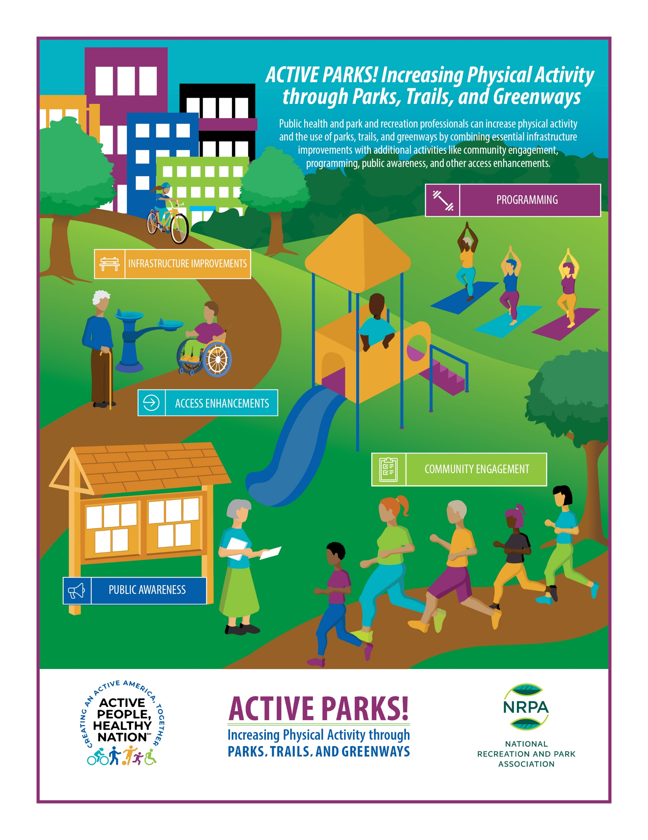
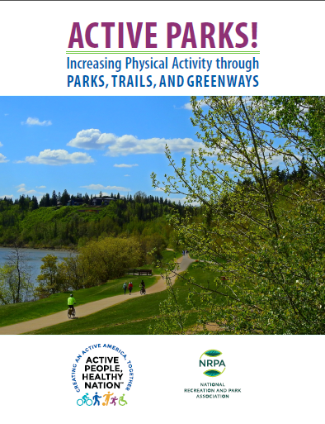
Sample Images for Promotion
Downloadable graphics available for promotion!

