Slide 1
Parks and Improved Mental Health and Quality of Life
Several studies have confirmed that separation from nature is detrimental to human development, health and well being, and that regular contact with nature is required for good mental health.
Physician-diagnosed depression was 33 percent lower in the residential areas with the most green spaces, compared to the neighborhoods with the least.
Individuals reported less mental distress and higher life satisfaction when they were living in greener areas.
A strong body of evidence suggests that physical activity in green spaces has stronger mental health benefits than physical activity in non-green spaces.
Use of green spaces is associated with improved blood pressure and cholesterol levels, reduced stress, improved general health perceptions and a greater ability to face problems.
Notes:
References:
Making the Case for Designing Active Cities, Active Living Research (Maller, 2008), 2015
Making the Case for Designing Active Cities, Active Living Research (NRPA Report, 2010), 2015
Making the Case for Designing Active Cities, Active Living Research (White, 2013), 2015
Making the Case for Designing Active Cities, Active Living Research (BoP consulting, 2013), 2015
Making the Case for Designing Active Cities, Active Living Research (King’s Fund, 2013), 2015

Slide 2
Several studies have confirmed that separation from nature is detrimental to human development, health and well being, and that regular contact with nature is required for good mental health.
Notes:
Making the Case for Designing Active Cities, Active Living Research (Maller, 2008), 2015

Slide 3
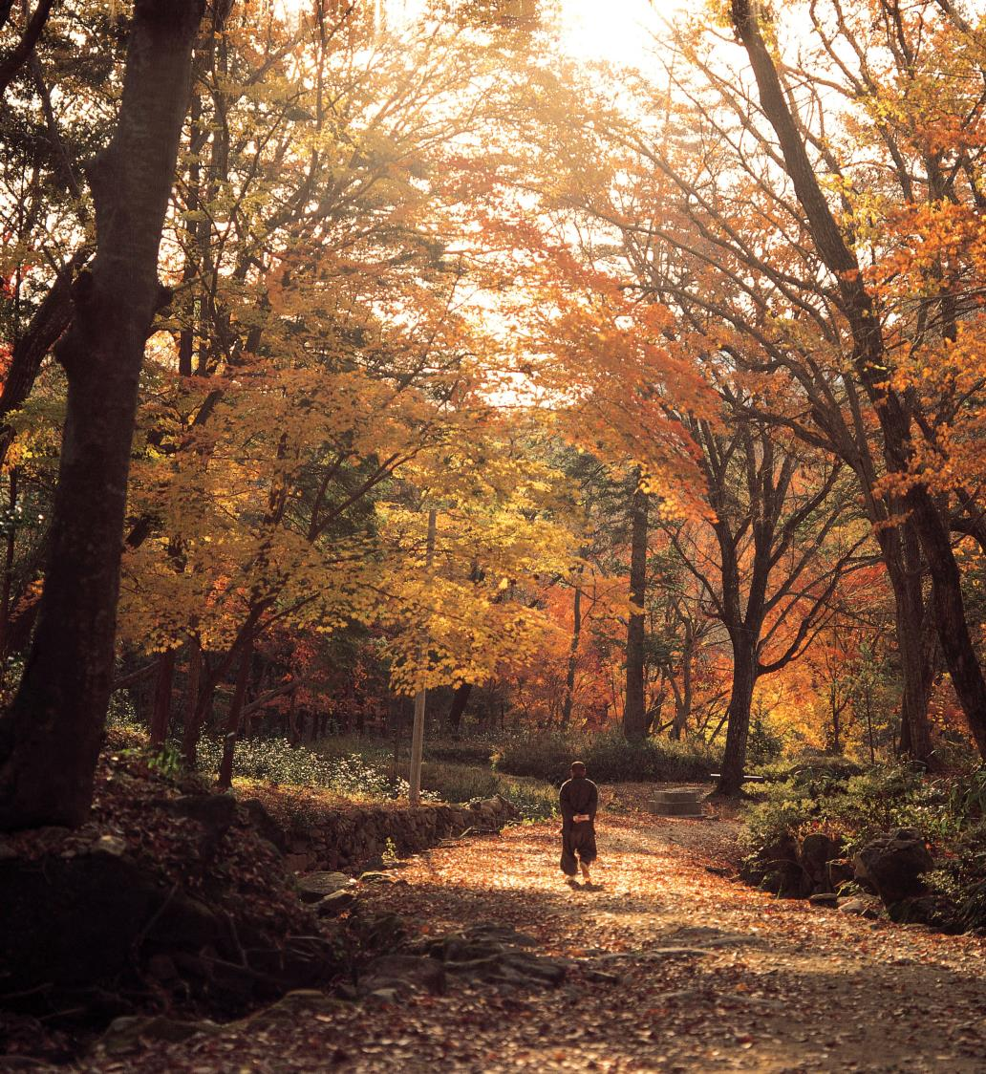
Physician-diagnosed depression was 33 percent lower in the residential areas with the most green spaces, compared to the neighborhoods with the least.
Notes:
Making the Case for Designing Active Cities, Active Living Research (NRPA Report, 2010), 2015

Slide 4
Individuals reported less mental distress and higher life satisfaction when they were living in greener areas.
Notes:
Making the Case for Designing Active Cities, Active Living Research (White, 2013), 2015

Slide 5
Use of green spaces is associated with improved blood pressure and cholesterol levels, reduced stress, improved general health perceptions and a greater ability to face problems.
Notes:
Making the Case for Designing Active Cities, Active Living Research (King’s Fund, 2013), 2015

Slide 6
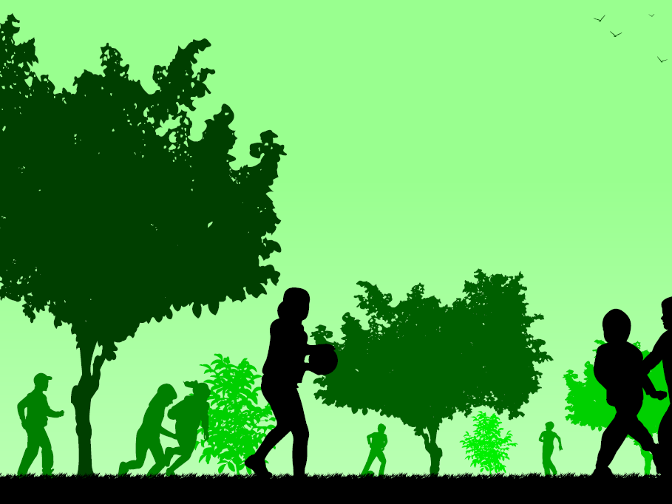
A strong body of evidence suggests that physical activity in green spaces has stronger mental health benefits than physical activity in non-green spaces.
Notes:
Making the Case for Designing Active Cities, Active Living Research (BoP consulting, 2013), 2015

