Slide 1
Parks and Healthy Kids
Children today experience record levels of obesity and preventable diseases like hypertension and Type II Diabetes, but using parks to help children move more and eat healthily can help children fight these diseases and live longer.
A 20-minute walk in a park or other natural area can help children with attention deficit hyperactivity disorder focus better.
Active children show more brain activity, and they are 20 percent more likely to earn an A in English or math.
Youth living in neighborhoods with multiple recreation and park facilities are more likely to be active five times a week, compared to young people who don’t have access to any. Unfortunately, young people who live in poor or mostly minority neighborhoods are 50 percent less likely to have a recreation and park facility near their homes.
Notes:
References:
How Parks Create Healthier Communities, NRPA
Infographic: Children & Nature, National Environmental Education Foundation
Infographic: Active Kids Learn Better, Active Living Research
Infographic: the Role of Parks and Recreation in Promoting Physical Activity, Active Living Research
Infographic: the Role of Communities in Promoting Physical Activity, Active Living Research

Slide 2
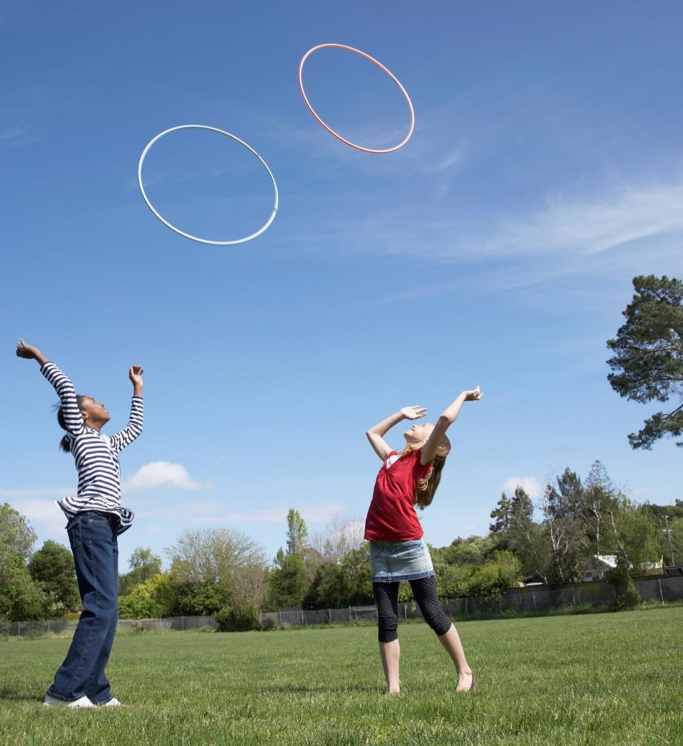
Youth living in neighborhoods with multiple recreation and park facilities are more likely to be active five times a week, compared to young people who don’t have access to any.
Unfortunately, young people who live in poor or mostly minority neighborhoods are 50 percent less likely to have a recreation and park facility near their homes.
Notes:
Infographic: the Role of Communities in Promoting Physical Activity, Active Living Research

Slide 3
Children today experience record levels of obesity and preventable diseases like hypertension and Type II Diabetes, but using parks to help children move more and eat healthily can help children fight these diseases and live longer.
Notes:
How Parks Create Healthier Communities, NRPA

Slide 4
Active children show more brain activity, and they are 20 percent more likely to earn an A in English or math.
Notes:
Infographic: Active Kids Learn Better, Active Living Research
Infographic: the Role of Parks and Recreation in Promoting Physical Activity, Active Living Research

Slide 5
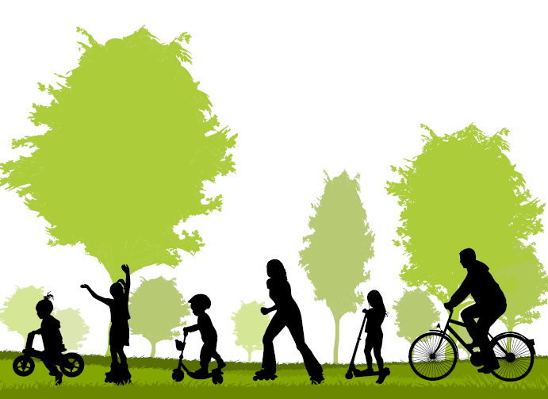
A 20-minute walk in a park or other natural area can help children with attention deficit hyperactivity disorder focus better.
Notes:
Infographic: Children & Nature, National Environmental Education Foundation

