Slide 1

Parks and Chronic Disease Management
Diabetic individuals taking 30-minute walks in a forest experienced much lower blood glucose levels than the same amount of time spent walking in other settings.
Males living in the greenest urban areas in the UK had a 5 percent lower risk of cardiovascular disease mortality and 11 percent lower risk of respiratory disease mortality than those in the least green areas.
Patients in hospital rooms facing a park had a 10 percent faster recovery and needed 50 percent less strong pain medication, compared to patients whose rooms faced a building wall.
Children today experience record levels of obesity and preventable diseases like hypertension and Type II Diabetes, caused in part by a decrease in physical activity and increase in processed food consumption. Park programming helps children move more and eat more healthy foods to fight these diseases.
Notes:
References:
Making the Case for Designing Active Cities, Active Living Research (NRPA Report, 2010), 2015
Making the Case for Designing Active Cities, Active Living Research (Richardson & Mitchell, 2010), 2015
Making the Case for Designing Active Cities, Active Living Research (Bolund, 1999), 2015
How Parks Create Healthier Communities, NRPA 2015

Slide 2
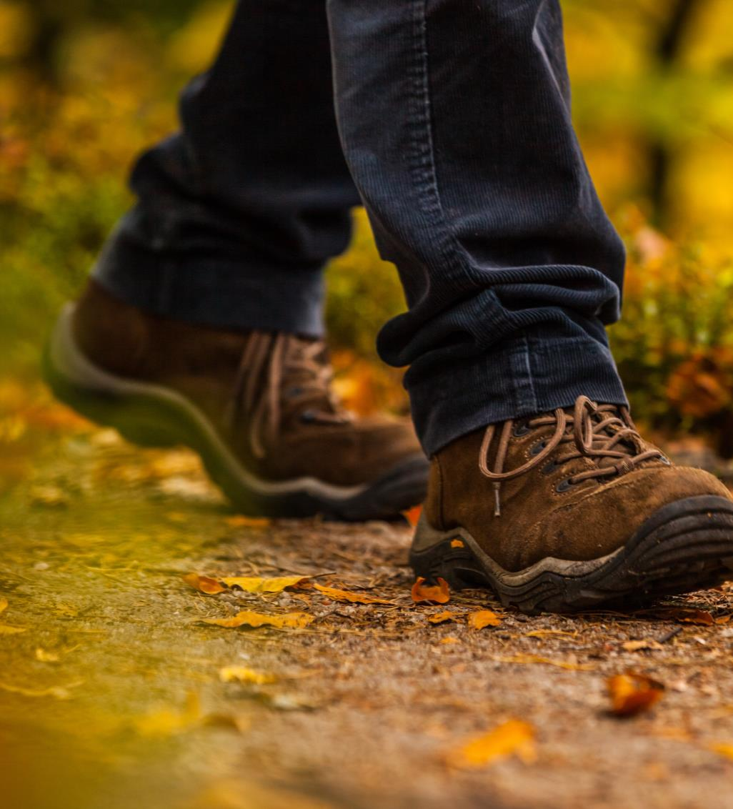

Diabetic individuals taking 30-minute walks in a forest experienced much lower blood glucose levels than the same amount of time spent walking in other settings.
Notes:
Making the Case for Designing Active Cities, Active Living Research (NRPA Report, 2010), 2015

Slide 3
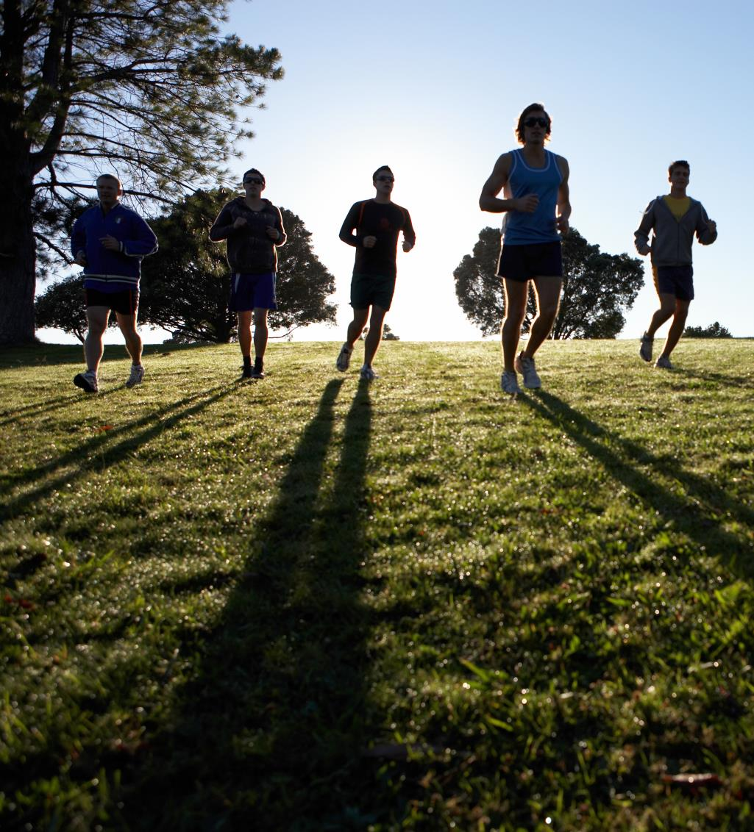
Males living in the greenest urban areas in the UK had a 5 percent lower risk of cardiovascular disease mortality and 11 percent lower risk of respiratory disease mortality than those in the least green areas.
Notes:
Making the Case for Designing Active Cities, Active Living Research (Richardson & Mitchell, 2010), 2015

Slide 4
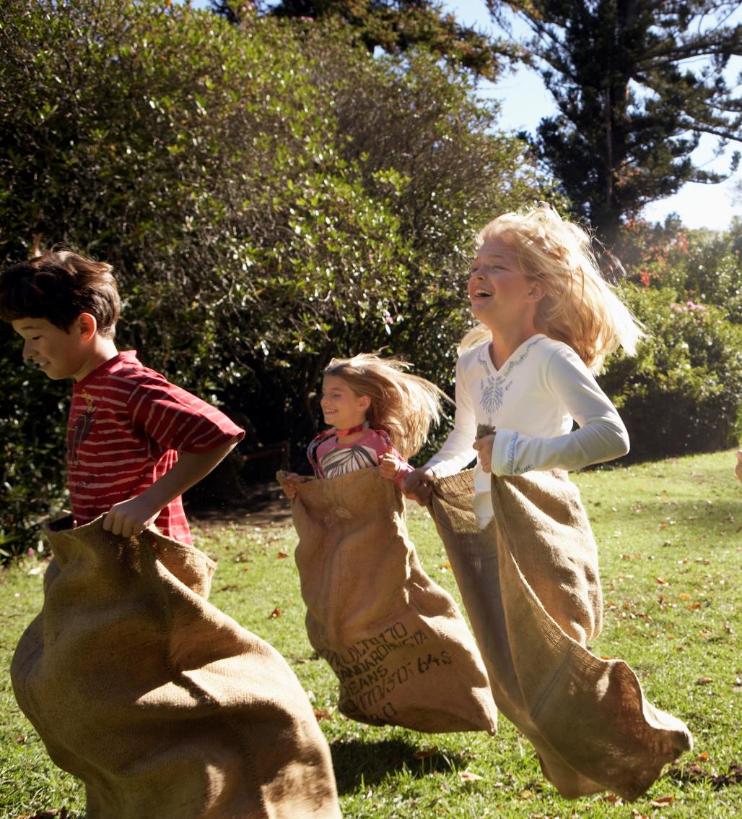
Children today experience record levels of obesity and preventable diseases like hypertension and Type II Diabetes, caused in part by a decrease in physical activity and increase in processed food consumption. Park programming helps children move more and eat more healthy foods to fight these diseases.
Notes:
How Parks Create Healthier Communities, NRPA 2015

Slide 5
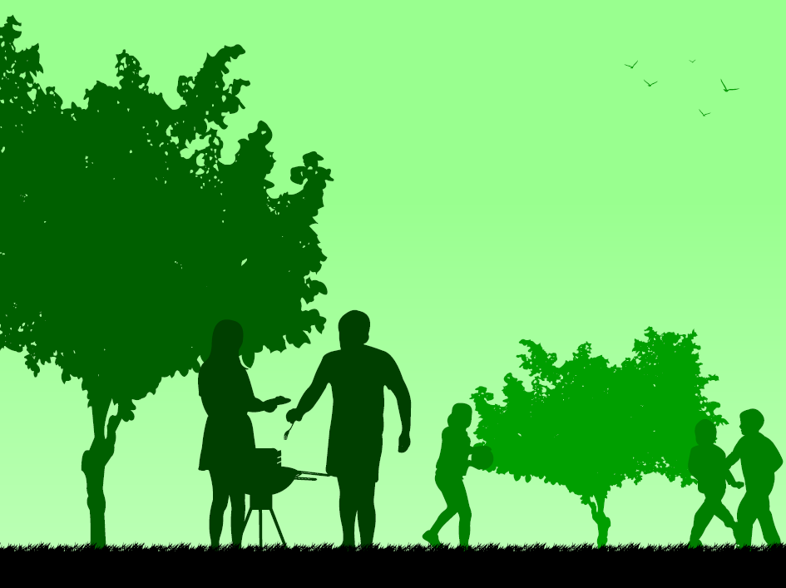
Patients in hospital rooms facing a park had a 10 percent faster recovery and needed 50 percent less strong pain medication, compared to patients whose rooms faced a building wall.
Notes:
Making the Case for Designing Active Cities, Active Living Research (Bolund, 1999), 2015

