Slide 1
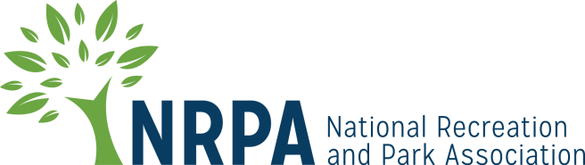
Active Transportation, Parks and Public Health
Maintaining or expanding active transportation systems often relies on recreation and park agencies for initial infrastructure development, maintenance, promotional programs and marketing. Recreation and park programs are helping to create a culture shift toward increased active transportation.
A study showed that people who walk a few times per week filed 14 percent fewer health care claims, spent 30 percent fewer days at a hospital, and had 40 percent fewer claims over $5,000. If people reduced automobile use by 1 percent and walked to do nearby appointments or errands, they could lower obesity, saving tens of millions of dollars in medical expenses.
In Lincoln, Nebraska, every $1 spent on trails accounted for $3 saved in direct medical costs over time.
Residents living in areas with more active transportation had lower obesity rates than areas without a local culture or infrastructure that supports active transportation.
Notes:
References:
Active Transportation and Parks and Recreation, NRPA
Active Transportation and Parks and Recreation, NRPA
Infographic: the Role of Parks and Recreation in Promoting Physical Activity, Active Living Research
Active Transportation and Parks and Recreation, NRPA

Slide 2


A study showed that people who walk a few times per week filed 14 percent fewer health care claims, spent 30 percent fewer days at a hospital, and had 40 percent fewer claims over $5,000. If people reduced automobile use by 1 percent and walked to do nearby appointments or errands, they could lower obesity, saving tens of millions of dollars in medical expenses.
Notes:
Active Transportation and Parks and Recreation, NRPA

Slide 3

In Lincoln, Nebraska, every $1 spent on trails accounted for $3 saved in direct medical costs over time.
Notes:
Infographic: the Role of Parks and Recreation in Promoting Physical Activity, Active Living Research

Slide 4
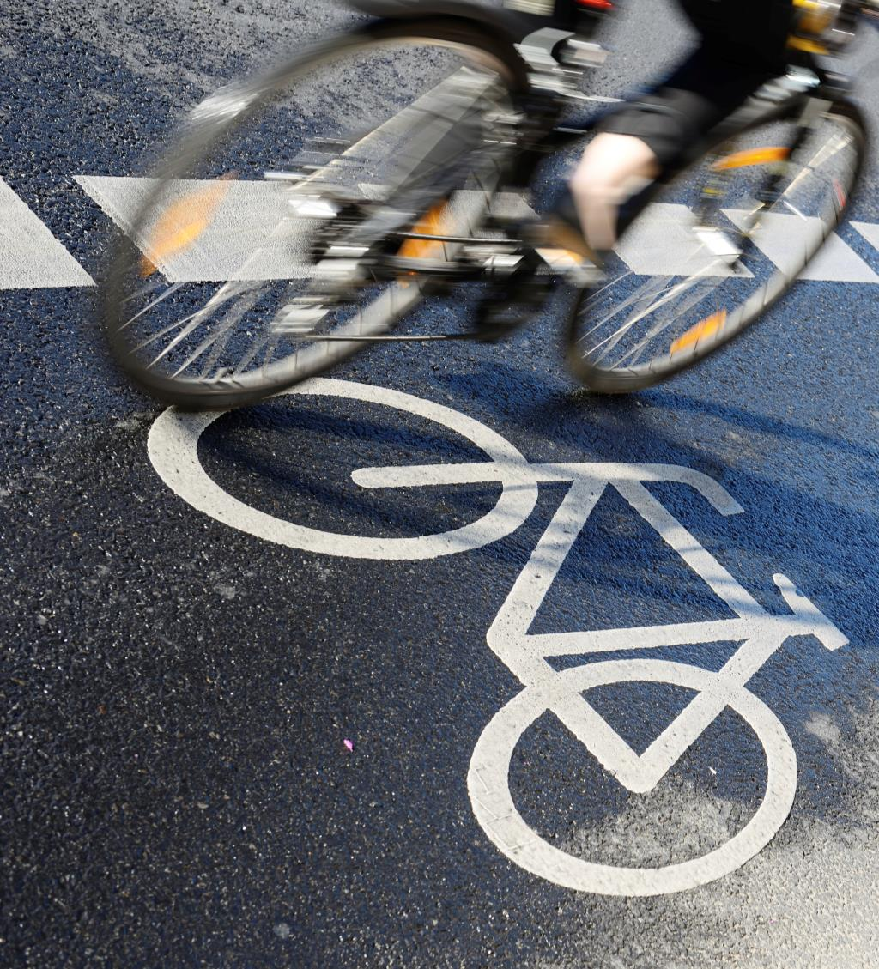
Residents living in areas with more active transportation had lower obesity rates than areas without a local culture or infrastructure that supports active transportation.
Notes:
Active Transportation and Parks and Recreation, NRPA

Slide 5
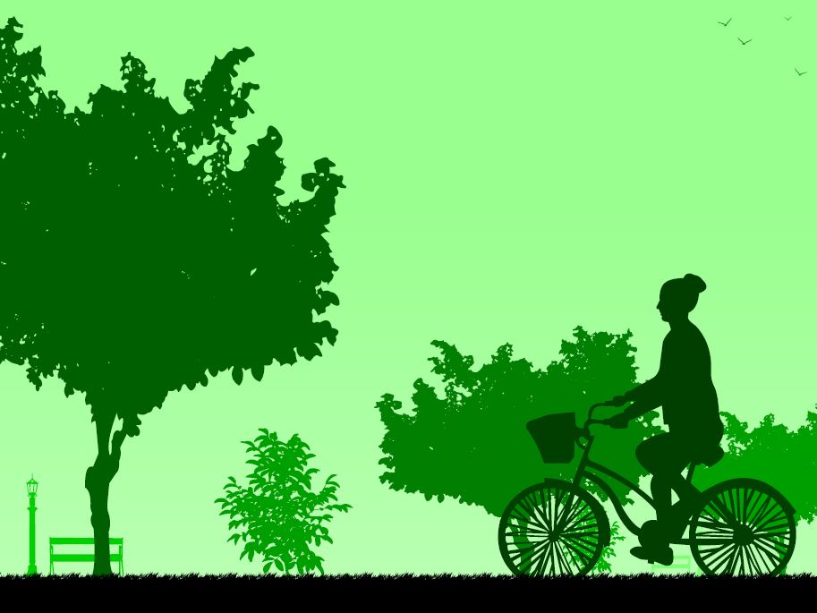
Maintaining or expanding active transportation systems often relies on recreation and park agencies for initial infrastructure development, maintenance, promotional programs and marketing. Recreation and park programs are helping to create a culture shift toward increased active transportation.
Notes:
Active Transportation and Parks and Recreation, NRPA

