Slide 1

Session: Parks and Quality of Life
Terry Clower, Ph.D., Professor of Public Policy and Director, Center for Regional Analysis, George Mason University (GMU)
Mark White, Ph.D., Deputy Director, Center for Regional Analysis, GMU
Notes:
http://www.thinkstockphotos.com/image/stock-photo-green-environment/161865156/popup?sq=sustainable/f=CPIHVX/p=2/s=DynamicRank
http://www.thinkstockphotos.com/image/stock-photo-group-of-multi-ethnic-kids-running-together/124425491/popup?sq=diverse%20runners/f=CPIHVX/s=DynamicRank
http://www.thinkstockphotos.com/image/stock-photo-group-of-young-children-running-towards/494209209/popup?sq=diverse%20playground/f=CPIHVX/p=2/s=DynamicRank
http://www.thinkstockphotos.com/image/stock-photo-people-doing-stretching-exercise-in-park/494377511/popup?sq=outdoor%20health/f=CPIHVX/p=3/s=DynamicRank
http://www.thinkstockphotos.com/image/stock-photo-asian-family/158898370/popup?sq=outdoor%20health/f=CPIHVX/p=6/s=DynamicRank

Slide 2
Promoting
Parks and Recreation's
Role in
Economic Development
Center for Regional Analysis at George Mason University
May 18, 2018

Slide 3
Parks & Recreation
Spur Economic Activity
Economic impacts
  Park systems can be significant employers
  Spending generates positive indirect and induced impacts
Local parks shape perceptions of quality of life and build a sense of place.
Investments in improving a community’s quality of life can support a virtuous cycle of growth.

Slide 4
Quality-of-Life
Supporting Role in Site Location Decisions
QoL most important to firms that prioritize talent attraction and retention
  Short-term: relocation of key staff
  Long-term: ability to attract/retain highly educated, skilled workers
Companies that want places that reflect their corporate culture or values.
  Small- and medium-sized, entrepreneurial or family-owned
  Emphasis on outdoor recreation and lifestyle

Slide 5
Where Does QoL Fit in the
Site Location Process?
1. Identify candidate cities
Basic quality of life measures
2. Reputation and marketing
Outdoor & rec. assets
3. Site visits and finding the right fit
First impressions and ‘Curb Appeal’
Cultural fit with company needs
Cost of living
Crime rates
Housing costs
School quality
Availability of specific sites & facilities
Experience of other similar companies
Validating marketing messages
Does your local EDO use parks-related images or data in their marketing materials?

Slide 6
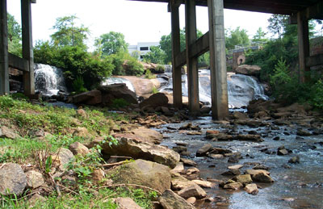
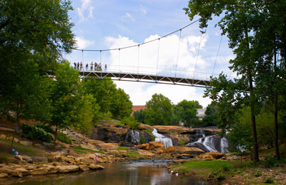
How Can You Contribute?
Falls Park, Greenville, SC
Business attraction
  Place making
  Product development
Business retention and expansion
  Engaging existing companies and workers
Talent attraction
  Positive experiences can influence recruitment
  First introductions to a place often occurs as visitors
Notes:
Reedy River Falls. Road pulled down in 2002, replaced by pedestrian bridge and park. Local Hospitality Tax

Slide 7
Engage Key Stakeholders!
Economic development organizations
Civic boosters (e.g., chambers, CVBs)
Other municipal departments
Shapers of the built environment (e.g., developers)
Other P&R organizations
Importantly, Park and Rec departments need an engaged citizenry.

Slide 8
Provide Evidence of Your Value
Track and measure impacts
Identify key metrics
  # of bike commuters,
  # of park workers being hired for their first job, and/or
  # of companies and company employees that use parks and recreation facilities.
Collect compelling anecdotes

Slide 9
Thank you
Dr. Terry Clower (tclower@gmu.edu)
Dr. Mark C. White (mwhite34@gmu.edu)

