Slide 1
Design & Planning for Resilience
NRPA Innovation Lab
January 17, 2019
Jason Hellendrung, ASLA, PLA
Vice President, Planning & Design
jason.Hellendrung@tetratech.com

Slide 2
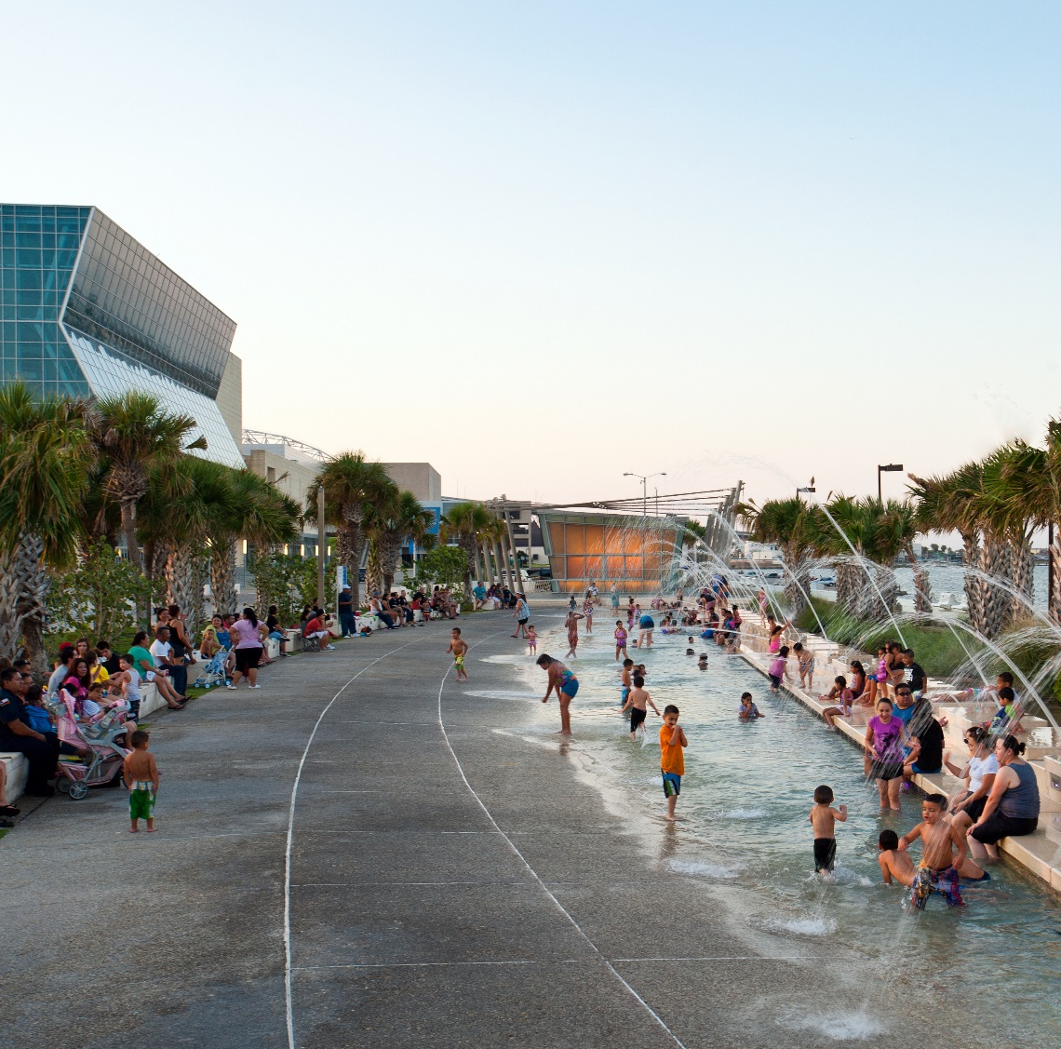
Integrating infrastructure into the public realm of cities to drive city revitalization
Topics:
Defining Resilience
Why Parks?
Assessing your vulnerability
Project Design: Project Prioritization
Designing Multi-benefit Solutions: Resilience Dividends
Previous work by Jason Hellendrung while Principal at Sasaki

Slide 3
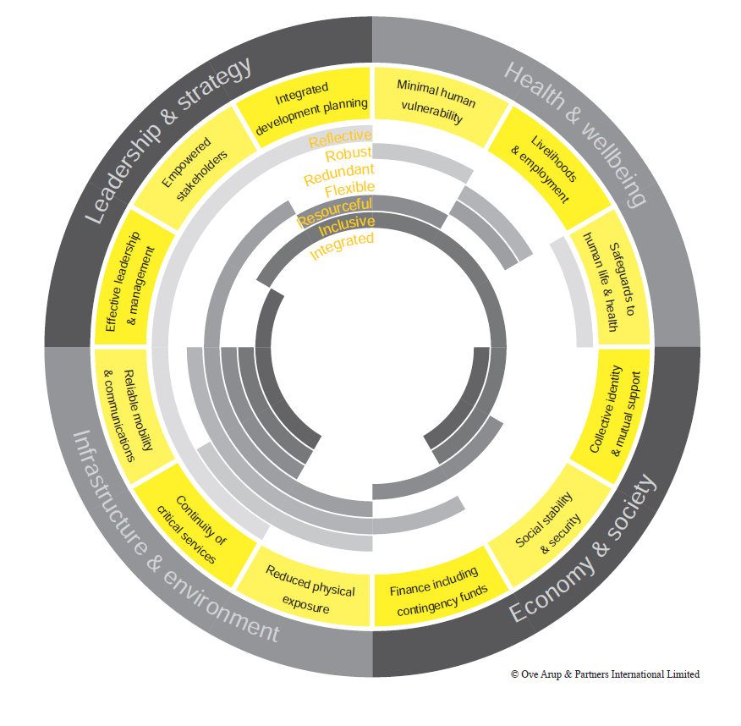
Defining Resilience
The capacity to recover quickly from difficulties; the ability of a substance or object to spring back into shape; elasticity

Slide 4
Importance of Parks…
Recreational Benefits
Public Health Benefits
Environmental Benefits
Community Development Benefits, particularly youth and seniors
Contribute to Quality of Life, Livability of Cities, and Cultural Value through Programming
Support Economic Development and Create Value

Slide 5
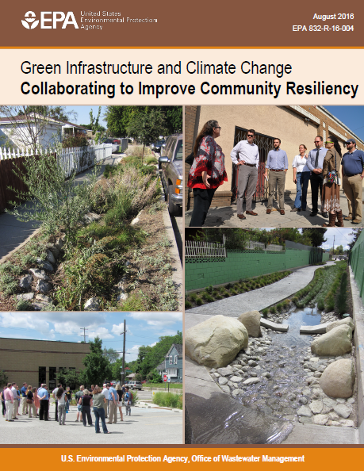
EPA Green Infrastructure and Climate Change
How GI Improves Climate Resilience
Manages Flood Risk
Builds Resilience to Drought
Reduces the Urban Heat Island Effect
Lowers Building Energy Demands
Improves Coastal Resiliency
Reduces Energy Needed to Manage Water

Slide 6
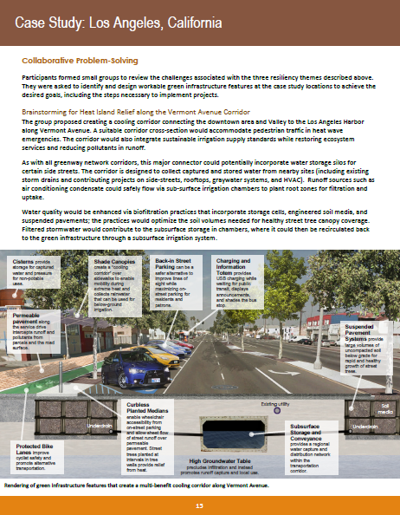
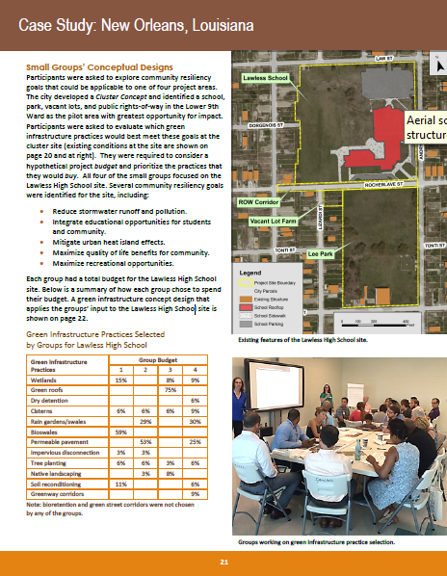
EPA Green Infrastructure and Climate Change

Slide 7
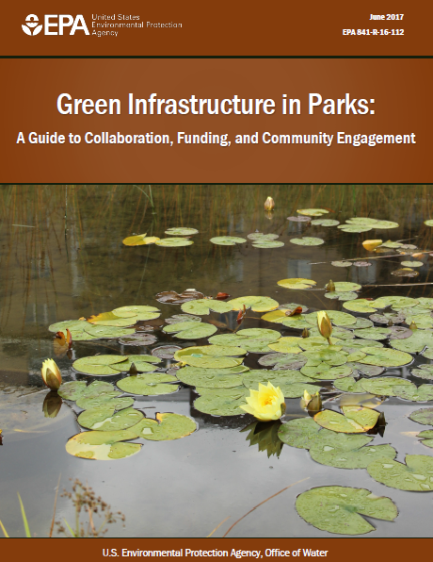
EPA Green Infrastructure in Parks
How GI Can Enhance Parks
Enhances Recreation Value
Creates Attractive Park Features
Enhances Environmental & Social Equity
Reduces Maintenance
Provides Economic Benefits (SW Credits)
Improves Drainage
Improves Water Quality
Benefits the Overall Environment

Slide 8
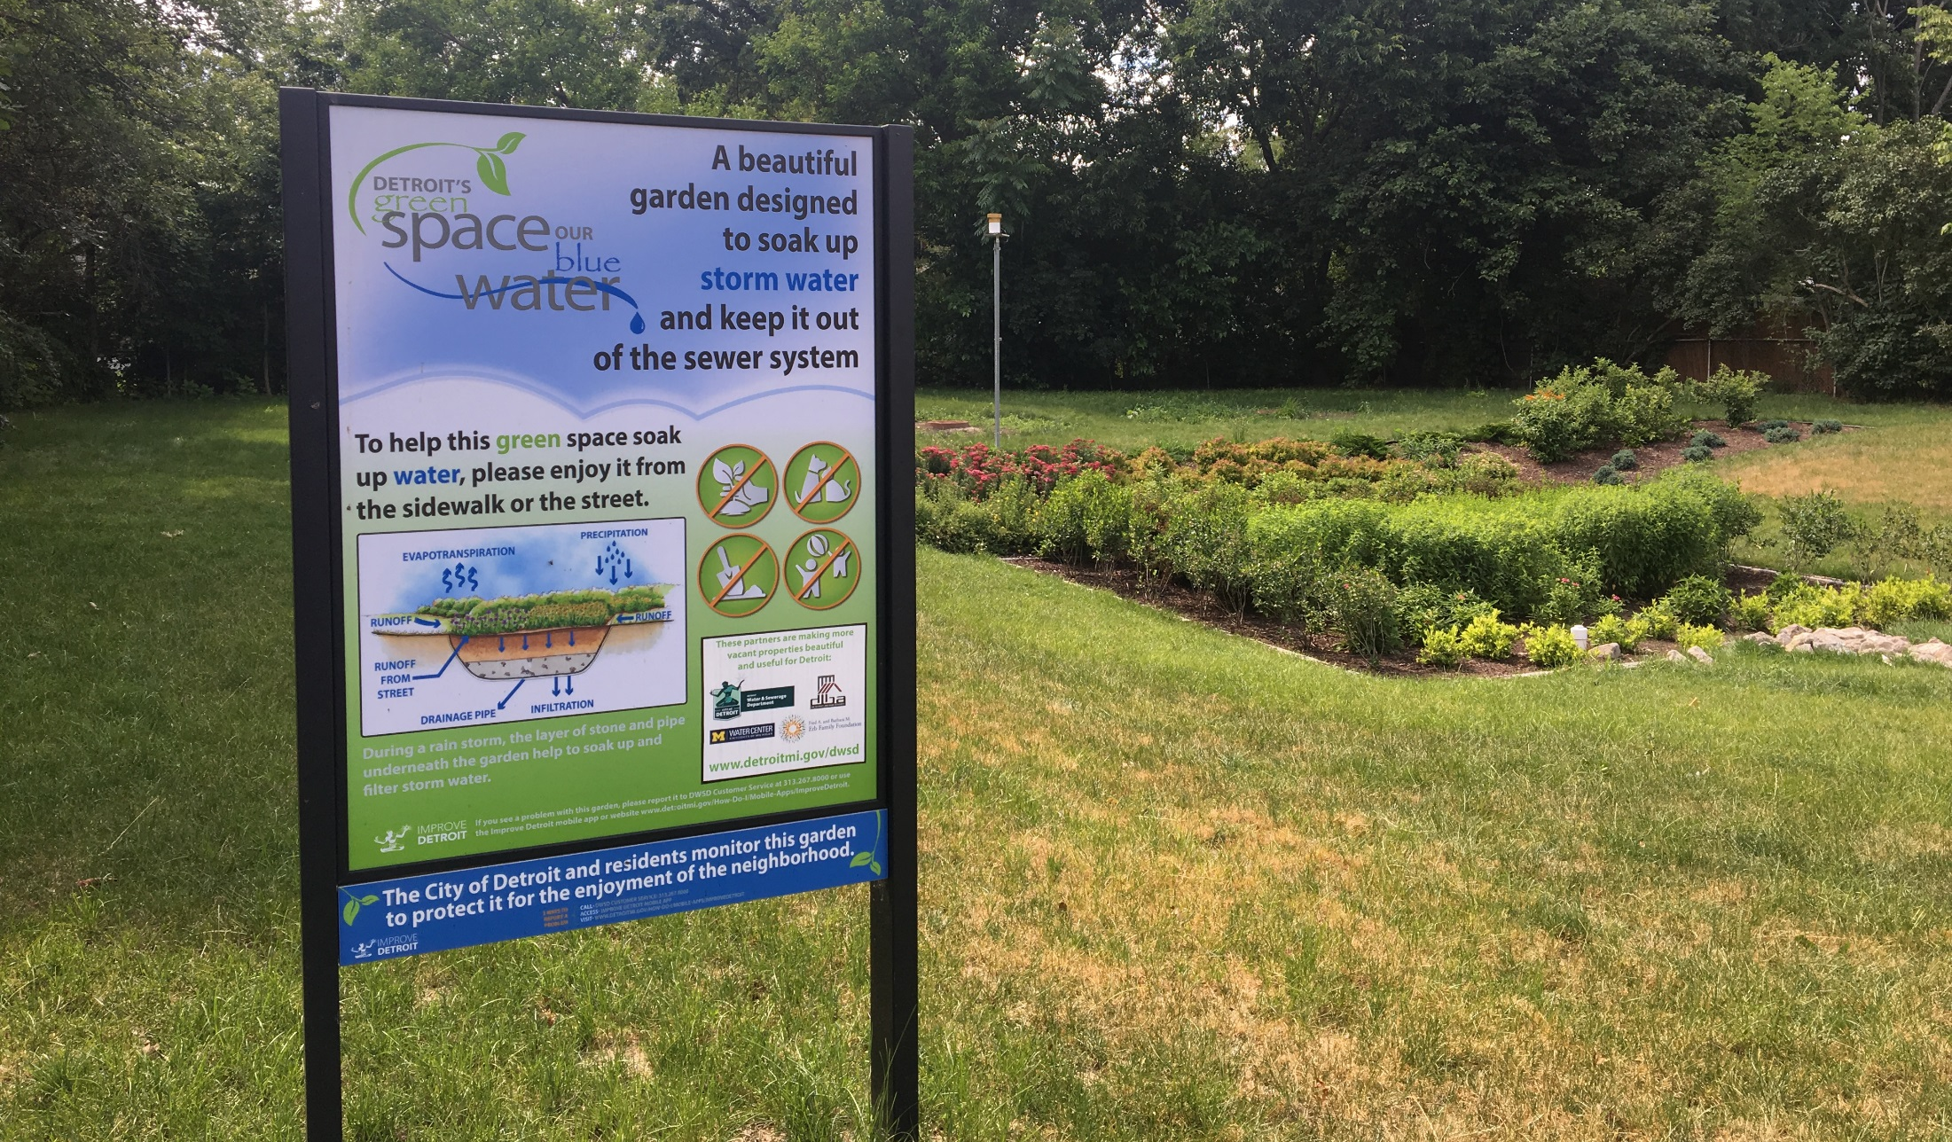
Green Stormwater Infrastructure

Slide 9
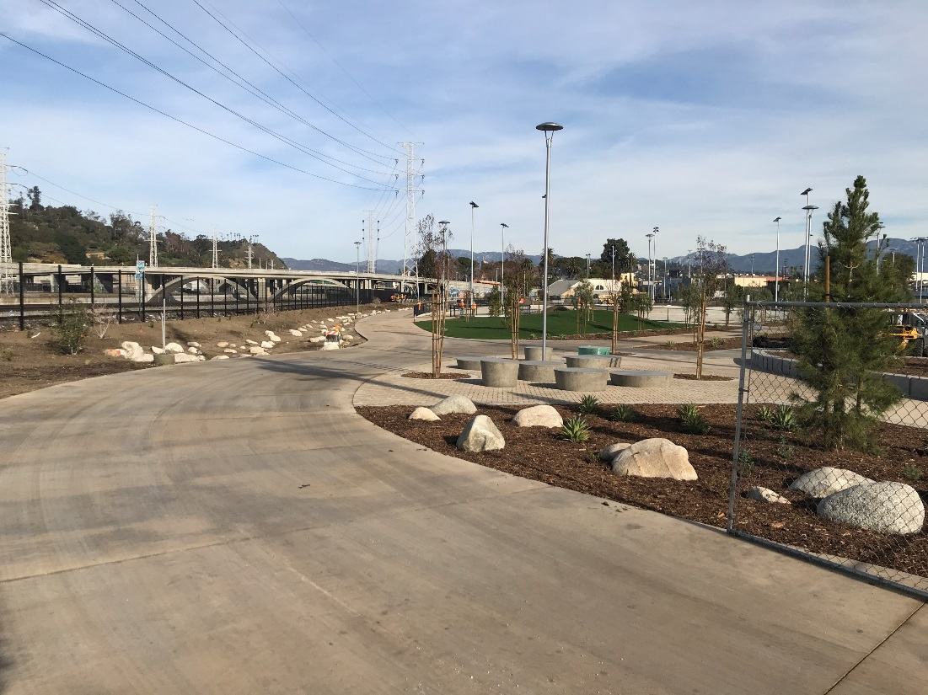
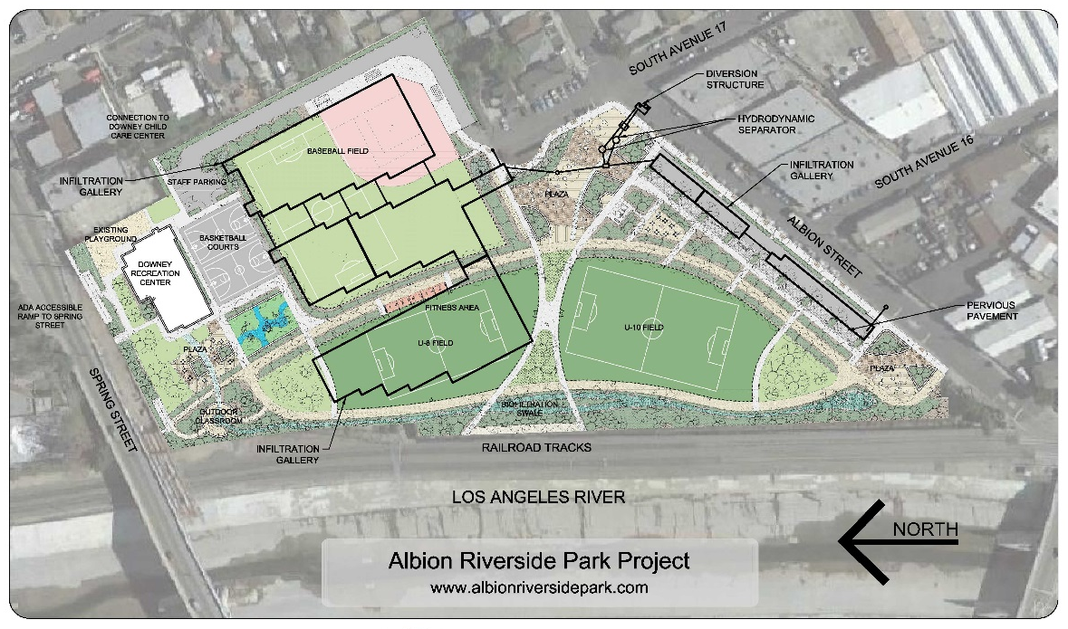
Albion Park

Slide 10
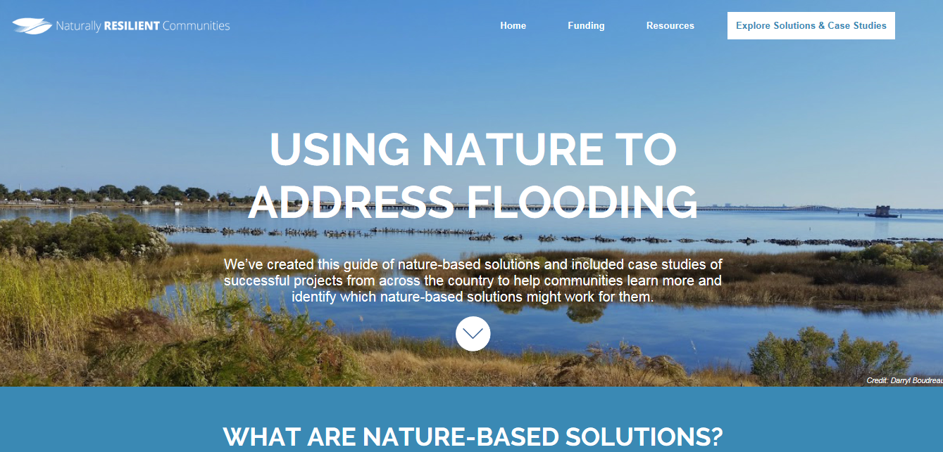
TNC Naturally Resilient Communities
Work led previously by Jason Hellendrung while Principal at Sasaki

Slide 11
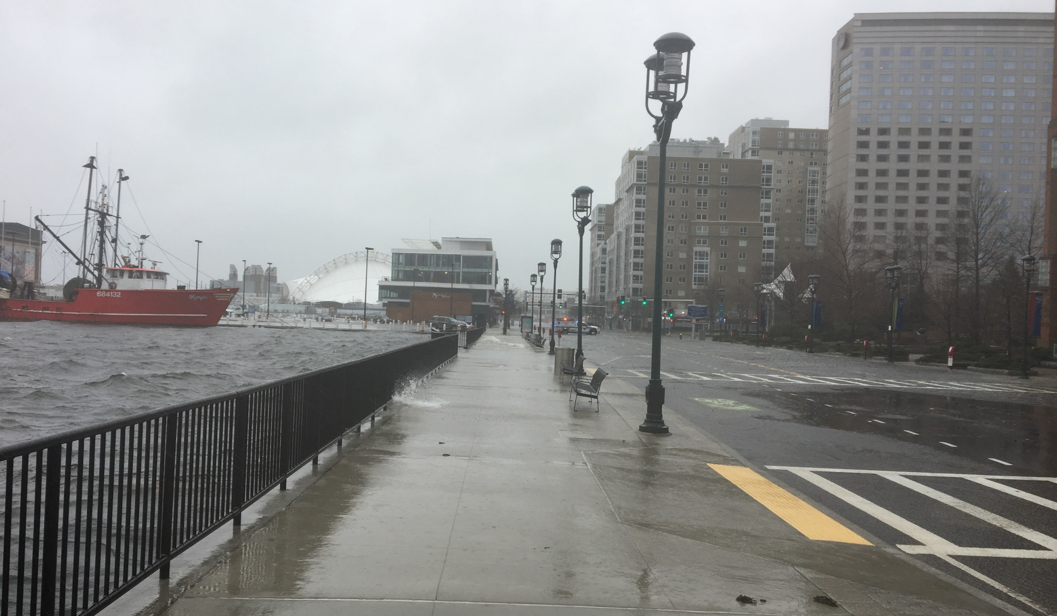
Understanding & Assessing Your Community’s Vulnerability

Slide 12
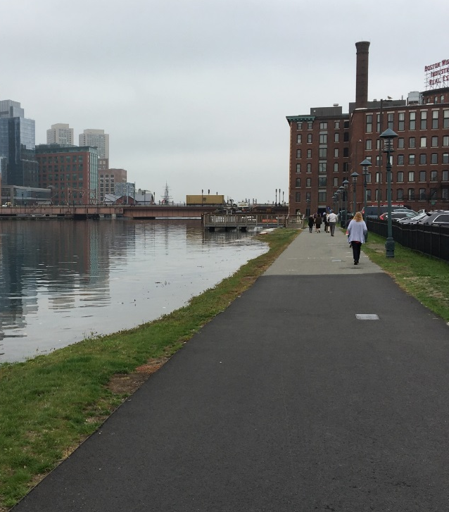
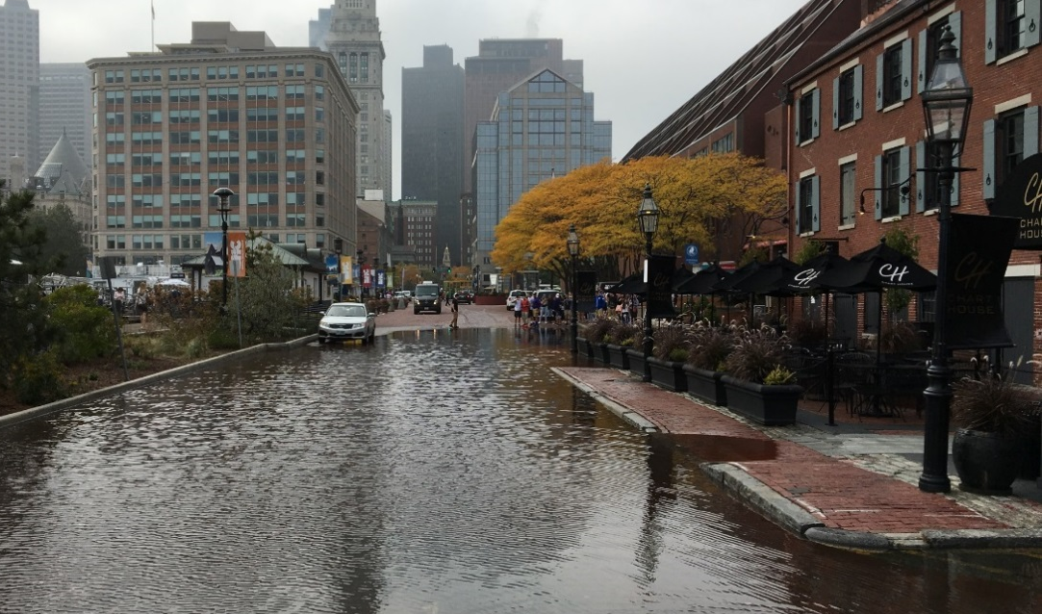
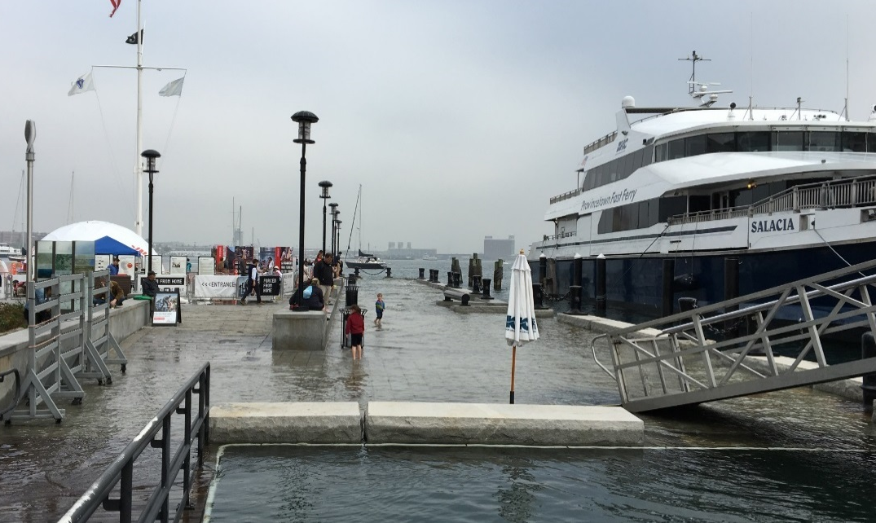
Assessing Your Communities Vulnerability

Slide 13
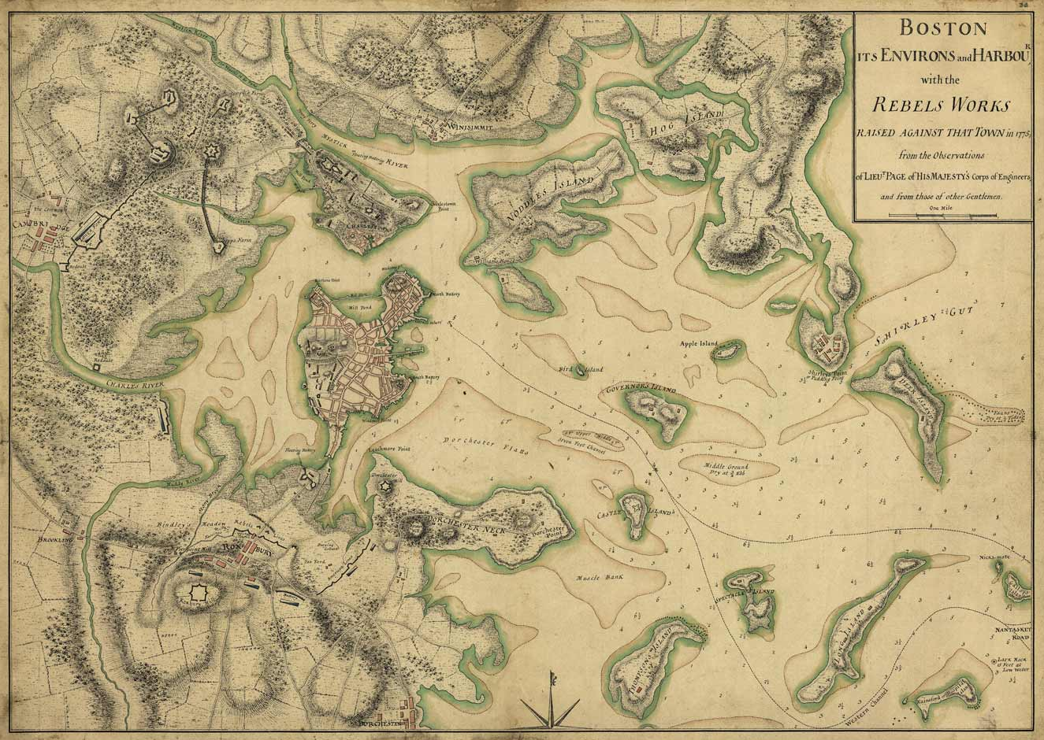
Boston, 1775

Slide 14
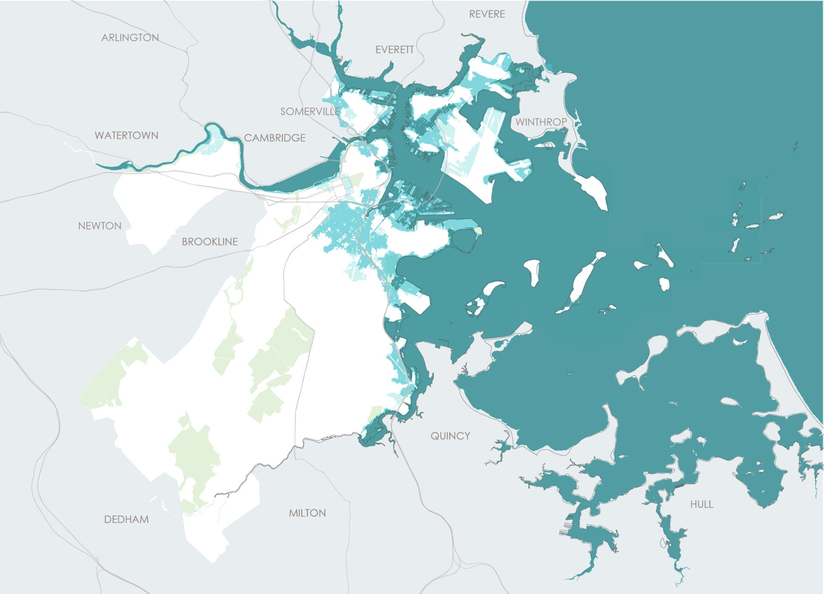
Boston, 2070’s with 3’ of Sea Level Rise

Slide 15
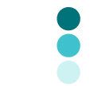
Climate Ready Boston
2070s or later
Flood Progression
Coastal & Riverine Flooding
Charlestown
East
Boston
55%
In the late century, exposure will expand to vast areas of the city, including inland neighborhoods like the South End and neighborhoods along the Charles River.
60%*
Allston/Brighton
10%
Back Bay
Beacon Hill
Downtown
15%
45%
South End
70%
South Boston`
60%
Roxbury
5%
Dorchester
20%
Average Monthly High Tide
10% Annual Chance Flood
1% Annual Chance Flood
% of Neighborhood Exposed to 1% Annual Chance Flood
X%
15
* Excludes Logan Airport
Work led by Jason Hellendrung while Principal at Sasaki

Slide 16
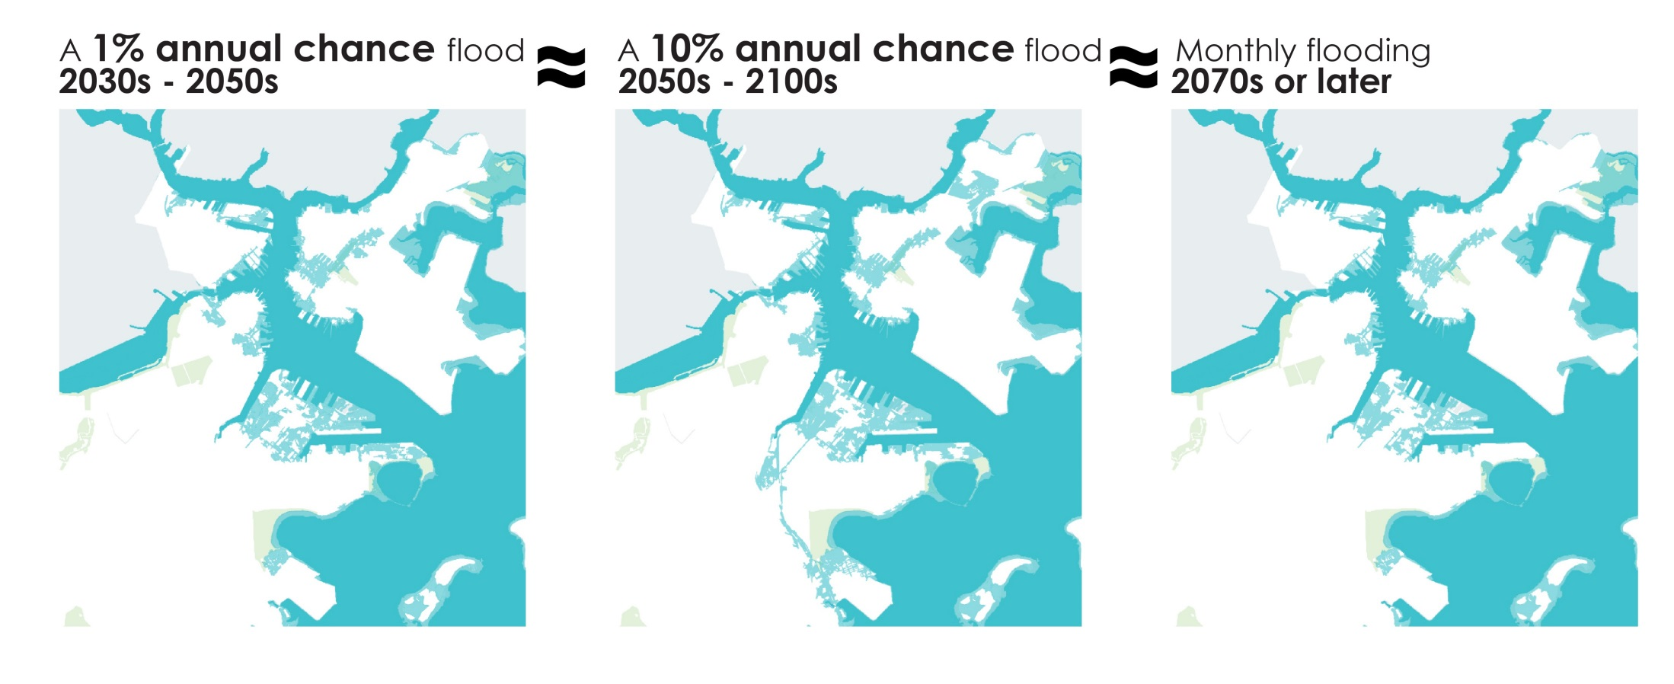
Climate Ready Boston
Work led by Jason Hellendrung while Principal at Sasaki

Slide 17
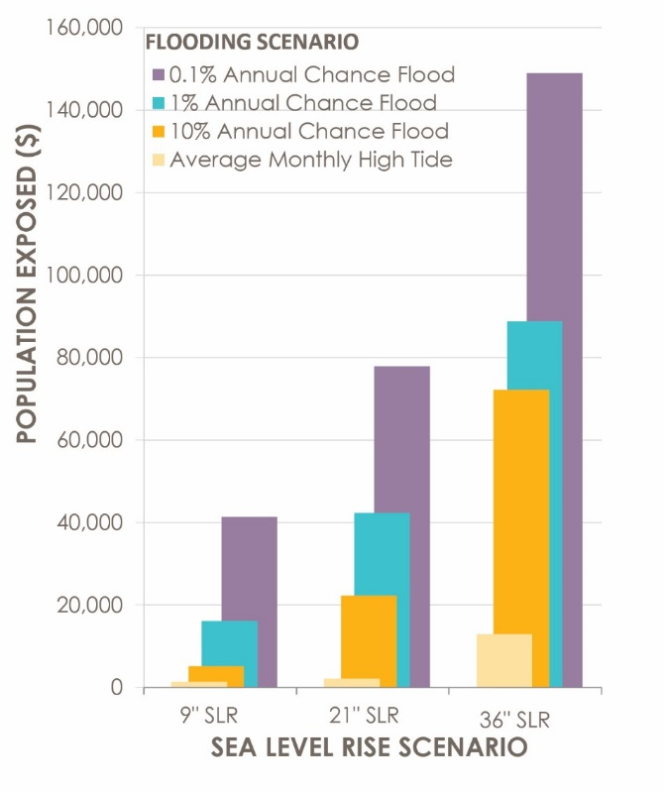

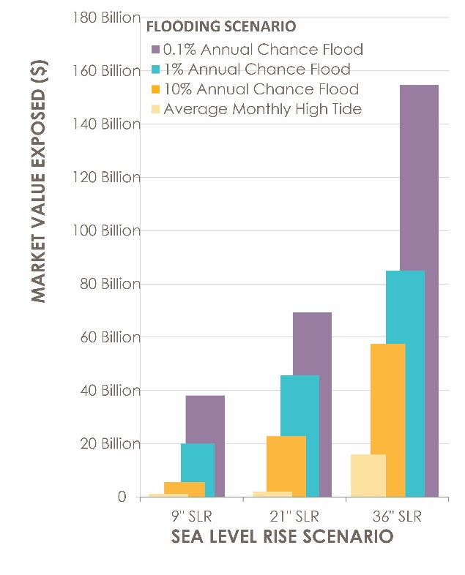
Climate Ready Boston
POPULATION
BUILDINGS
BUILDING VALUE
Near-term 1% annual chance exposure
2030s-2050s
2050s-2100s
2070s or Later
2030s-2050s
2050s-2100s
2070s or Later
2030s-2050s
2050s-2100s
2070s or Later
Work led by Jason Hellendrung while Principal at Sasaki

Slide 18
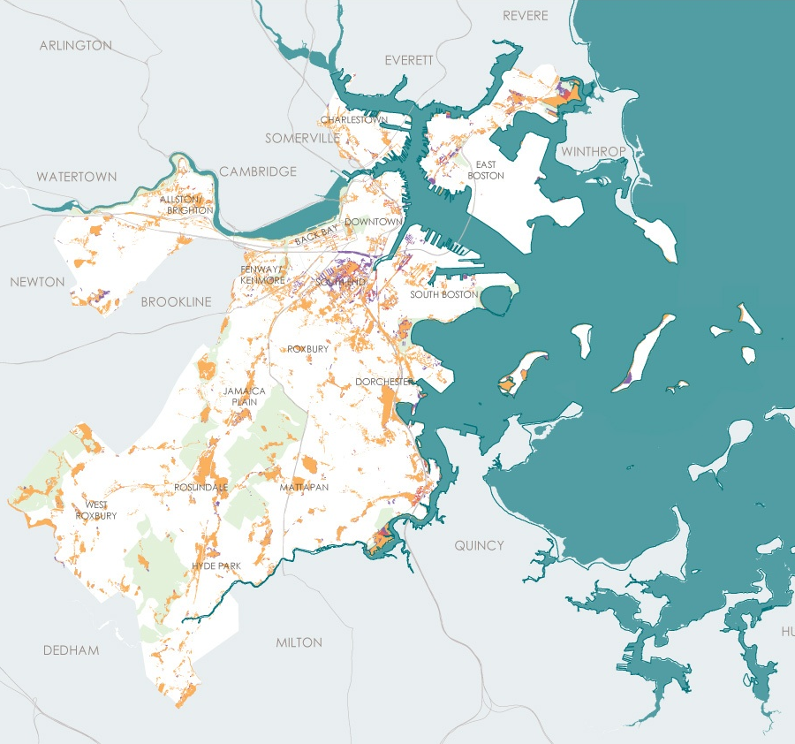
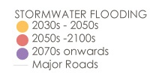
Climate Ready Boston
Chronic Flood Exposure
Stormwater Flooding
Exposure is widespread and includes regional & local transportation infrastructure
Previous work led by Jason Hellendrung while Principal at Sasaki

Slide 19
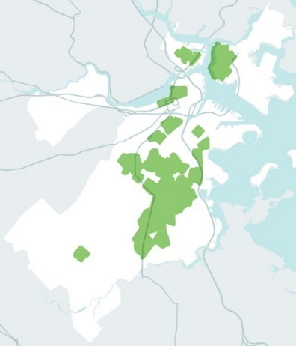
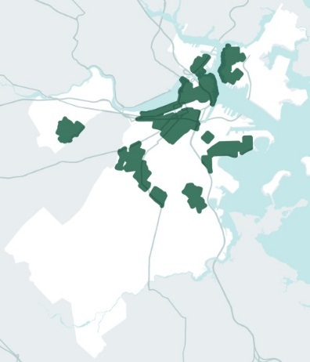
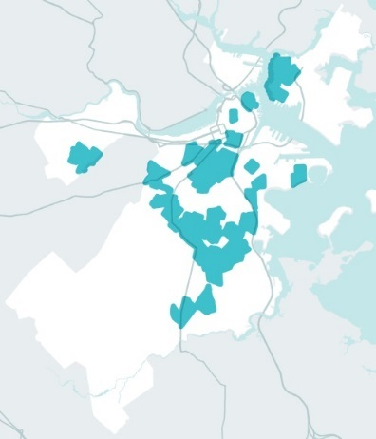
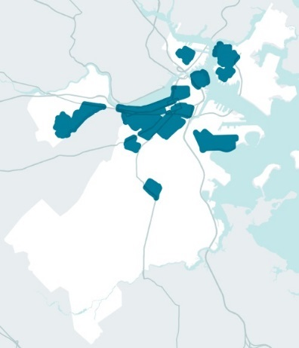
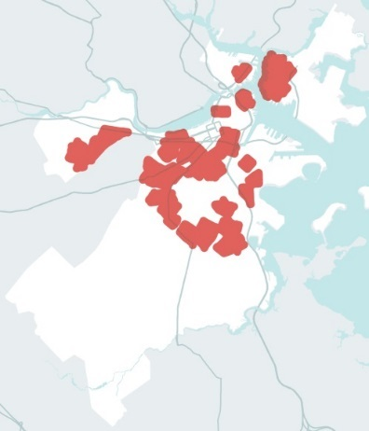
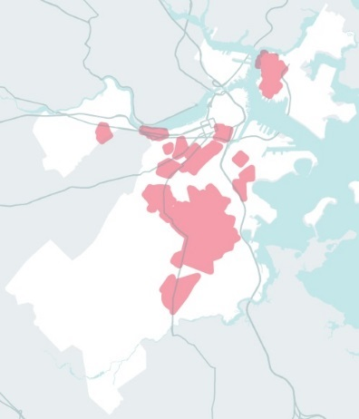
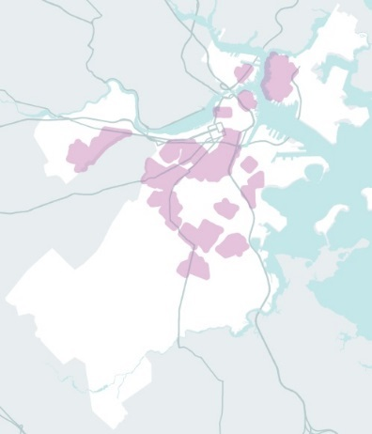
Climate Ready Boston
Vulnerability Assessment Focus on Socially Vulnerable Populations
CENSUS TRACTS IN TOP QUARTILE
PEOPLE WITH DISABILITIES
CHILDREN
OLDER ADULTS
MEDICAL ILLNESS
PEOPLE WITH LIMITED ENGLISH PROFICIENCY
PEOPLE WITH
LOW INCOMES
PEOPLE OF COLOR
Previous work led by Jason Hellendrung while Principal at Sasaki

Slide 20
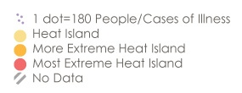
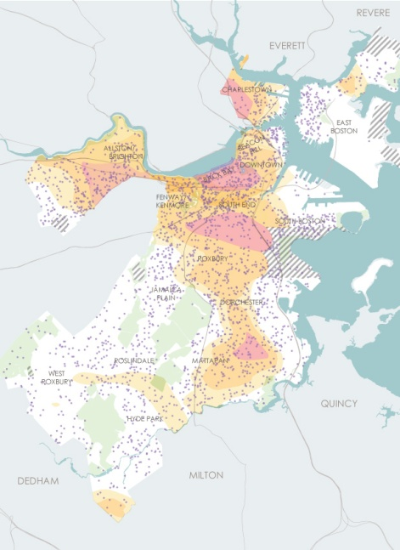
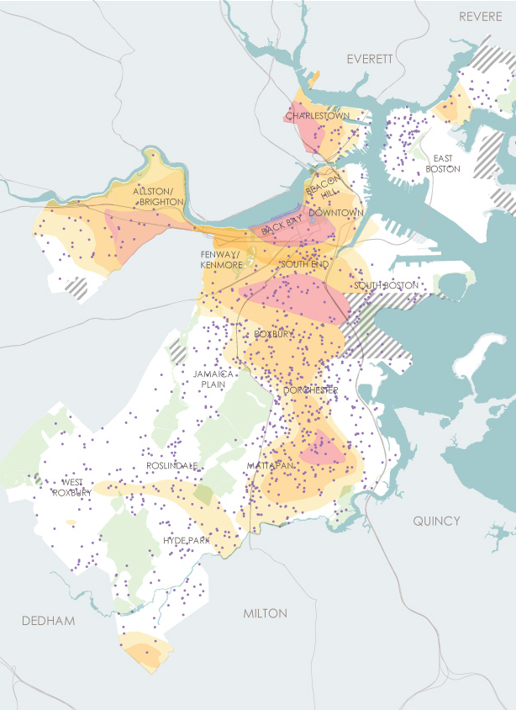
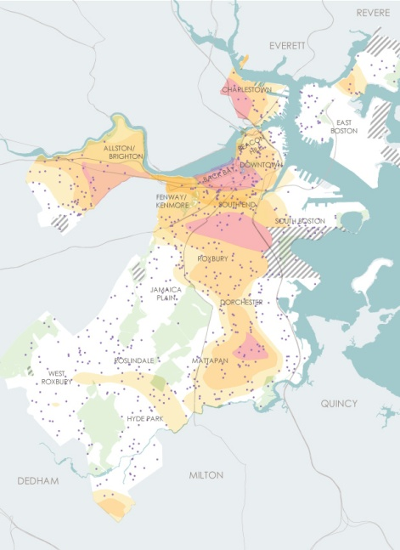
Climate Ready Boston
Vulnerability Populations & Heat Islands
CASES OF MEDICAL ILLNESS
CHILDREN
OLDER ADULTS
Previous work led by Jason Hellendrung while Principal at Sasaki

Slide 21
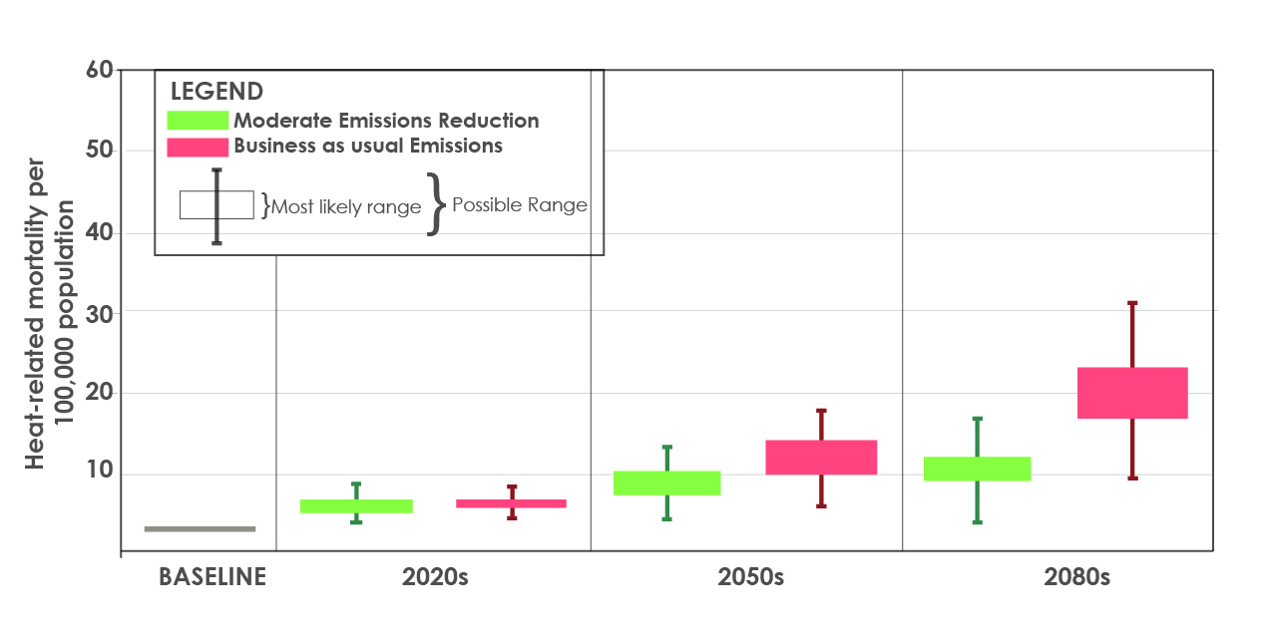
Climate Ready Boston
Public Health Impacts
Extreme Heat
Heat-Related Mortality Rates Will Increase Significantly
Other Public Health Impacts
Higher rates of heart and lung disease due to increased air pollution
Increases in cases of vector borne disease
Previous work led by Jason Hellendrung while Principal at Sasaki

Slide 22
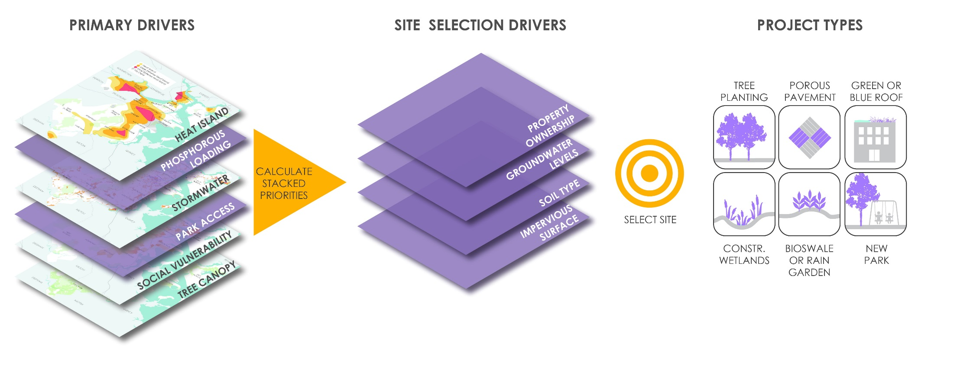
Climate Ready Boston
Previous work led by Jason Hellendrung while Principal at Sasaki

Slide 23
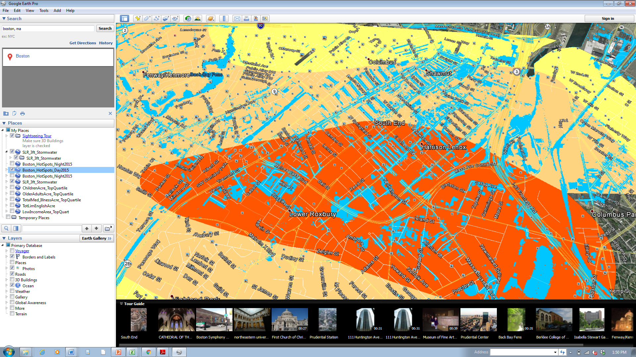
Climate Ready Boston
Previous work led by Jason Hellendrung while Principal at Sasaki

Slide 24
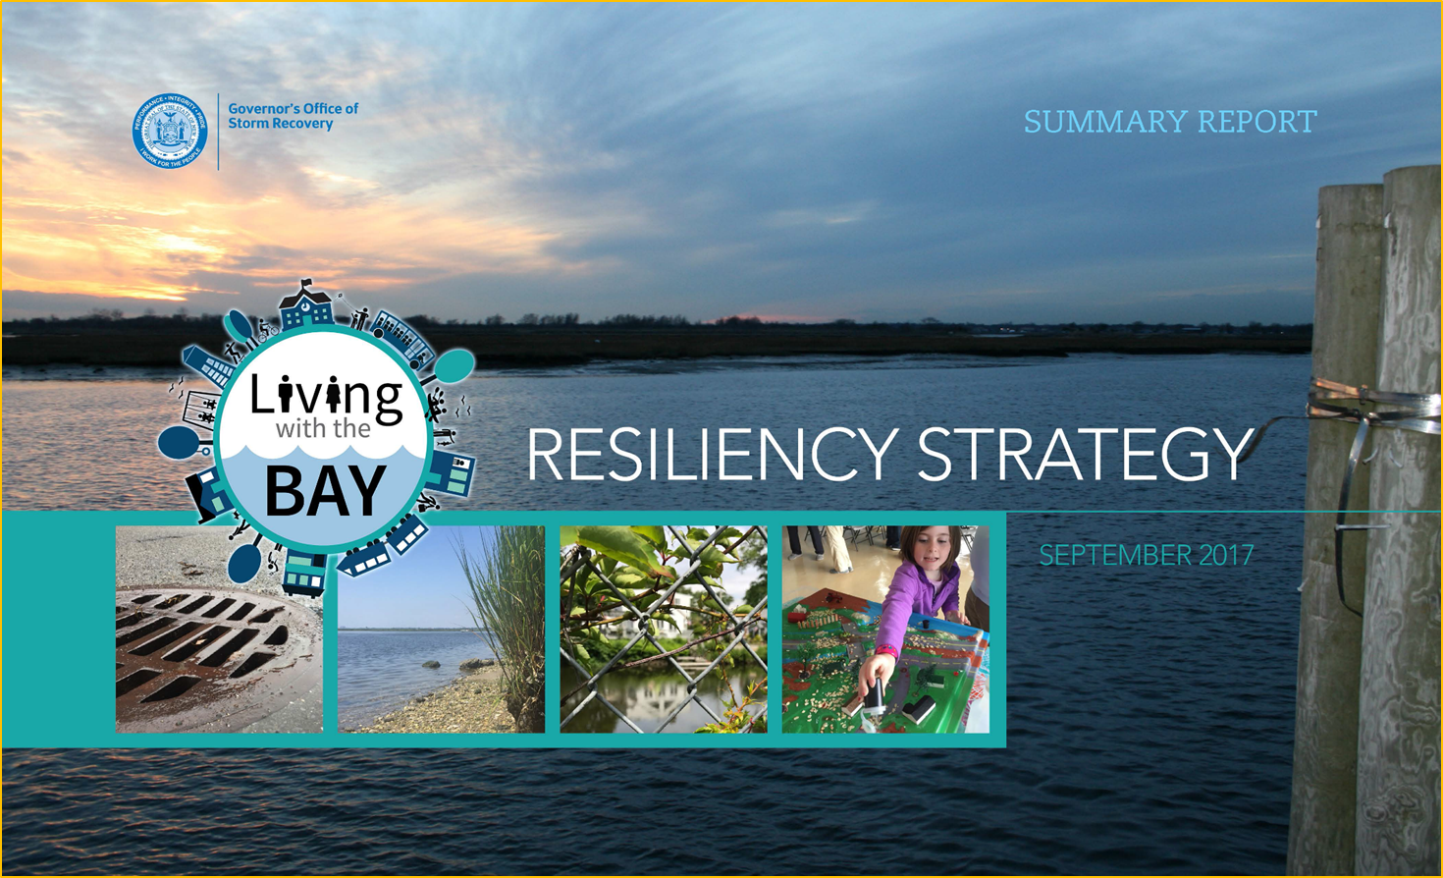
Project Prioritization

Slide 25
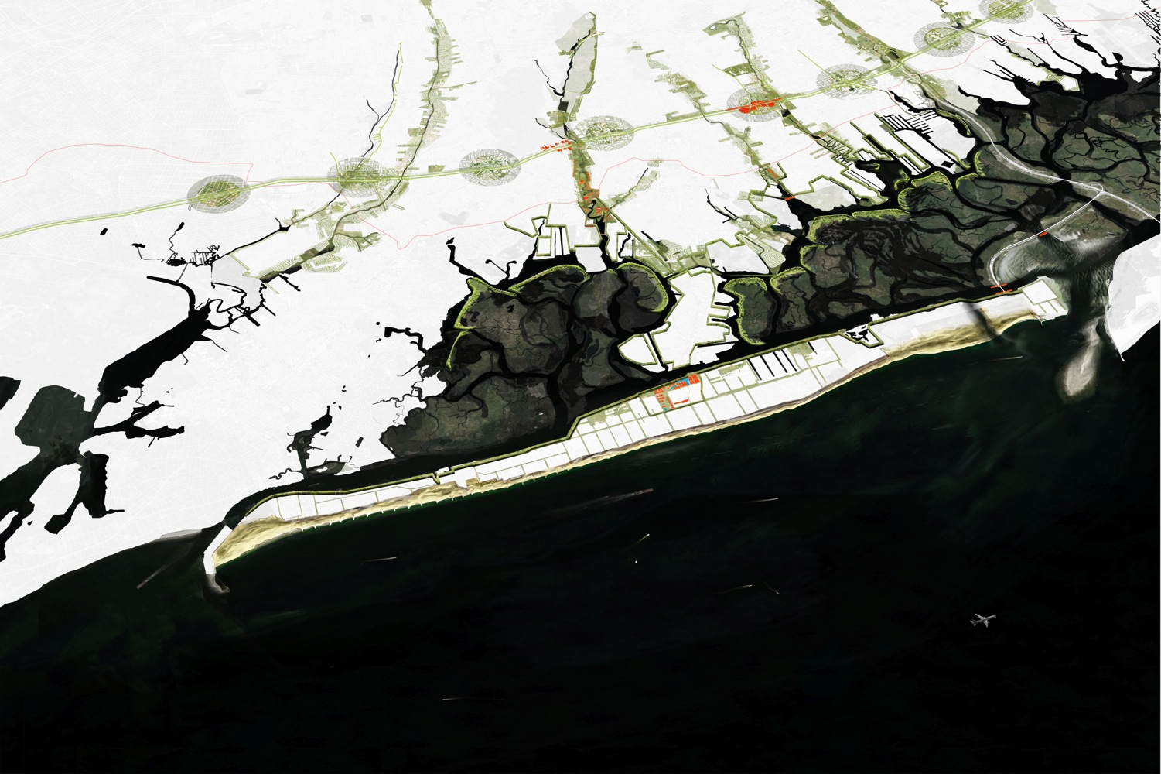
SEDIMENT
FLOW
SMART
BARRIER
ECO-EDGE
SLOW
STREAMS
GREEN
CORRIDOR
Sand Engine
North Park
Freeport
East Rock to
Rockville
Freeport Station
Area
Notes:
So, our regional approach of the buffered bay is our answer to the issues of safety, resiliency and urban quality.
Our solutions not only make Southern Nassau County safe, but also add economic value, ecological and social resilience and spatial quality.

Slide 26
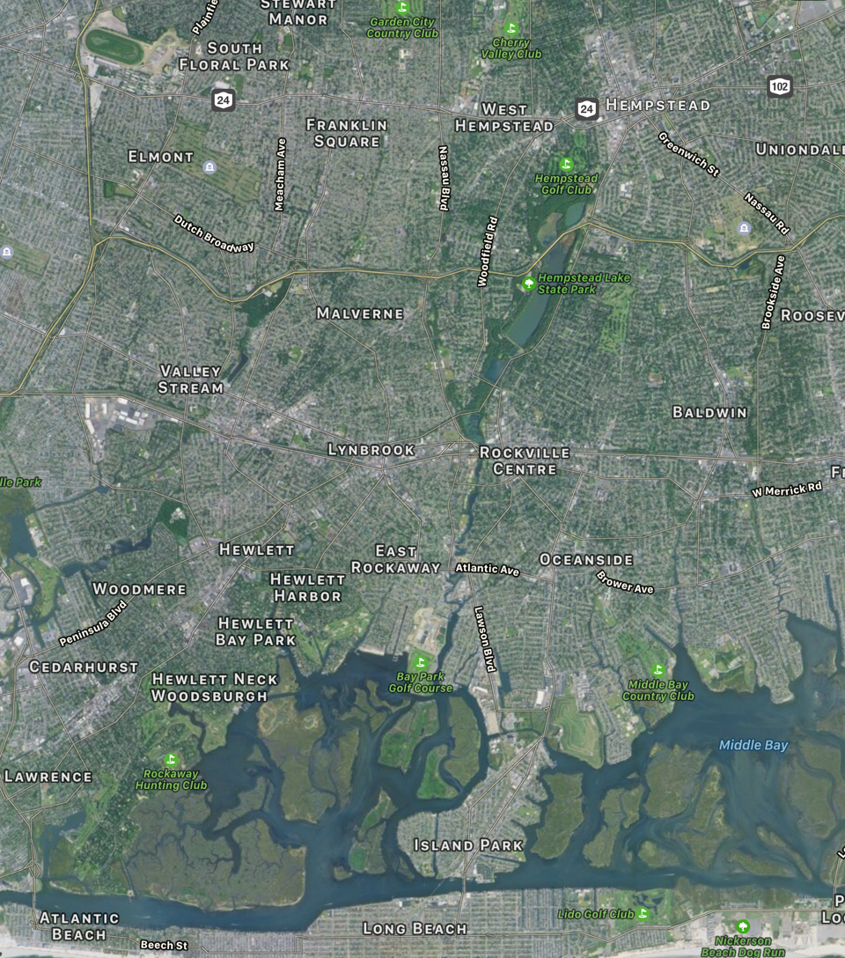
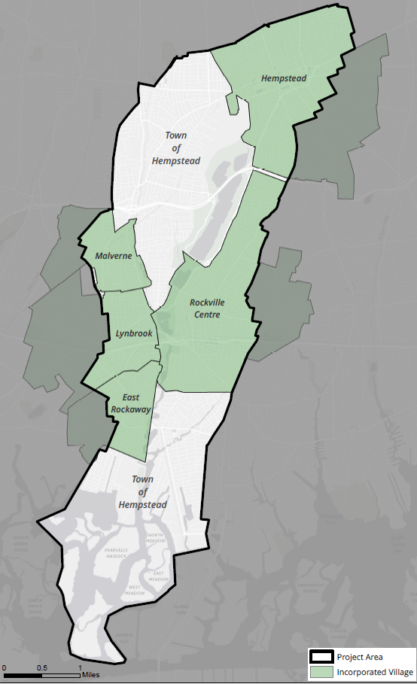
LWTB PROGRAM AREA
Coa

Slide 27
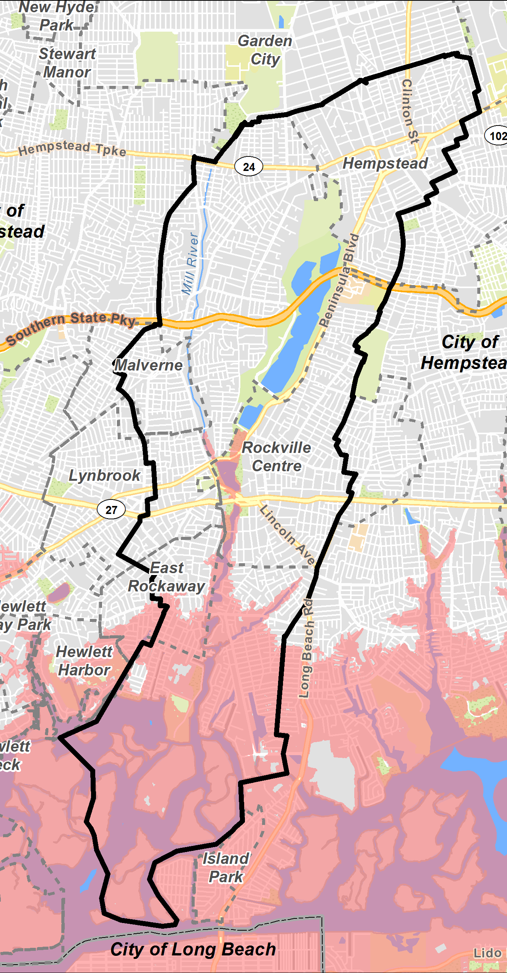
LWTB PROGRAM AREA
10,000 Acres
28,400 Parcels
Sandy Impact:
2,500 Acres
4,100 Parcels (80% Residential)
Town

Slide 28
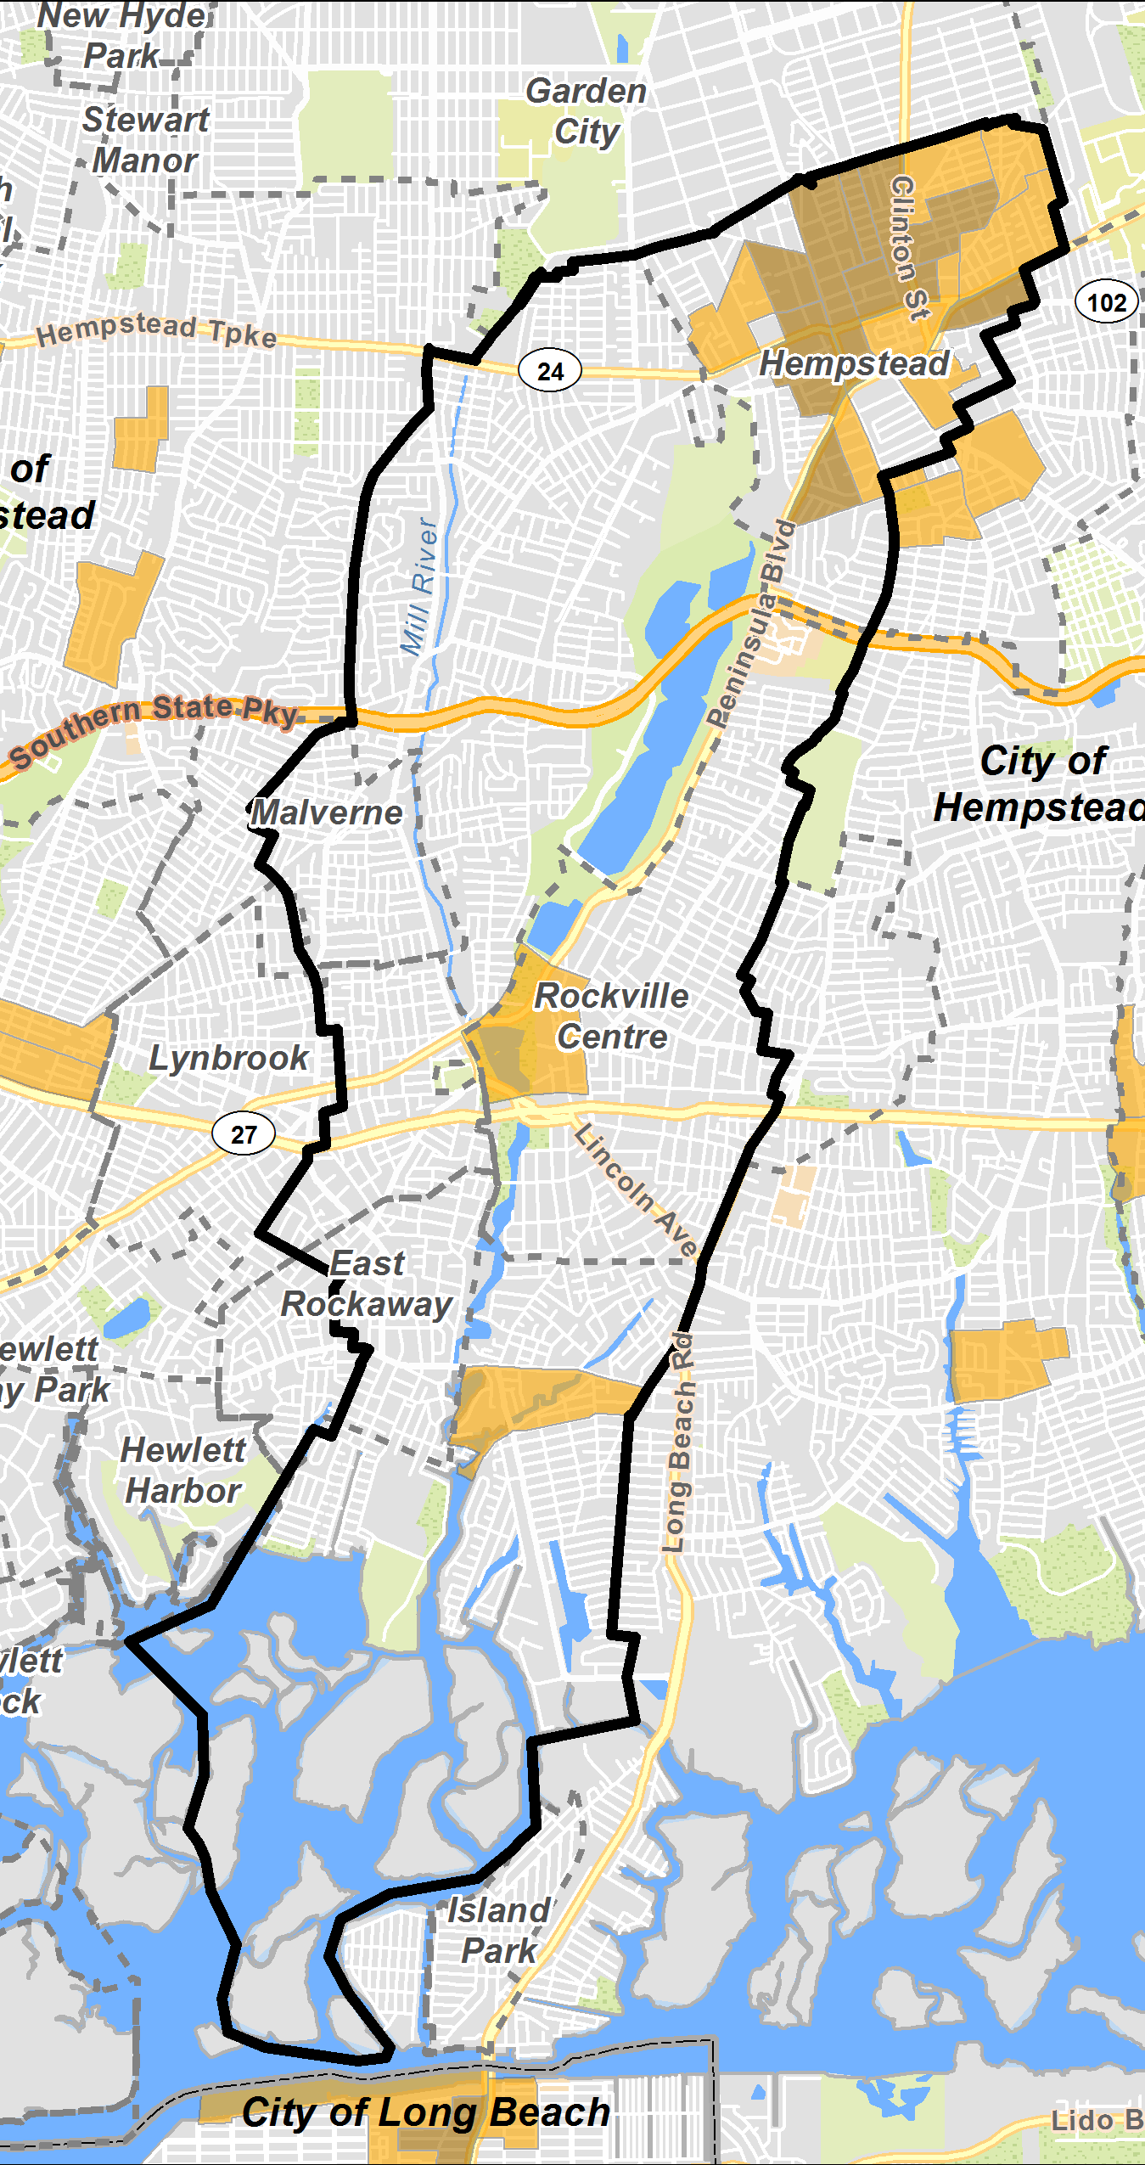
LWTB PROGRAM AREA
10,000 Acres
28,400 Parcels
Sandy Impact:
2,500 Acres
4,100 Parcels (80% Residential)
Low-Moderate Income Areas
Town

Slide 29
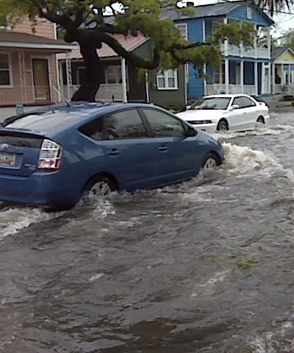
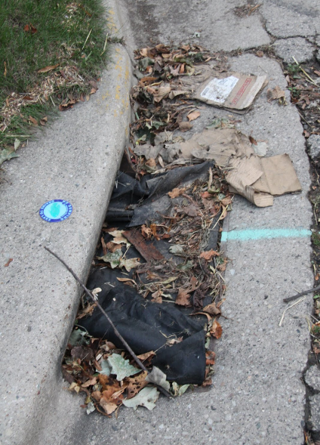
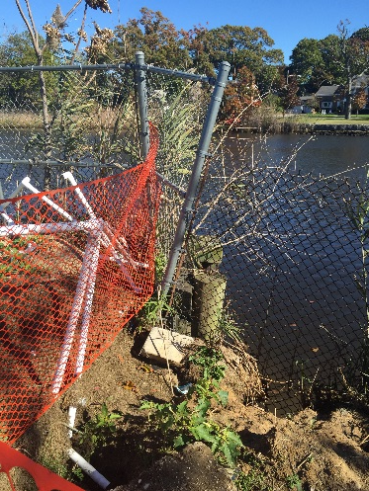
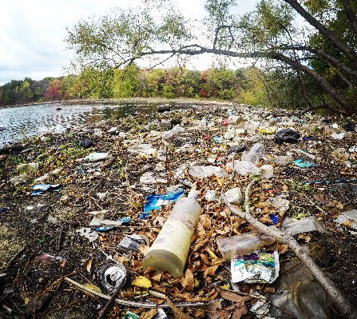
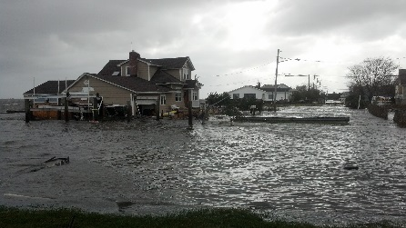
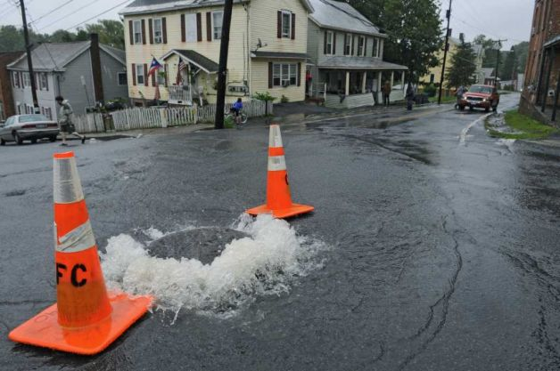
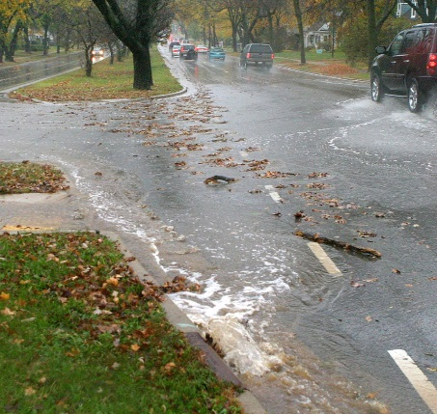
LWTB types of PROBLEMs

Slide 30
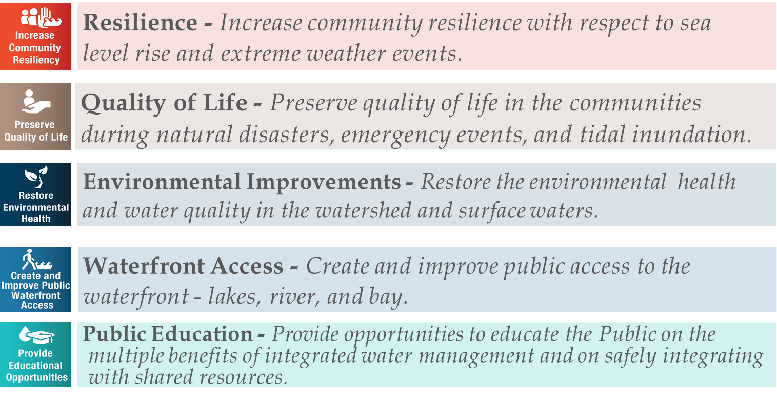
LWTB PROGRAM GOALS

Slide 31








THREE-WAY BALANCING ACT
Community
Development
Needs
Benefiting
LMI
Preventing/
Eliminating
Blight
HUD-Funded CDBG Program National Objectives
Flood
Defense
Access
and Urban
Quality
Social
Resiliency
Dynamic
Landscape
The Storm
and the
Norm
Prototypical
and Catalytic
Interventions
Low Risk,
“No Regrets”
Scenarios
Ecological
Restoration
Rebuild by Design Objectives
Living with the Bay Design Submittal Objectives

Slide 32

CONNECTING OBJECTIVES

Slide 33

PROJECT GOALS
90+ Problem Areas → 35 Projects

Slide 34
TOTAL PROJECT COSTS
$878M*
Program = $125M
*$723M identified for
1 of the 36 projects

Slide 35


THE NEED TO PRIORITIZE PROJECTS
Watershed Resiliency Strategy
Costs
Synergies
Social Resiliency
Risk & Vulnerability
Benefits

Slide 36
Prioritization framework
Increase Community Resiliency (Tidal Inundation and Extreme Storms)
Living with the Bay Resiliency Strategy Objectives
Preserve Quality of Life (Flooding)
Restore Environmental Health
Create and Improve Public Waterfront Access
Provide Educational Opportunities
Costs
Benefits
Risk Reduction
Synergies
Social Resiliency
Social Resiliency

Slide 37

Prioritization BREAKDOWN

Slide 38

Prioritization RANKING

Slide 39

Results: Designing for Multi-benefit Solutions
Previous work led by Jason Hellendrung while Principal at Sasaki

Slide 40

Cedar Rapids Flood Recovery
Previous work led by Jason Hellendrung while Principal at Sasaki

Slide 41





Cedar Rapids Flood Recovery
Image: WYES New Orleans
Phase 1: Public open houses
Phase 2: Neighborhood meetings and workshops
Trained city employees facilitate conversations
Citizen-advisory committees
Previous work led by Jason Hellendrung while Principal at Sasaki

Slide 42

Cedar Rapids Flood Recovery
Work led by Jason Hellendrung while Principal at Sasaki

Slide 43
Lessons Learned: Livable and Resilient Cities
Commitment to creating a long-term plan with a vision for the future, not just building back; phased, institutionalized plan
Partnerships: interdepartmental coordination with city staff; city, county, state, fed, and private partnerships; (bringing neighborhoods together on shared interests - not competing)
Engagement is the foundation to create a plan that could stand the test of time and changes in politics; community-building
Designing for multi-benefit solutions: flood protection, economic development, public gathering spaces, green infrastructure, restored ecological function, trail connections
Build citywide resilience: economic, social, environmental, health, and governance, not just infrastructure
Need for interdisciplinary teams: Parks & Rec, Planning, Engineering, PW, Transportation…

Slide 44

Thank you!
Jason Hellendrung, ASLA, PLA
Vice President, Planning & Design
Tetra Tech
jason.Hellendrung@tetratech.com

Slide 45

CHARLESTOWN FLOODING

Slide 46

CHARLESTOWN FLOODING

Slide 47

CHARLESTOWN: FLOOD PATHWAY 2070

Slide 48

CHARLESTOWN: WATERFRONT PARK + DISTRICT PROTECTION

Slide 49

Cambridge St.
Sullivan Square
G
Mystic Ave.
Gardner St.
Spice St.
F
D St.
Maffa Way
C
B
Dorrance St.
North Main St.
D
Rutherford Ave.
A
Beacham St.
E
Mishawum St.
Alford St.
West St.
Main St.
Arlington Ave.
Main St.
Bunker Hill St.
Medford St.
Ryan Playground
N
5

Slide 50


Preserving & Expanding the Urban Forest
Previous work led by Jason Hellendrung while Principal at Sasaki

