Slide 1
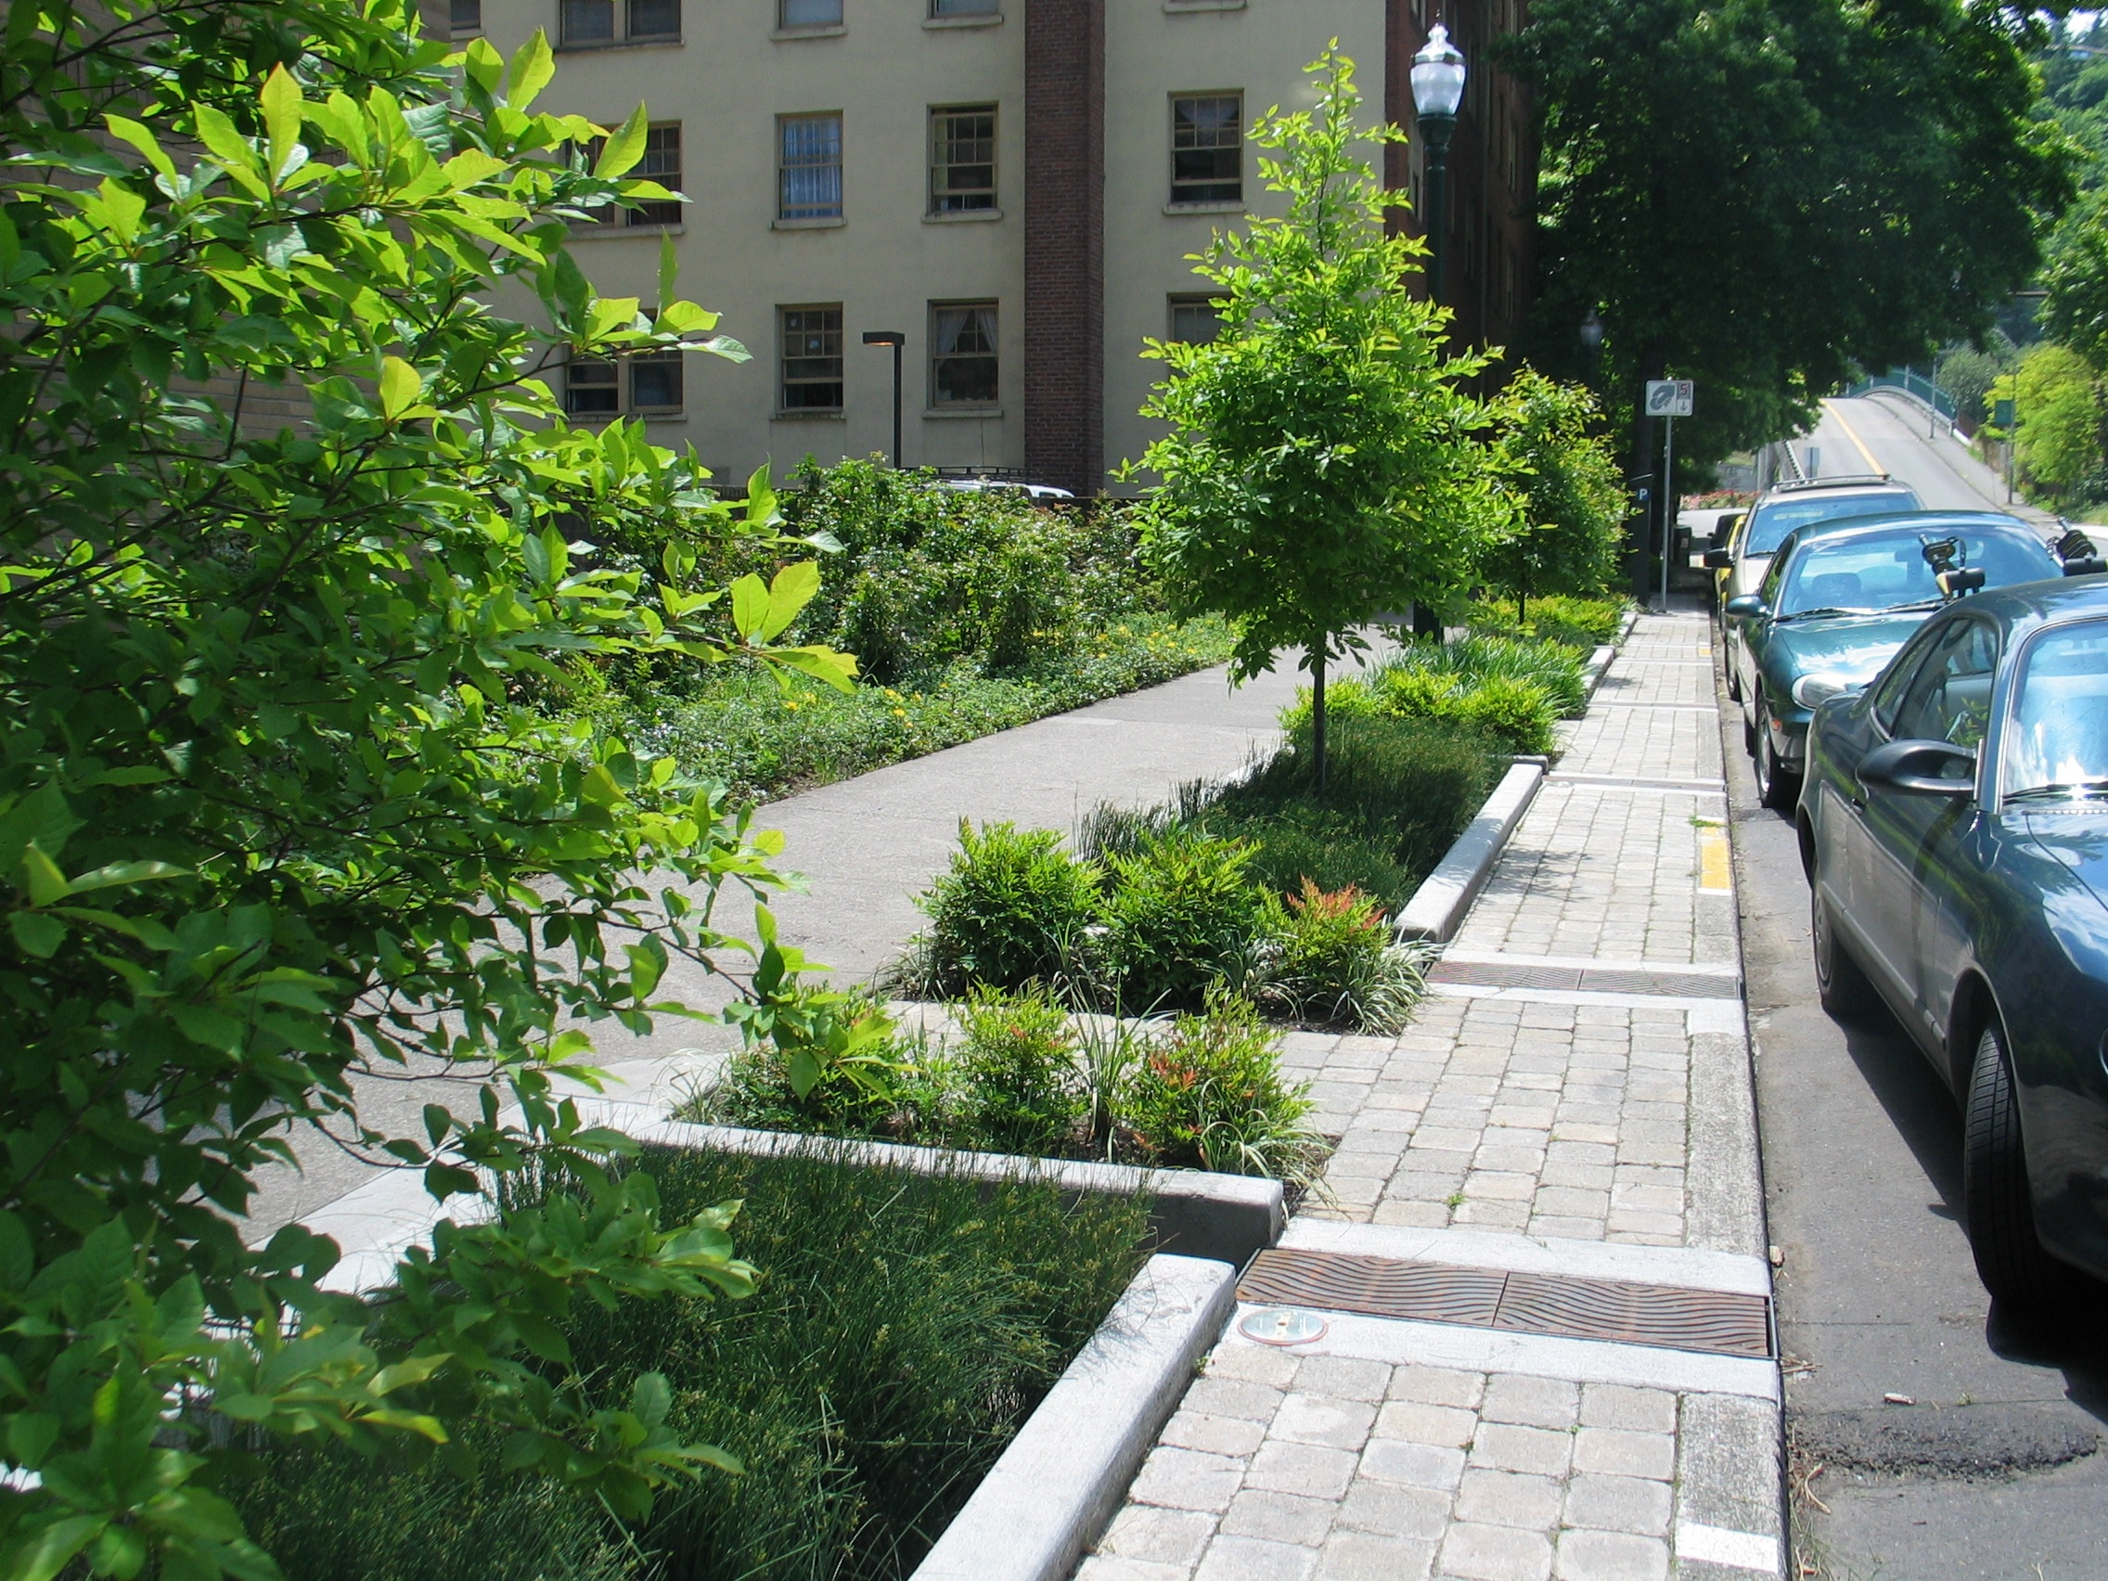
Capitalizing on the public benefits of parks
Jordan Wildish | Earth Economics | January 17th, 2019
Notes:
Speaker: Matt V

Slide 2
Earth Economics is a leader
in ecological economics and
has provided innovative analysis
and recommendations to governments, tribes, organizations, private firms,
and communities around the world.
Notes:
Earth Economics is a leader in ecological economics and has provided innovative analysis and recommendations to governments, tribes, organizations, private firms, and communities around the world.

Slide 3
OUR APPROACH
Notes:
We’ve talked about concepts and specific cases, so now we want to give you an idea of how we approach these types of projects so you can start thinking about how this might work for you (how we can work together?)
This is how we organize our approach to these challenges
Flexible, scalable, customizable

Slide 4
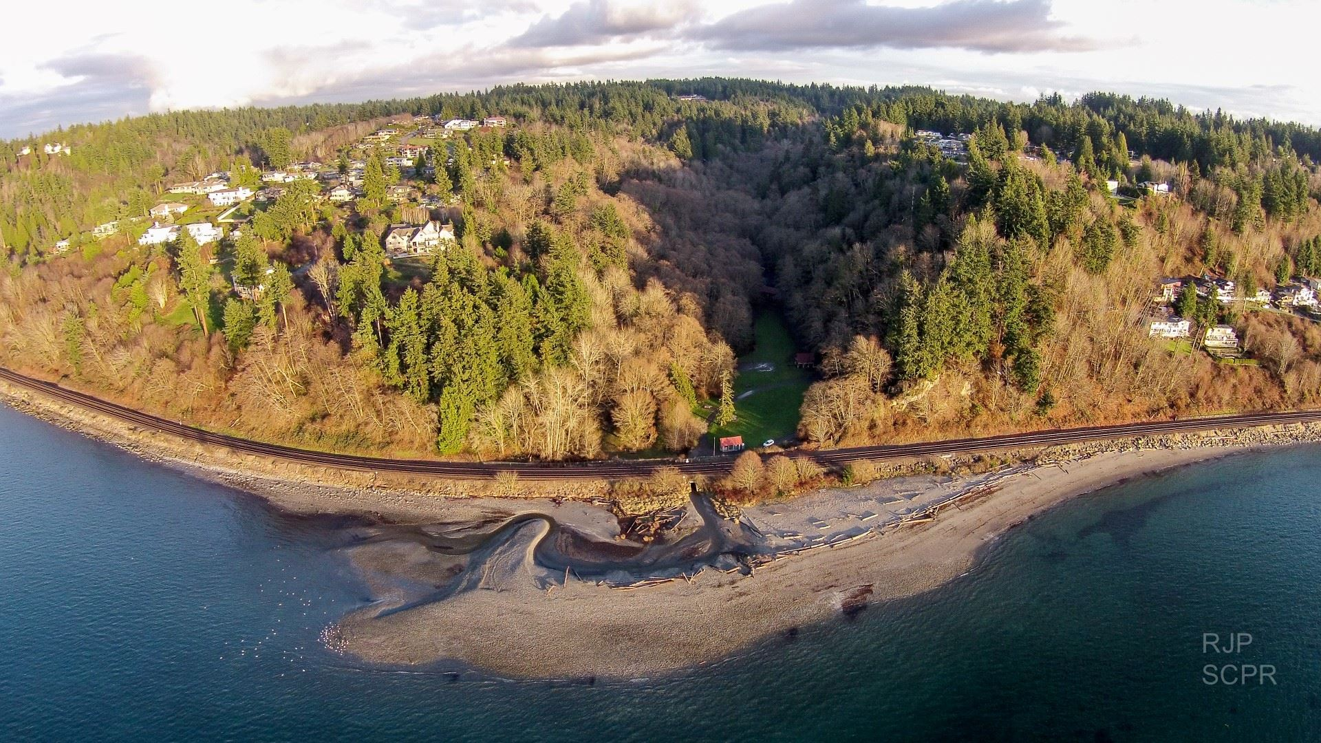
Parks Provide Ecosystem Services
Aesthetic Value
Recreation
Stormwater Capture and Storage
Water Filtration
Air Quality Improvements
Habitat

Slide 5
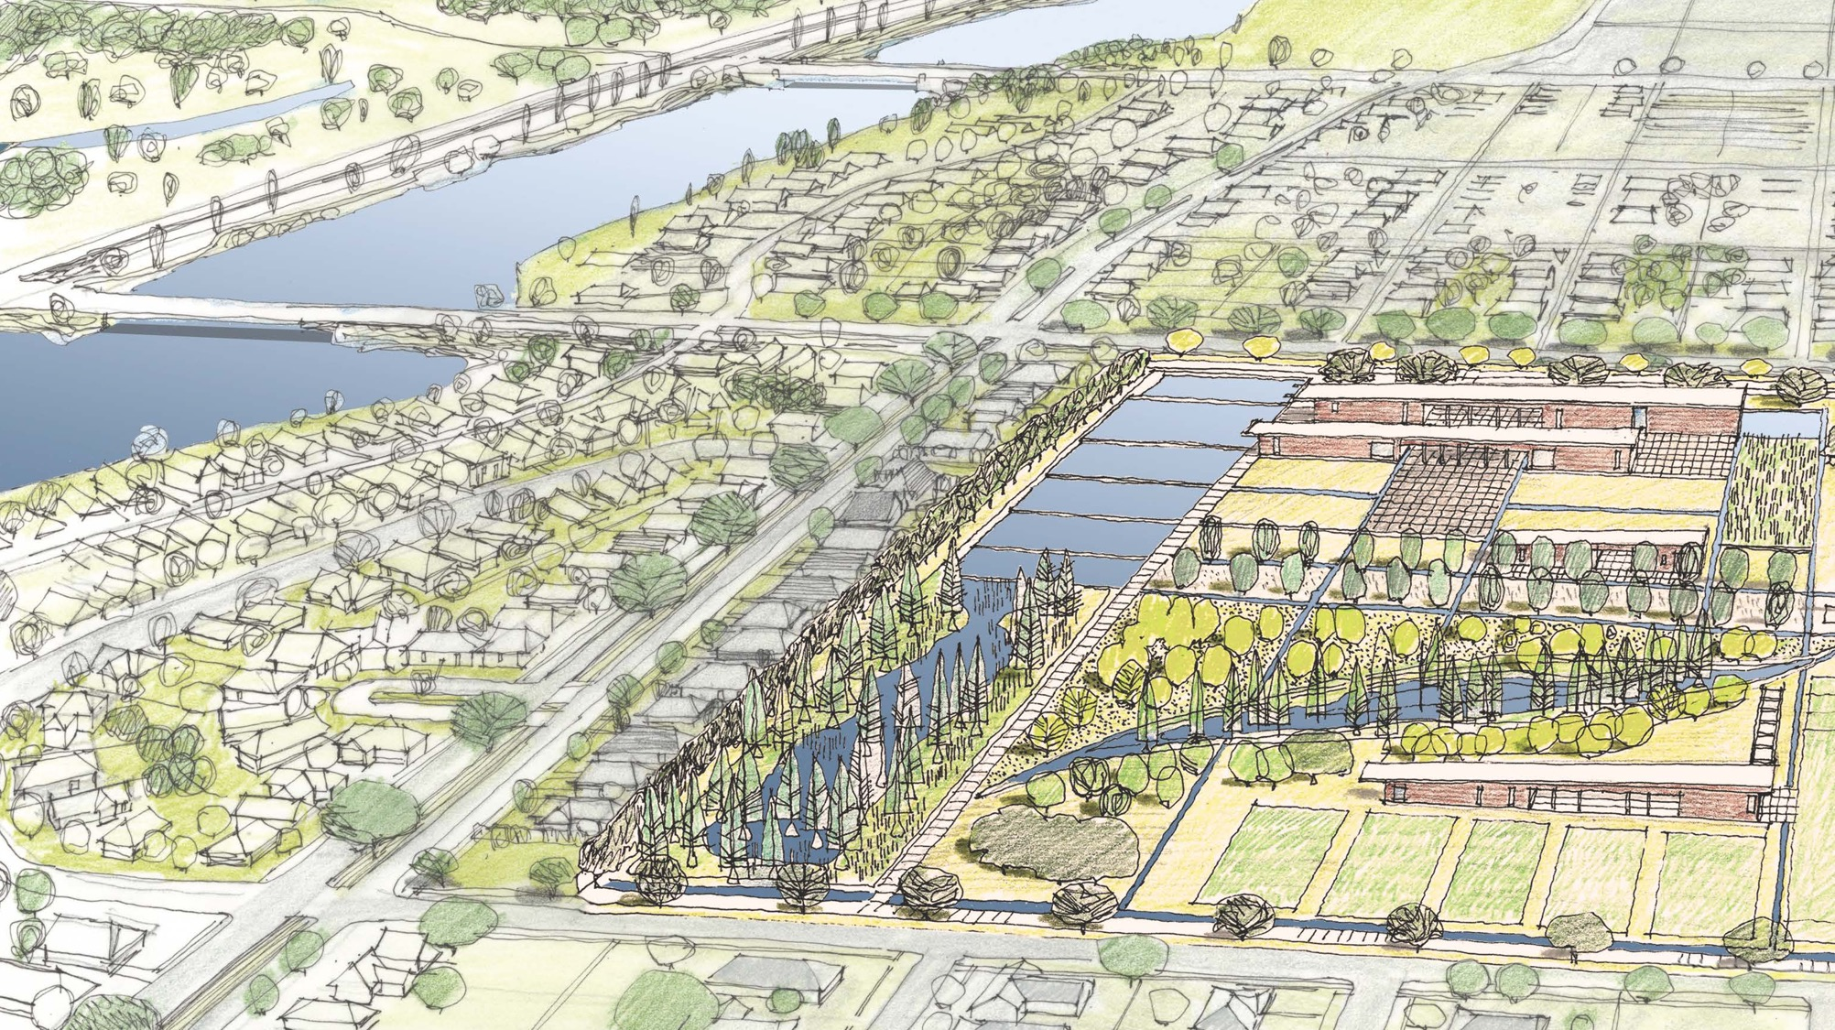
Holistic Benefit Cost Framework
Mirabeau Gardens, New Orleans, LA
Waggonner & Ball Architects

Slide 6
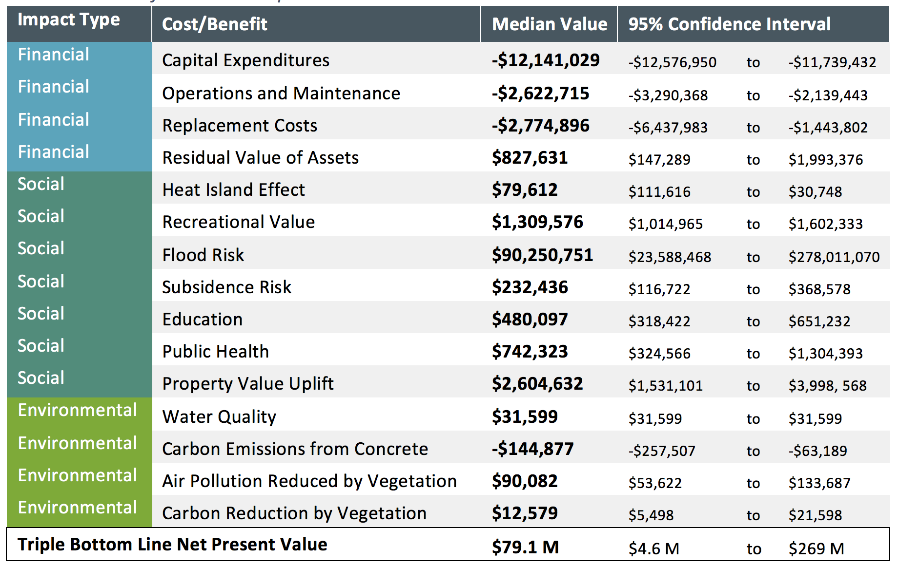
For every $1 spent, Mirabeau contributes $5.73 to society
$95.7MM
in social benefits
COMPREHENSIVE NET PRESENT VALUE

Slide 7
Valuing Ecosystem Services can Identify Funding Streams
Aesthetic Value -> Tax Increment Finance (TIF)
Stormwater Capture, filtration and storage -> Water Utility Parterships
Disaster Risk Reduction -> FEMA Hazard Mitigation and Pre-Disaster Mitigation Program
Air Quality Improvements -> Carbon Offset Trading (CARB Urban Forest Offset Protocol)

Slide 8
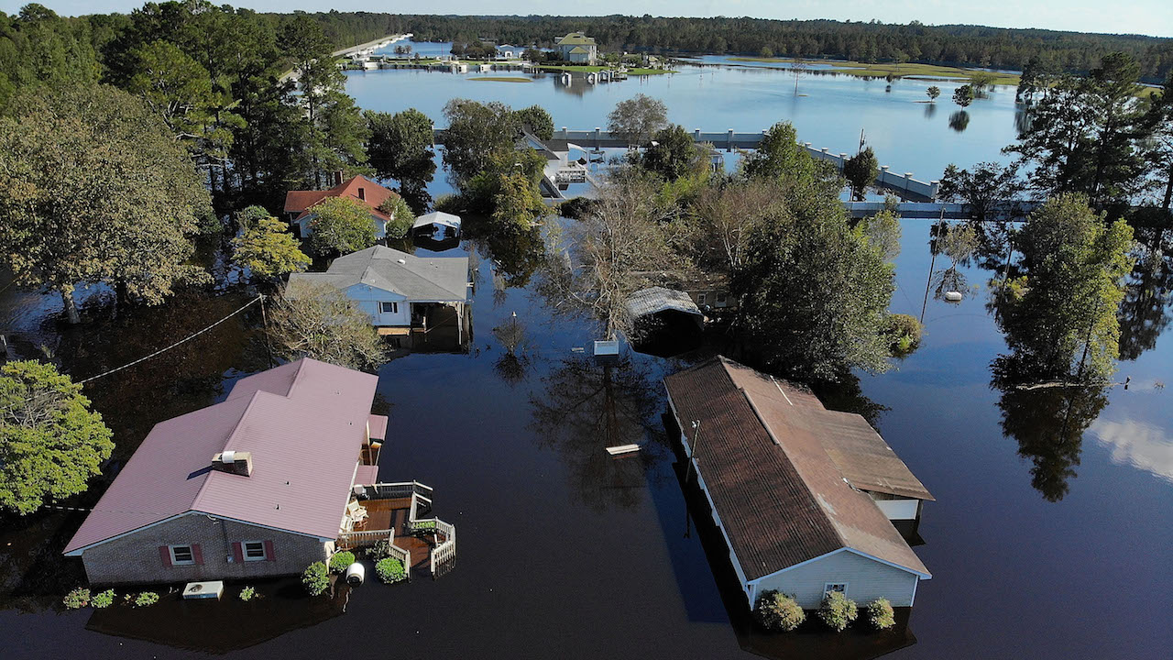
FEMA funds Hazard Mitigation
FEMA’S ROLE

Slide 9
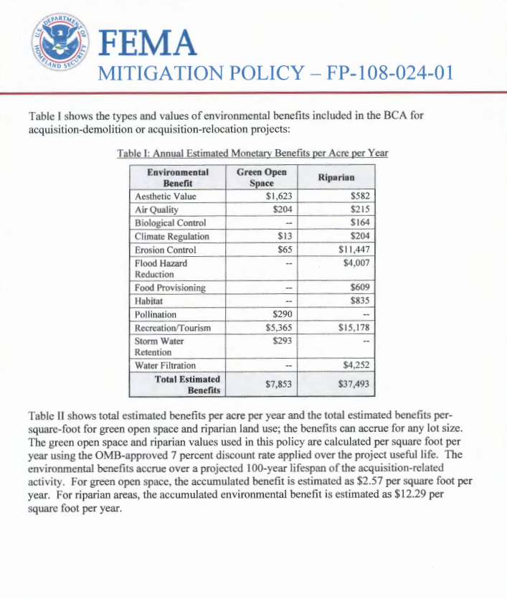
Notes:
After a presentation by Earth Economics, FEMA took notice, hired EE and we helped add ecosystem service valuation (environmental benefits) to all FEMA flood and hurricane mitigation, 80% of FEMA mitigation expenditures. This shifts investment out of the floodplain and away from the coast.
FEMA policies adopted post EE:
ES valuation;
2. 300% ROI: automatic approval $275K or less;
Sea Level Rise included in BCA.
FEMA is a climate adaptation investment agency, don’t have to go into the politics of Climate Change, just implement. 50 States.
We now have continuing contracts with FEMA to look at fire, drought, further flood and hurricane, climate adaptation: fire, flood and drought.

Slide 10
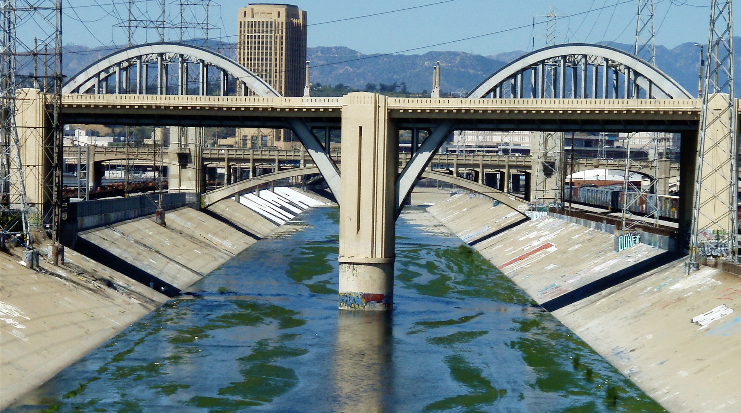
Hazard Mitigation
LA River | Los Angeles, CA
Notes:
Hazard Mitigation Old vs. New
This is what happens when you use the narrow framework to evaluate infrastructure projects
Very literally grey
Very literally divisive versus inclusive, holistic, etc.
This moves water…and that’s about it.

Slide 11
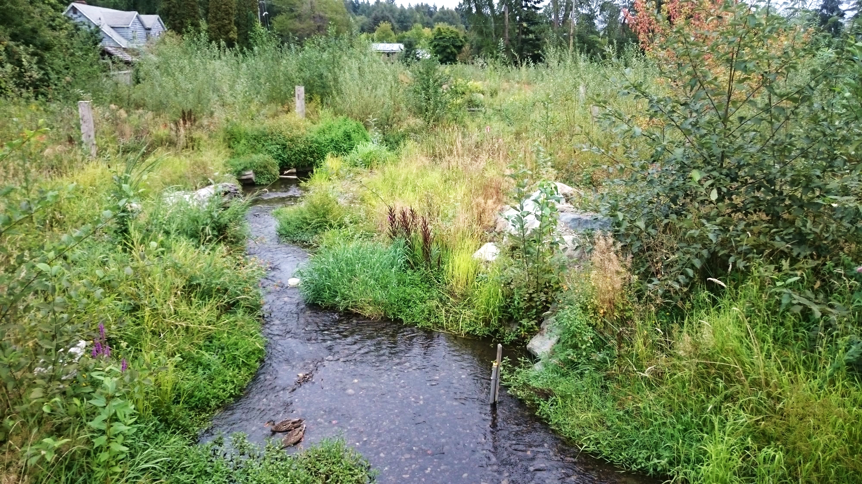
Hazard Mitigation+
Thornton Creek| Seattle, WA
Notes:
- Meets a similar flood control objective
Very clearly green
- Flood protection + == co-benefits!
Inclusive, holistic, and RESILLIENT etc
Our job as economists is to be able to describe the difference between Thornton Creek and LA River in Dollars and Cents.

Slide 12
FEMA’S FUNDING APPROACH
Hazard Mitigation Grant Program
After federally declared disaster
Can be used to acquire parcels with houses and convert to open space
Or can be used to acquire open space parcels with the goal of reducing disaster risk
Pre-disaster Mitigation Grant Program
New expansion of funding for Pre-Disaster Mitigation (PDM)
PDM follows similar application process as HMGP, but is not tied to disaster declaration
PDM funding is estimated to increase from $100-$200 million/year to over $1 billion, starting in 2019

Slide 13
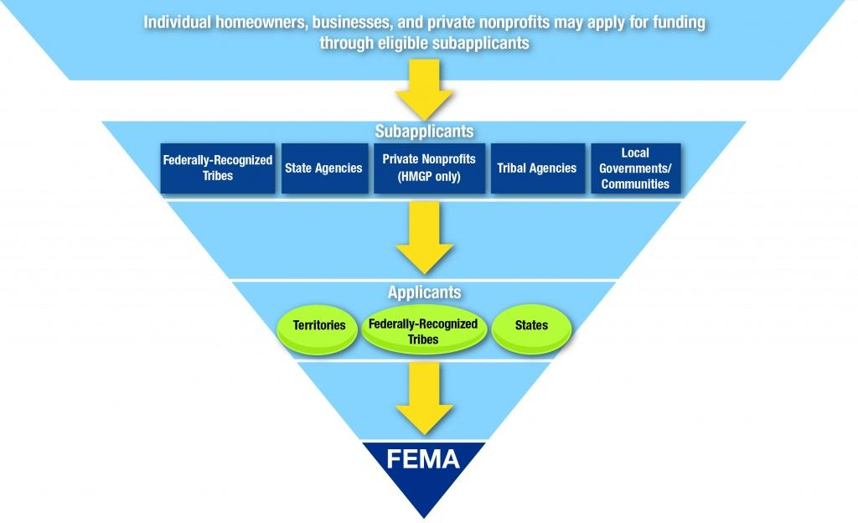

Slide 14
Houston Parks Board (HPB) – Acquisitions of Parcels with Structures
Notes:
Alt Option

Slide 15
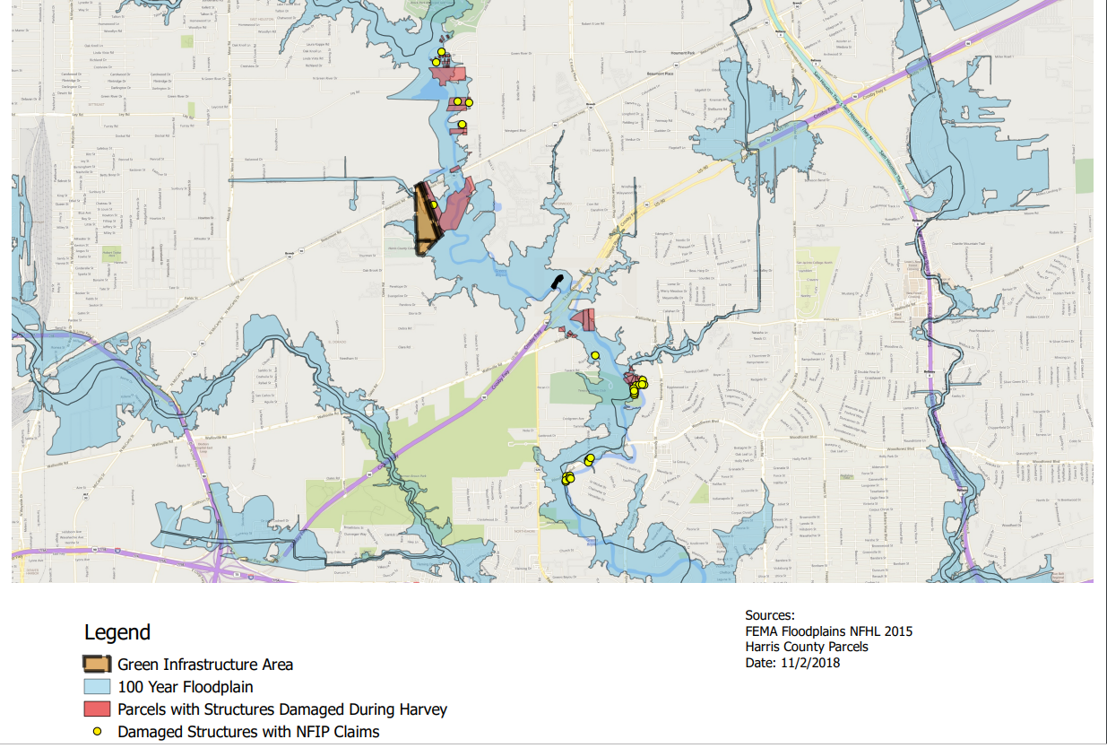
HPB – Green Infrastructure Development for Flood Risk Reduction

Slide 16
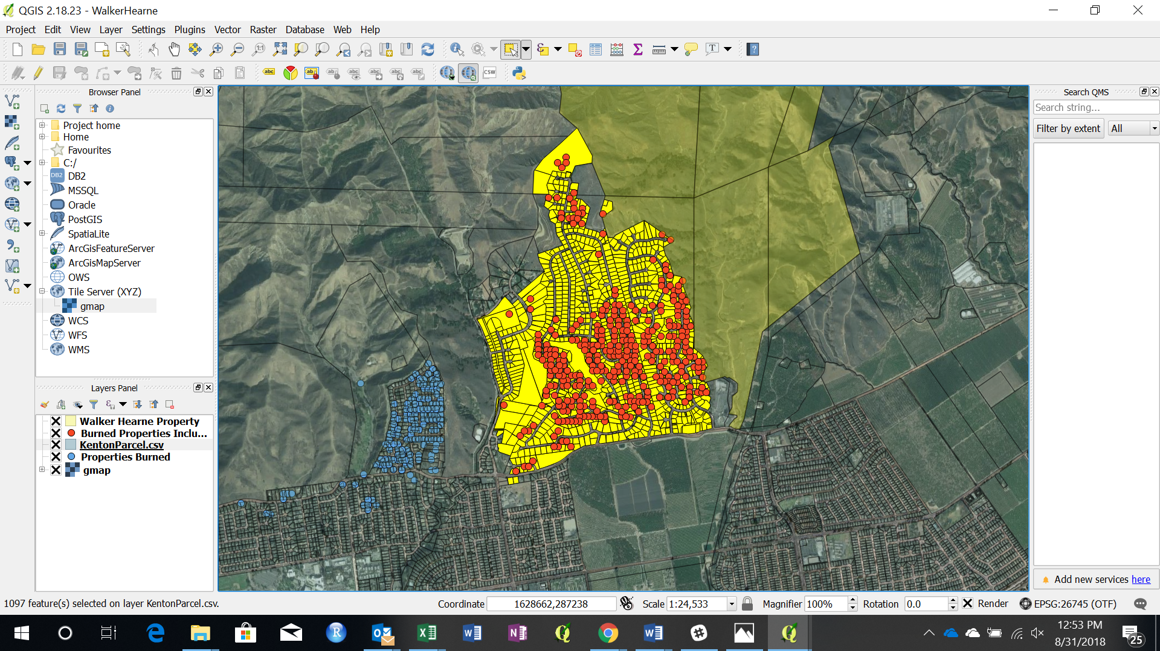
Acquisition of forest adjacent to fire damaged subdivision
Notes:
Optional Alt

Slide 17

Questions?
jwildish@eartheconomics.org
eartheconomics.org
Notes:
Ask for Questions

