Slide 1
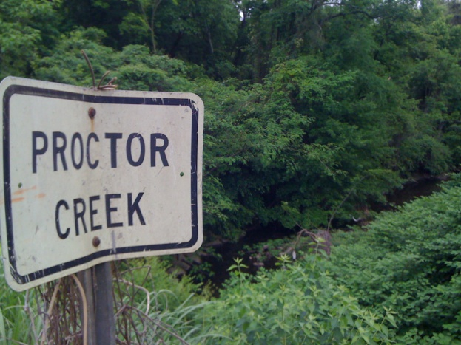
From Peril to Possibilities: Delivering Triple Bottom-Line Benefits and Advancing Resilience Through Parks, Green Infrastructure & Authentic Engagement
Na’Taki Osborne Jelks, Ph.D., MPH
West Atlanta Watershed Alliance
Spelman College

Slide 2
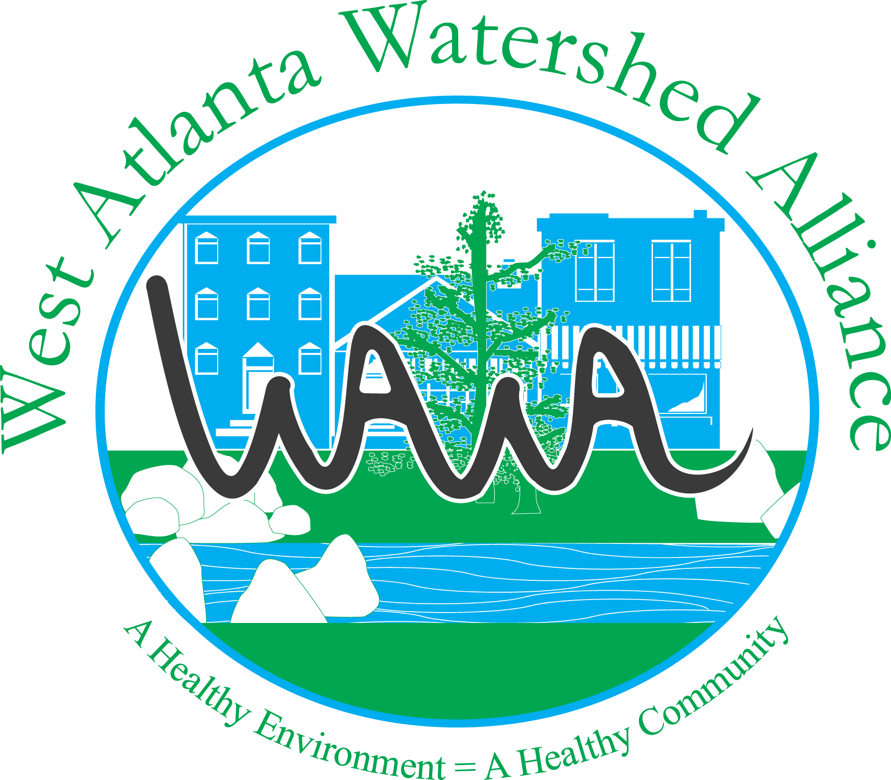
West Atlanta Watershed Alliance
Growing a Cleaner, Greener, Healthier & More Sustainable West Atlanta

Slide 3
Guiding Principle of Authentic Community Engagement & Collaboration
PROCESS is just as important as results!

Slide 4
WAWA’s Work
In the late1990’s/early 2000’s WAWA, in collaboration with West Atlanta residents and stakeholders from across Metro Atlanta, led community efforts to close one of two CSO facilities in the Proctor Creek Watershed and to separate the combined sewers in the Utoy Creek Watershed.
Since our founding, we have elevated the challenges and opportunities in underserved, urban watershed…sometimes as “the lone voice crying in the wilderness.”

Slide 5
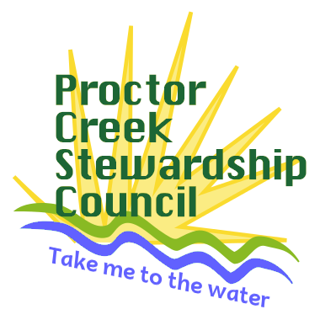
An Urban Waters Capacity-Building Grant Supported the Formation of the Proctor Creek Stewardship Council
Convened by WAWA
Organized in Collaboration with Community Improvement Association and Environmental Community Action (Eco-Action)

Slide 6
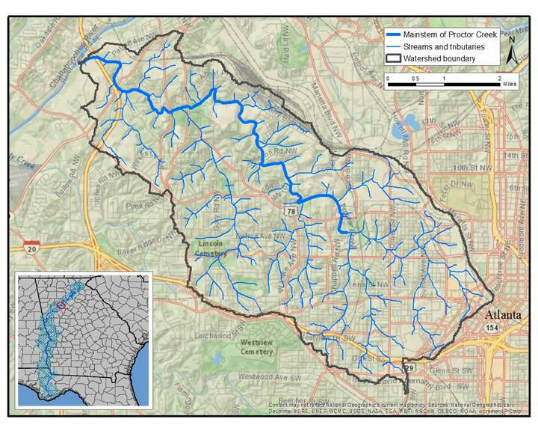
Setting the Community Context: The Proctor Creek Watershed
Notes:
The 23 square mile watershed has a population of >51,000 people living in more than 38 neighborhoods, and it primarily traverses five City of Atlanta neighborhood planning units (NPUs) (Park Pride, 2014). Many of the watershed’s residents, who are primarily African American, experience social and economic disparities (City of Atlanta, 2013).

Slide 7
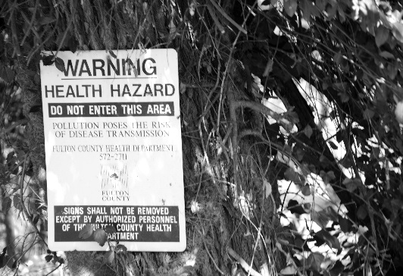
A Proctor Creek In Peril
Proctor Creek used to be a source of pride for West Atlanta communities – a place where children played, a place where people could fish, and a place where people were baptized.
Proctor Creek is now one of the most environmentally impaired creeks in metro Atlanta.
  Today, Proctor Creek is impacted by numerous pollution sources and does not meet state-mandated water quality requirements (including that for E.coli).
    The creek does not meet its “designated use” for fishing (ARC, 2011; GA EPD, 2013)
    A part of the watershed was identified as the #4 hotspot in a list of the top five (5) environmental justice hotspots in The Patterns of Pollution: A Report on Demographics and Pollution in Metro Atlanta (GreenLaw, 2012)

Slide 8
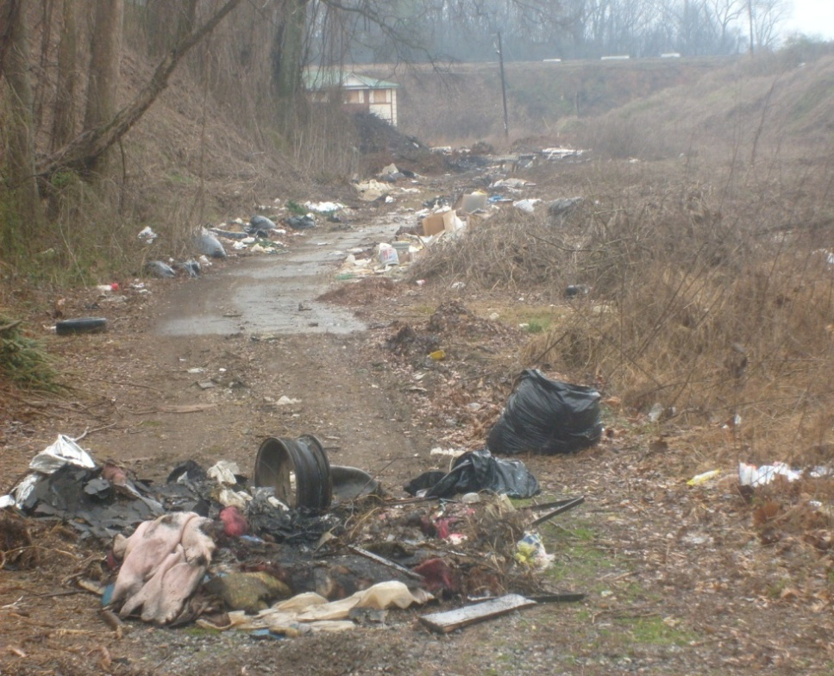
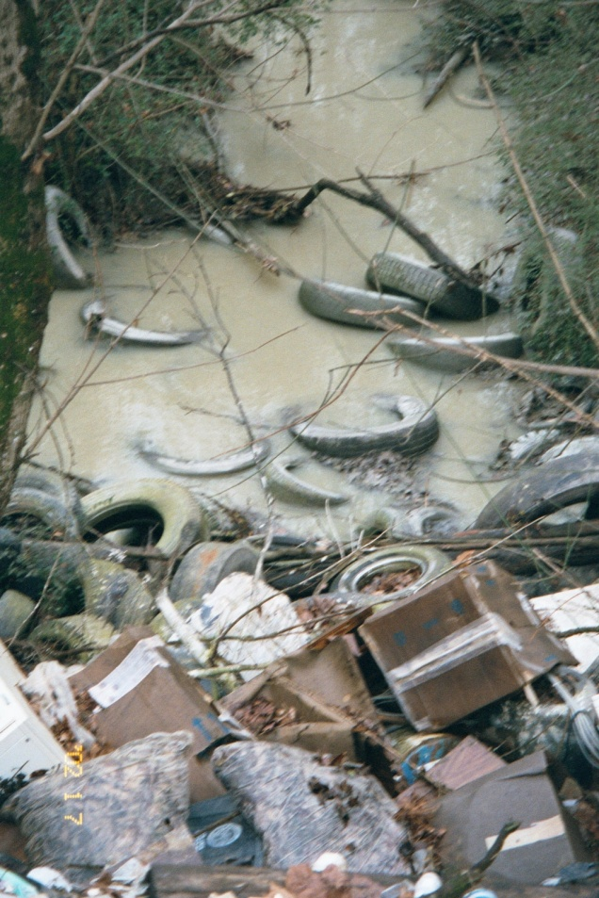
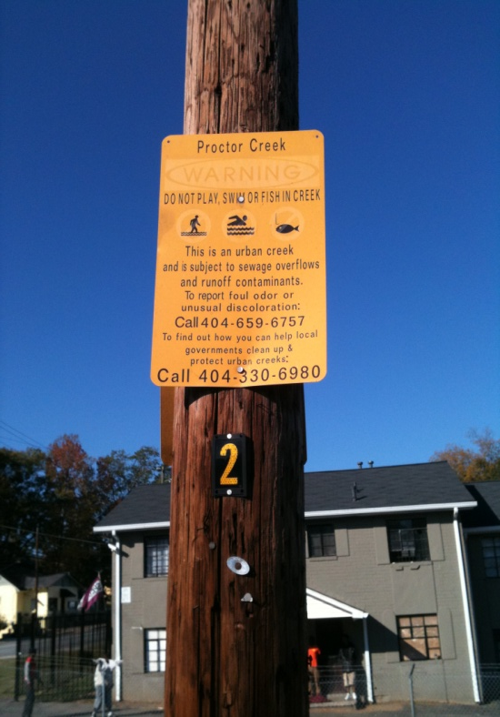
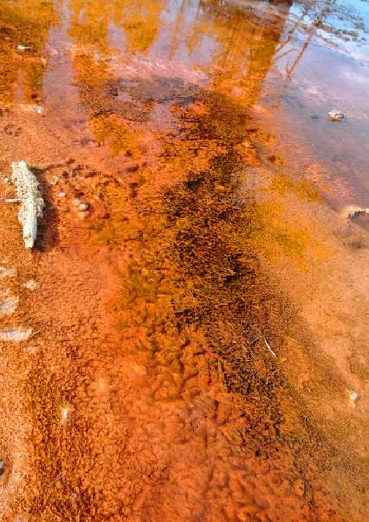
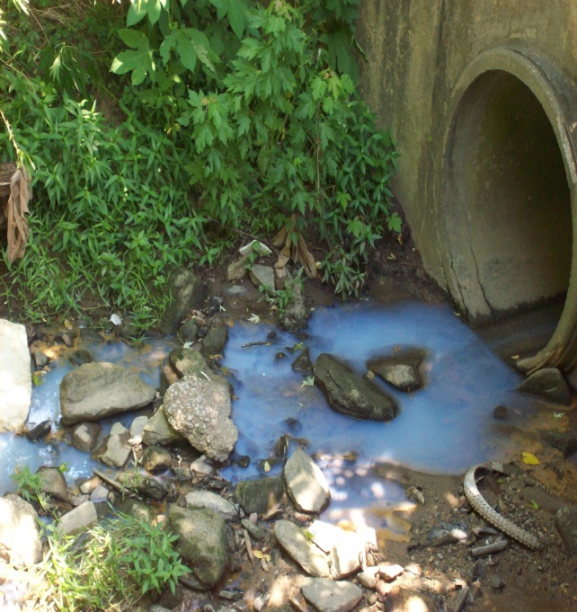
Proctor Creek and its Communities Have Numerous Challenges

Slide 9
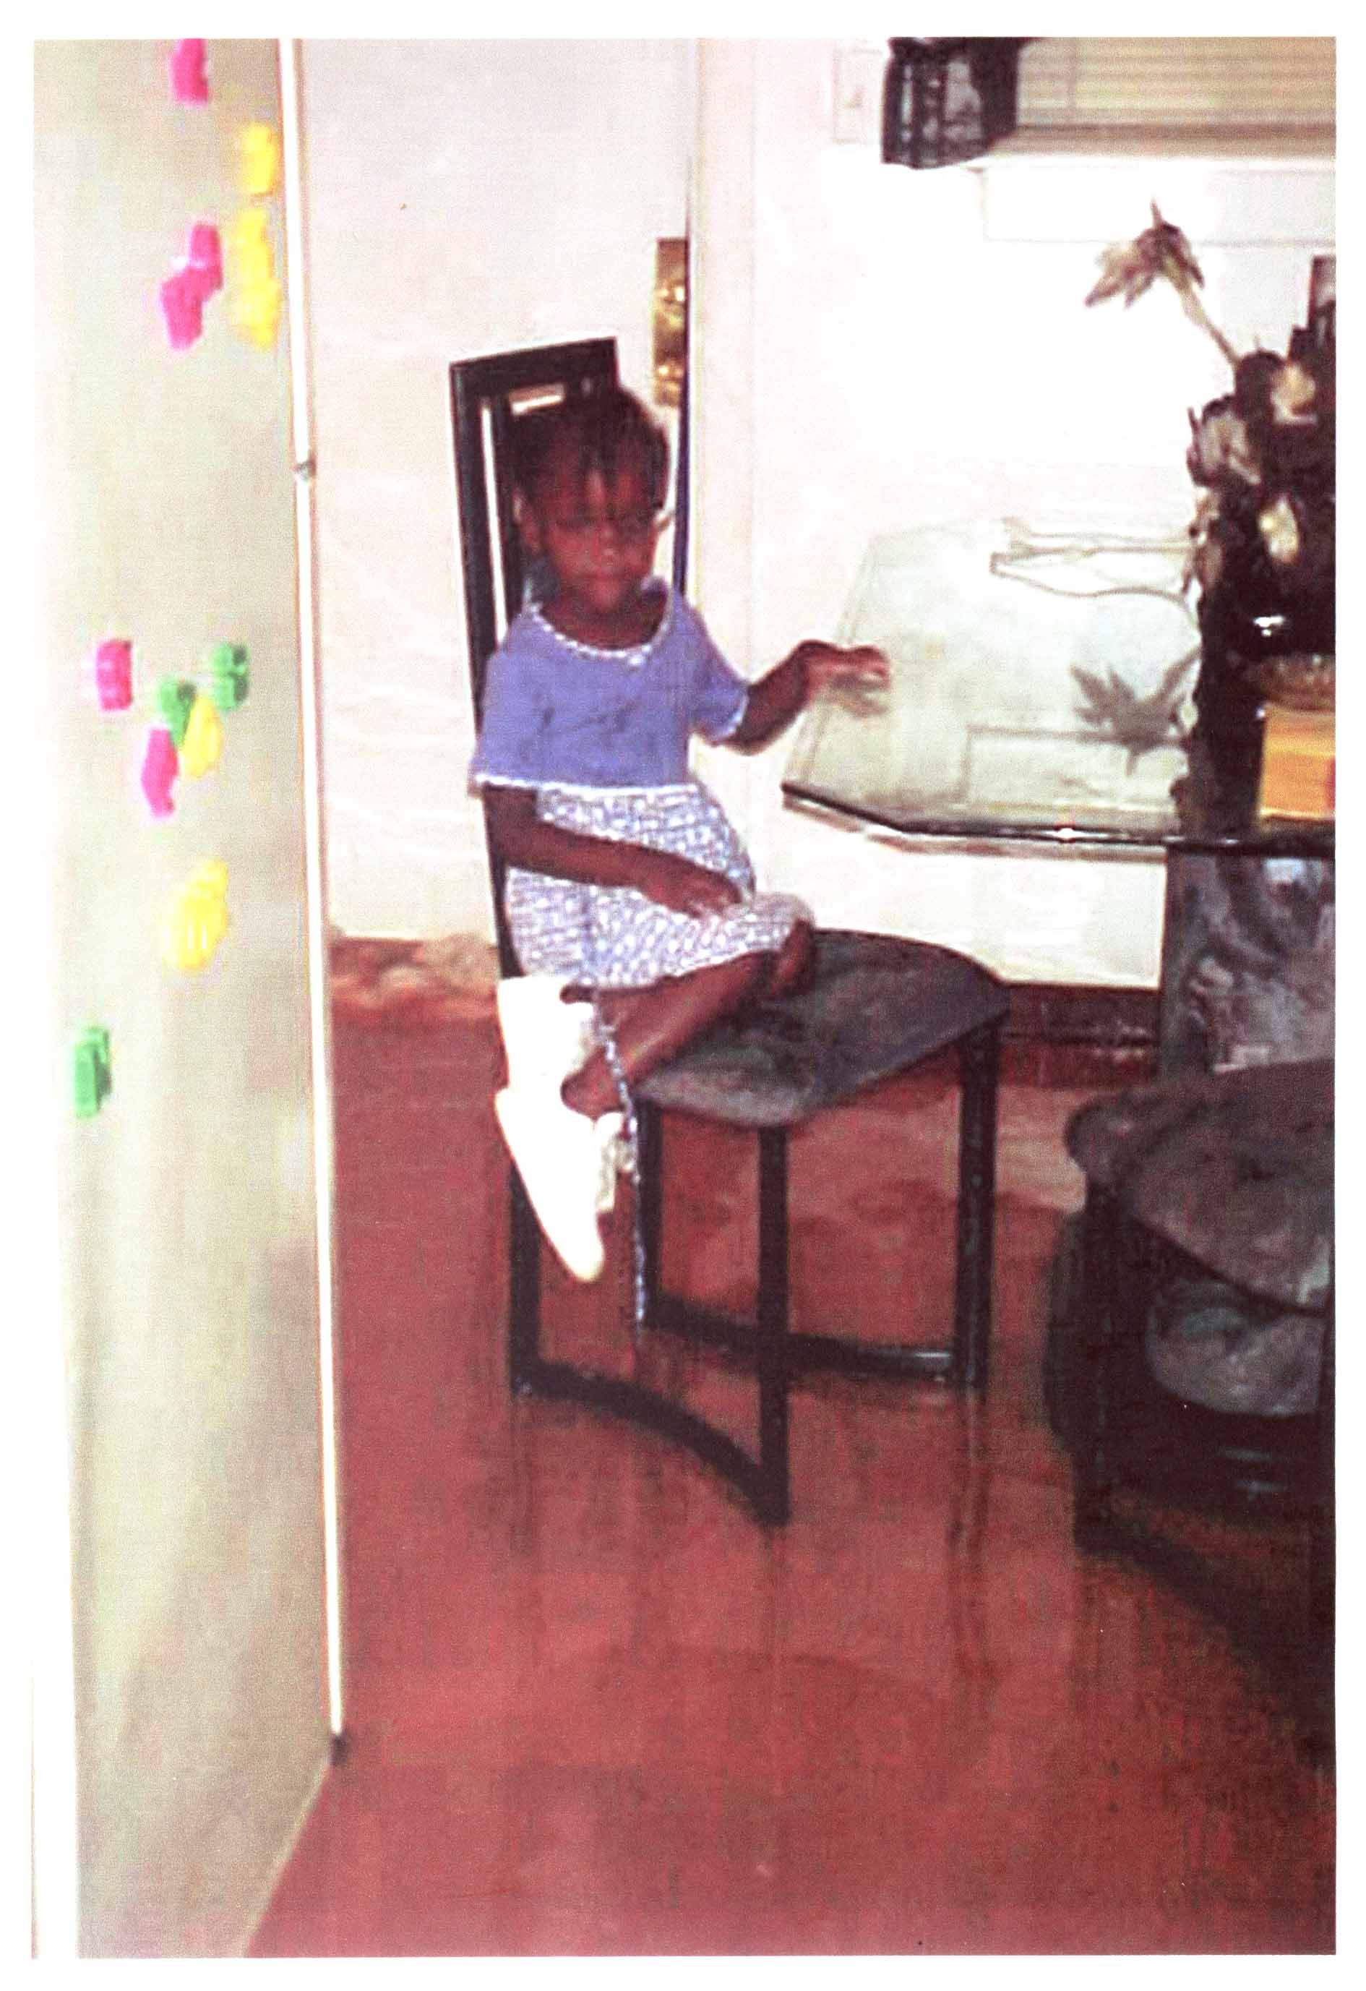
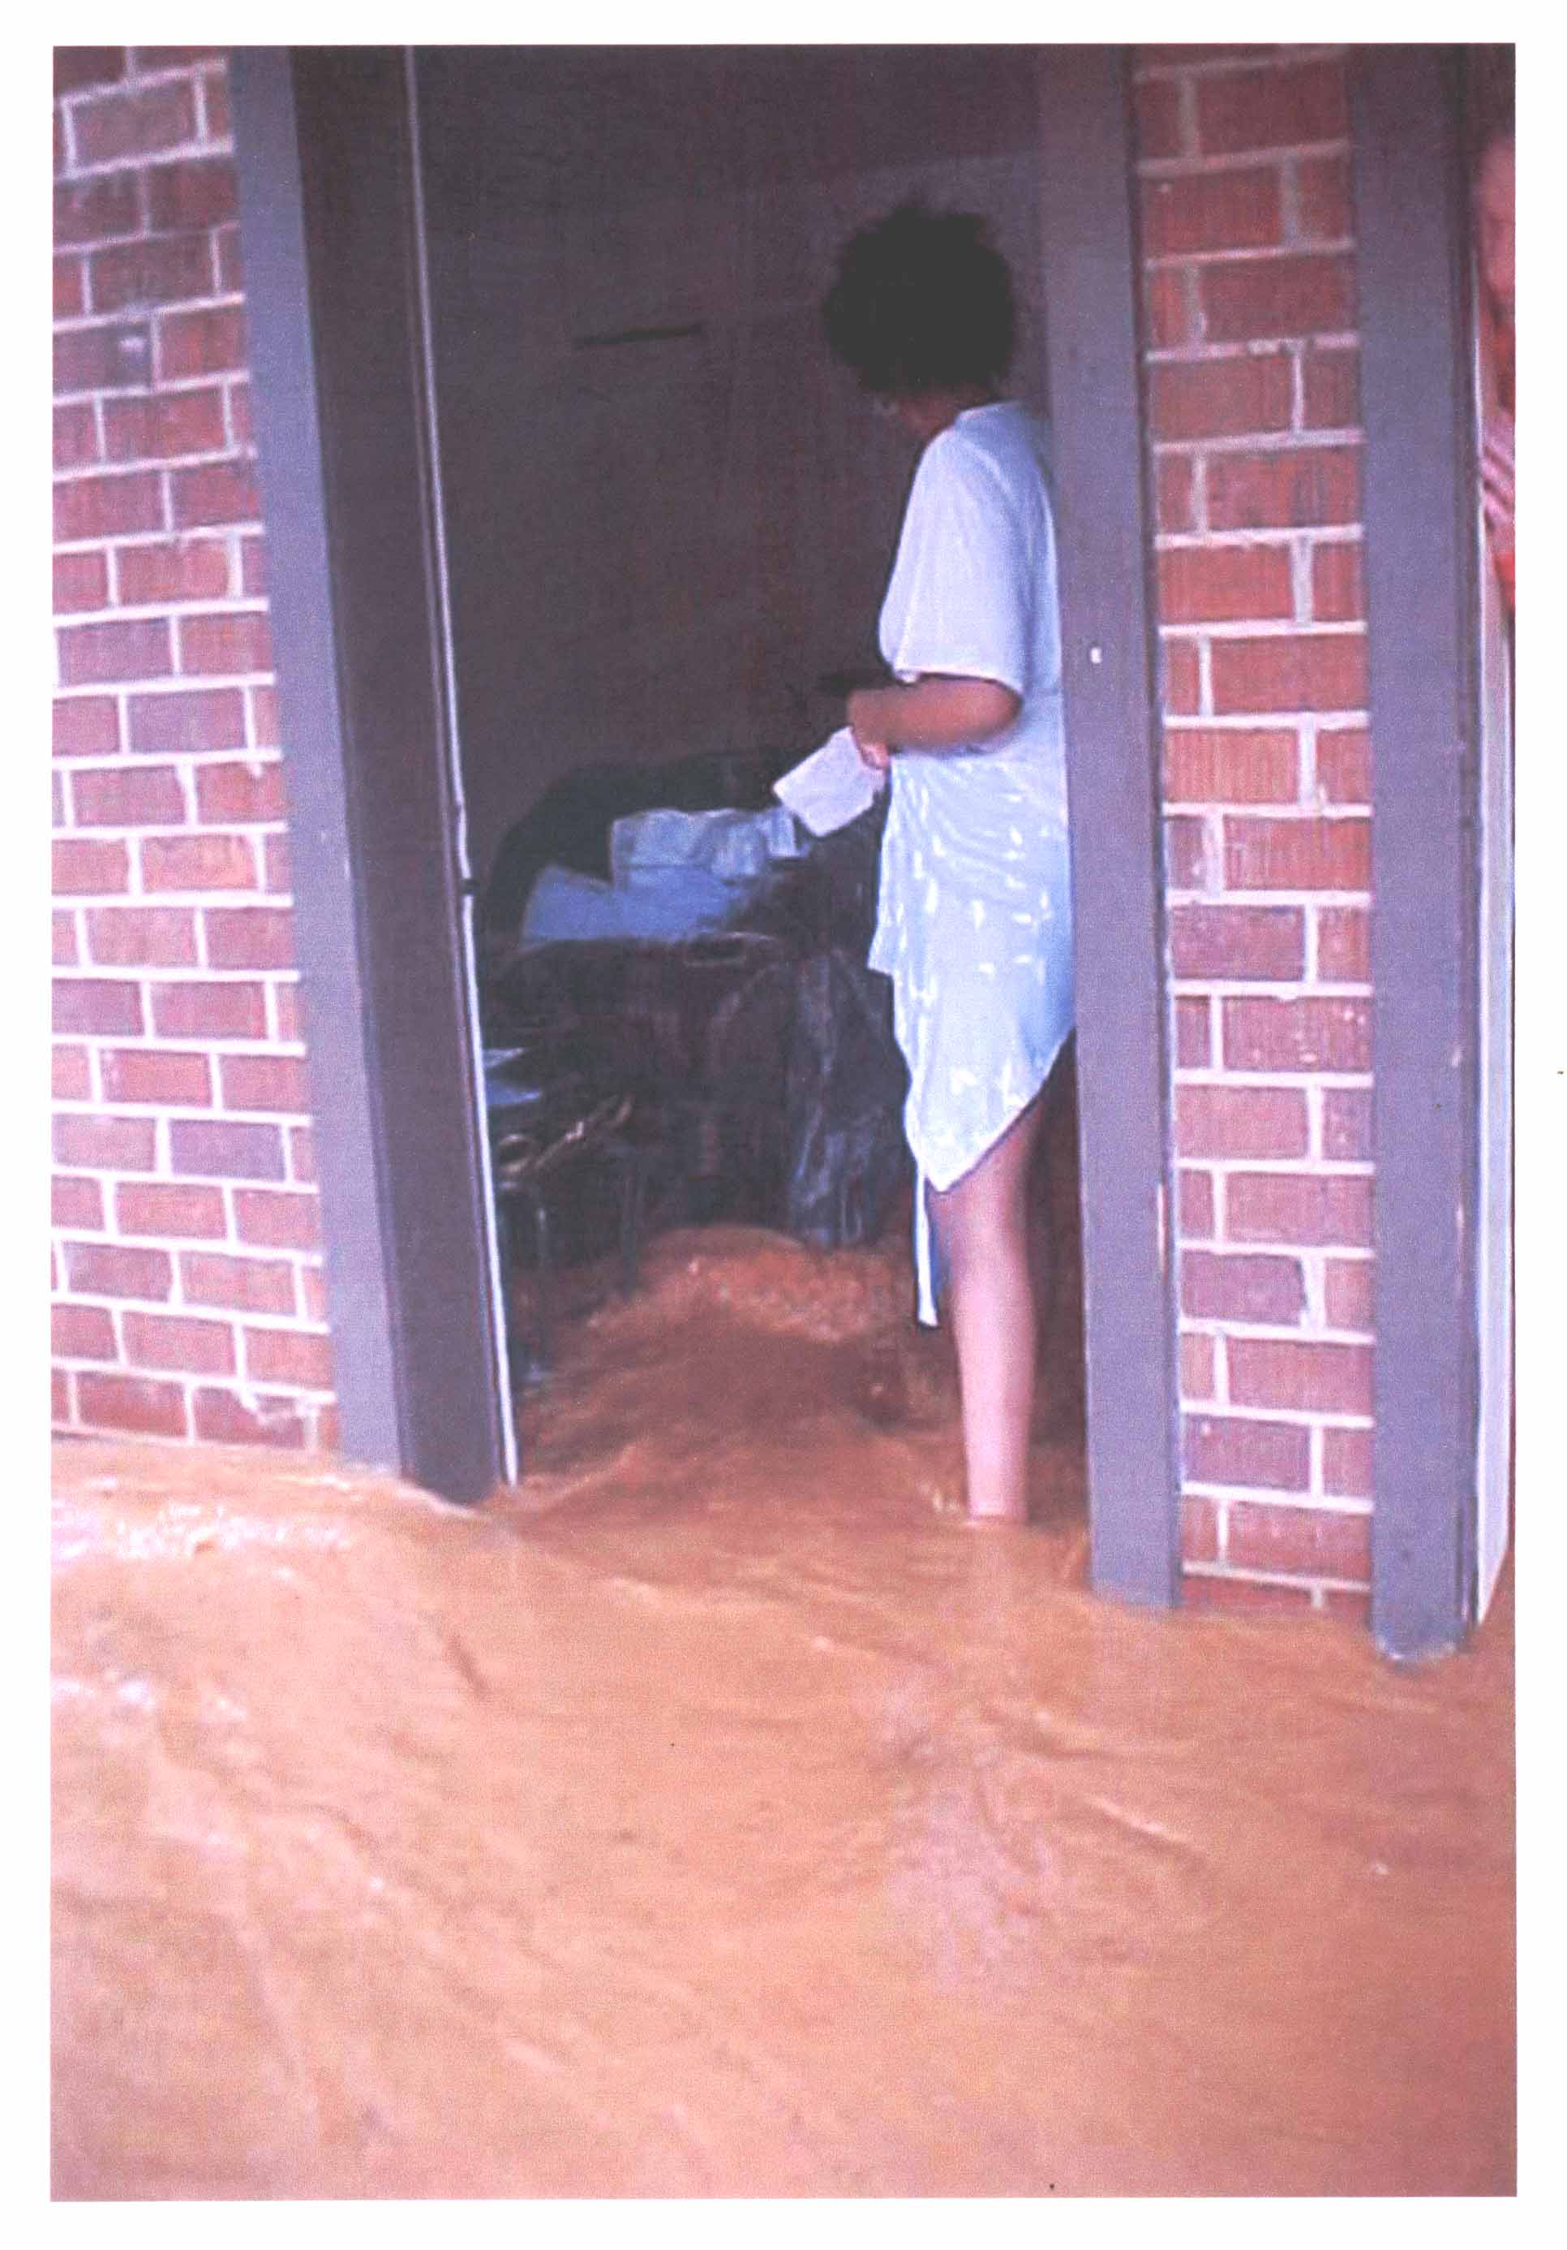

Slide 10
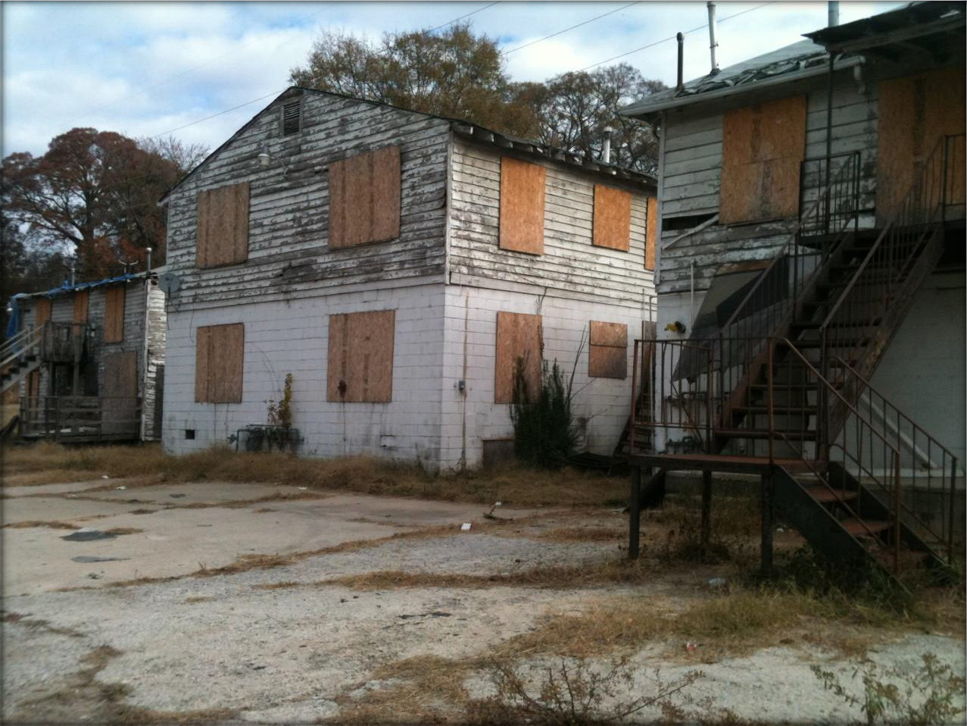
Vacancy, Blight, and Neglect

Slide 11
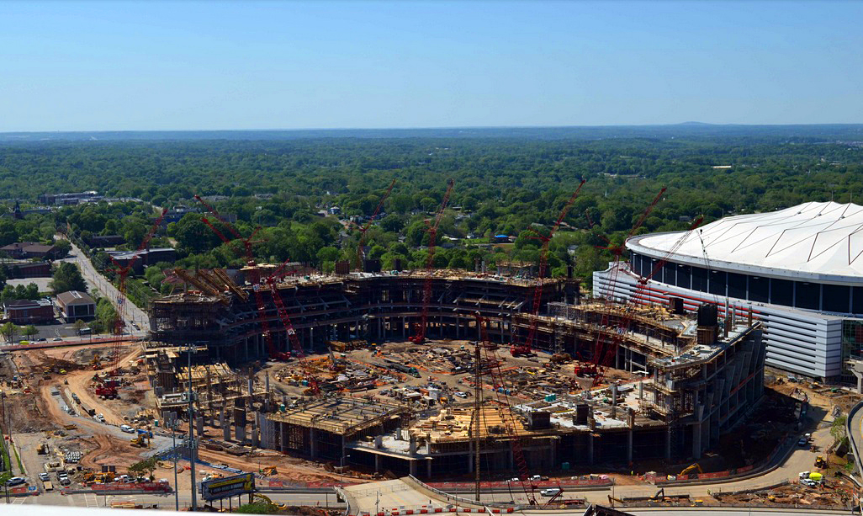
The Stadium Effect

Slide 12
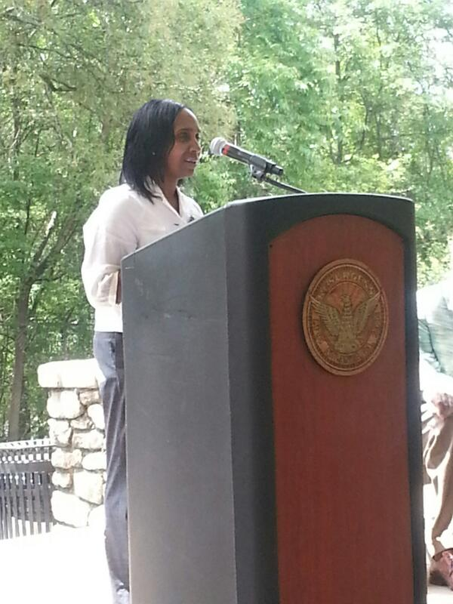
The Proctor Creek “Comeback”: Urban Waters Federal Partnership Designation (2013)
“Communities in and around the Proctor Creek Watershed have long suffered from pollution caused by Atlanta’s aging sewer infrastructure, disinvestment in the urban core, illegal dumping and other environmental and public health hazards.
The strength of the Partnership will be realized through collaboration with residents who have assets, local knowledge, and a history of action focused on restoring the watershed.”

Slide 13
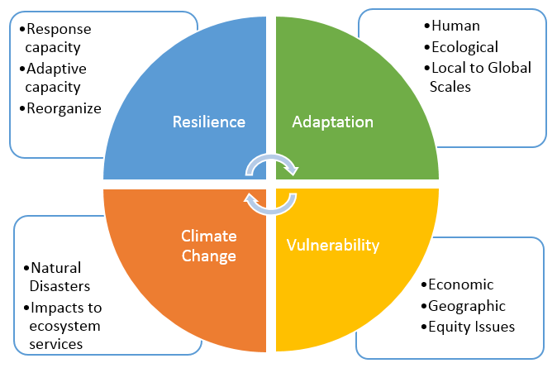

Slide 15
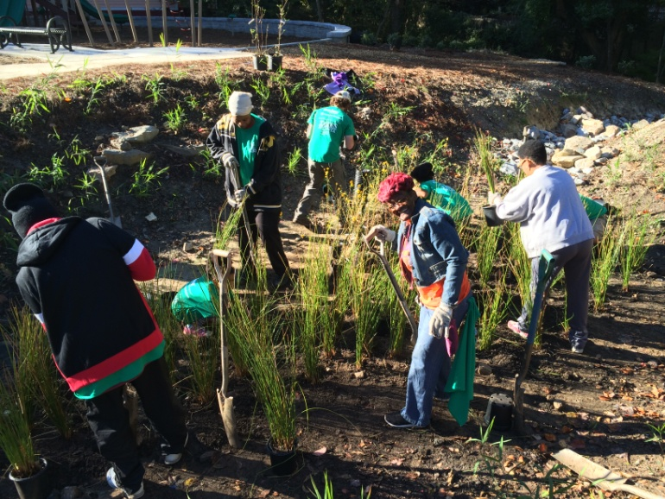


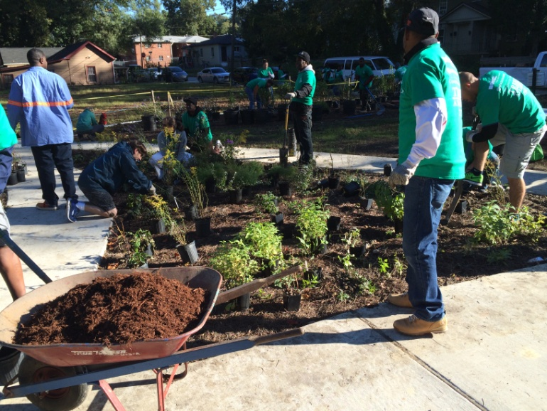
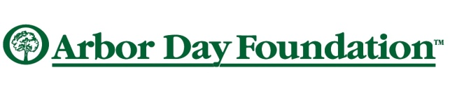


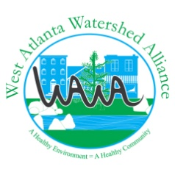

Environmental Benefits
Environmental Benefits
First park for community
\
Green Infrastructure demonstration site
Stormwater capture and improved water quality
Habitat restoration & pollinator gardens
Transform 6 blighted lots
Community’s Triple Bottom-Line Design Design

Slide 16
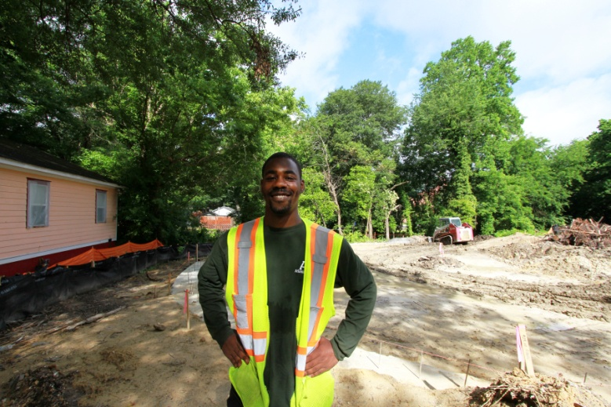
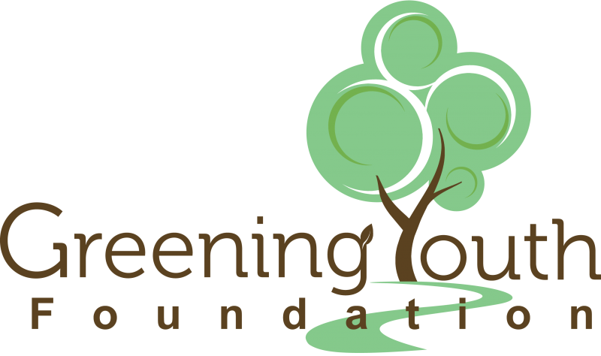
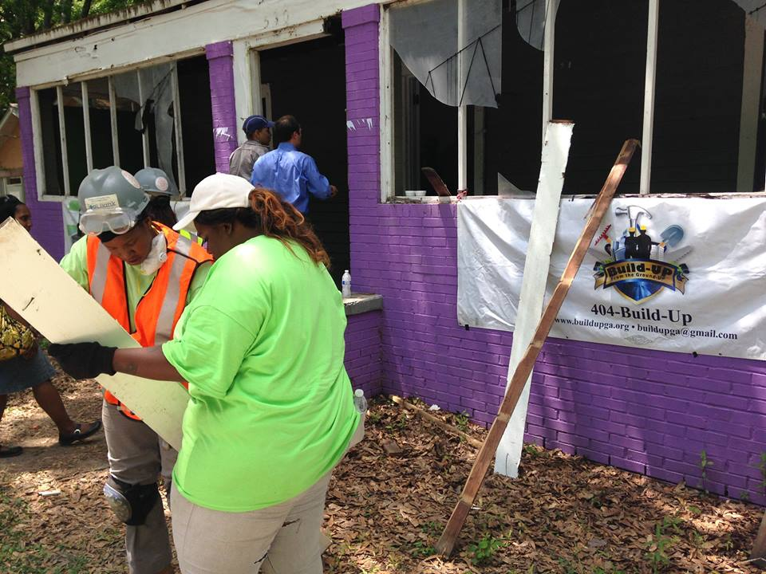
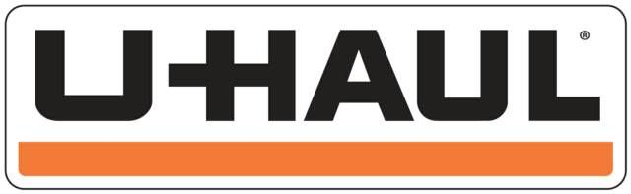




Economic Benefits
Economic Benefits
Workforce training for local residents
General construction skills
Demolition & deconstruction
Financial literacy training
Employment opportunities
Community’s Triple Bottom-Line Design
Community’s Triple Bottom Line Design

Slide 17
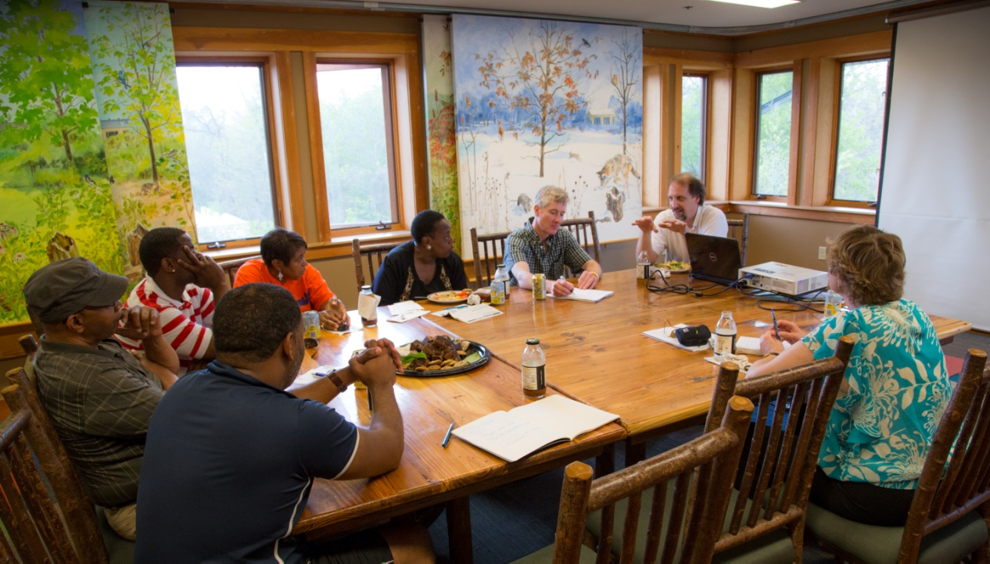





Social Justice BenefitsBefits
Community leaders developing plans
Access to decision making & resources
Local residents receiving educational training
Capacity building for grassroots organizations
Access to recreation, nature and exercise
Citizen Science opportunities
Community’s Triple Bottom-Line Design

Slide 18
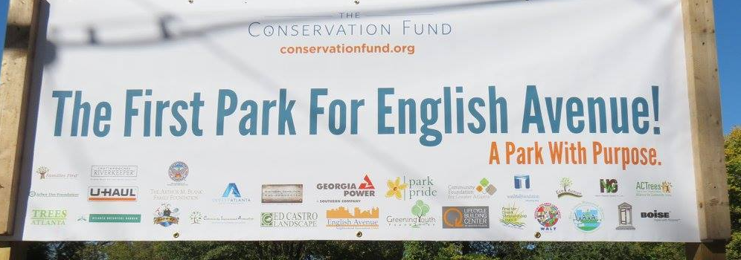
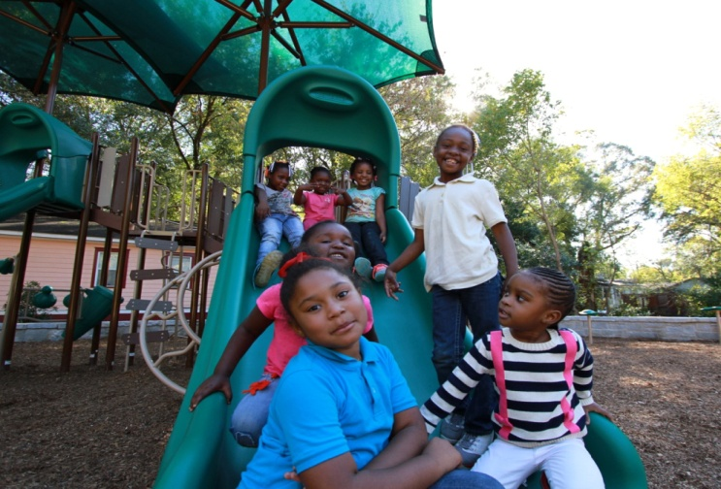
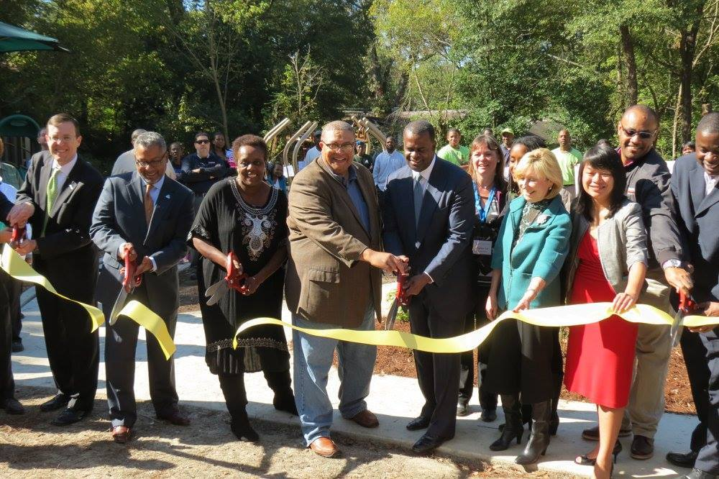
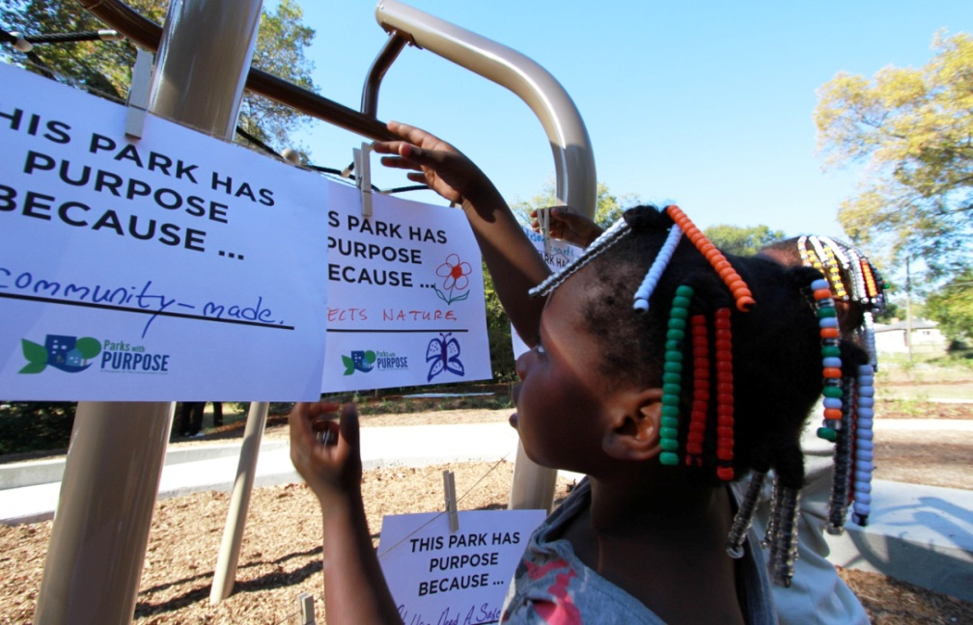
Celebration!
Lindsay Street Park Opened October 2015

Slide 19
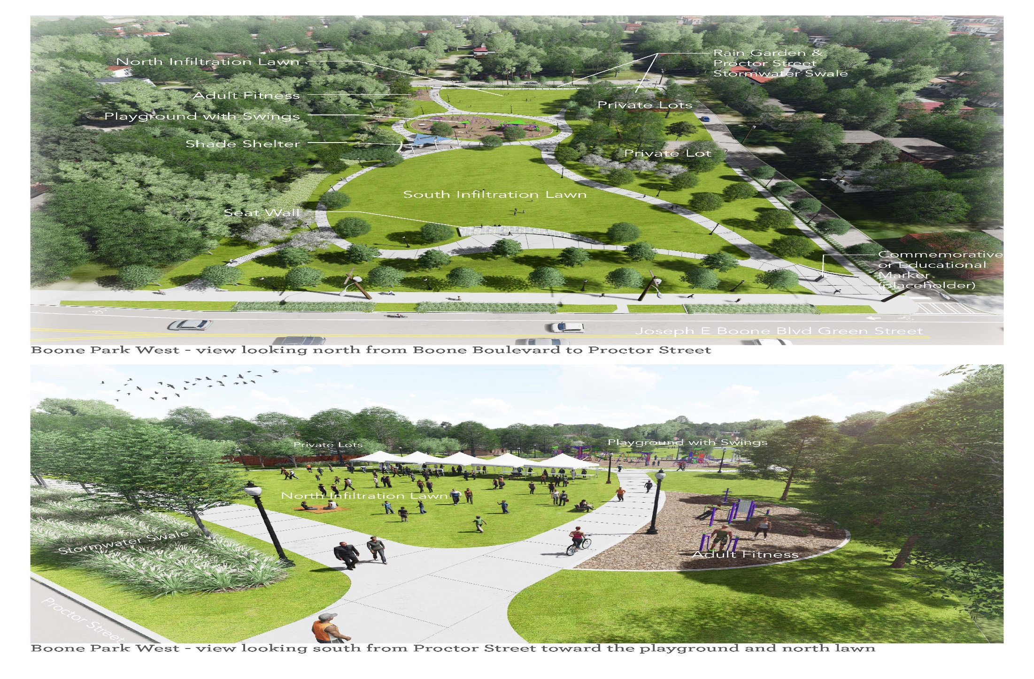
Kathryn Johnston Memorial Park

Slide 20
Guiding Principle of Authentic Community Engagement & Collaboration
PROCESS is just as important as results!

Slide 21
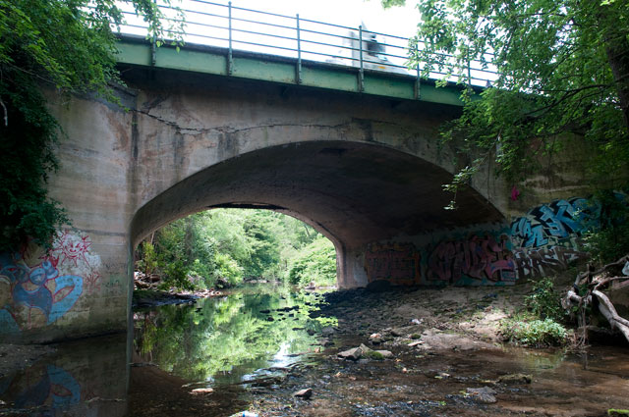
Na’Taki Osborne Jelks, Ph.D., MPH
E-mail: nojelks@wawa-online.org
404-825-3872

