Slide 1

Seattle Park District
Approved by Seattle Voters, August 4, 2014

Slide 2
Structural Challenges Facing Seattle Parks & Rec in Early 2000’s
Extended periods of down economies decimated budgets
Competing needs during down cycles: police, fire, human services
Increasing costs combined with decreasing tax revenues and smaller budget allocation to Parks and Recreation
Funding gap from extended periods of down economies
Increasing costs
Decreasing funding

Slide 3
The Park District Imperative
Situation:
Continuous budget cuts, every year from 2000 through 2014
More than $25 million in cuts during this time
Laid off or reduced more than 200 positions (employees) in one budget cycle
Accumulated deferred maintenance
$270 million in deferred capital maintenance
Failing facilities: infrastructure, roofs, electrical systems, pools, etc.
Basic park maintenance was suffering

Slide 4
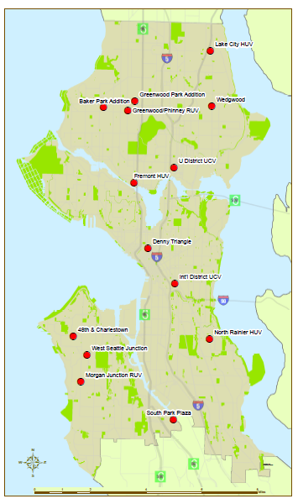
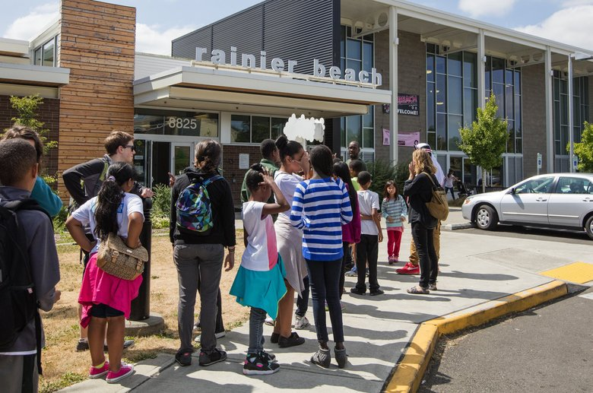
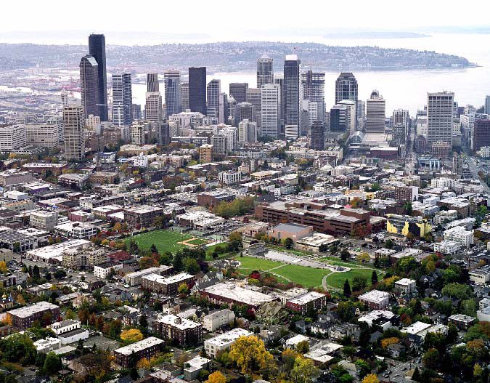
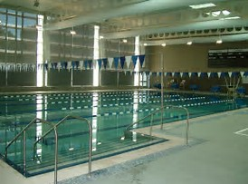
The Seattle Parks Legacy Was Threatened
Limited funding for open space acquisition & developing new parks
Reduced hours at community centers & pools
14 land-banked sites

Slide 5
What is a Park District?
Also known as Metropolitan Park District
A funding mechanism that collects property taxes dedicated to park and recreation uses
Requires the authorization of the State Legislature
Is usually additive to General Fund support
In Washington State requires a single one-time approval from voters, unlike special tax levies
Not as vulnerable to General Fund reductions
Revenues can be used to pay debt and operate: no use restrictions
A way to insulate the department against boom/bust cycle of General Fund reductions

Slide 6
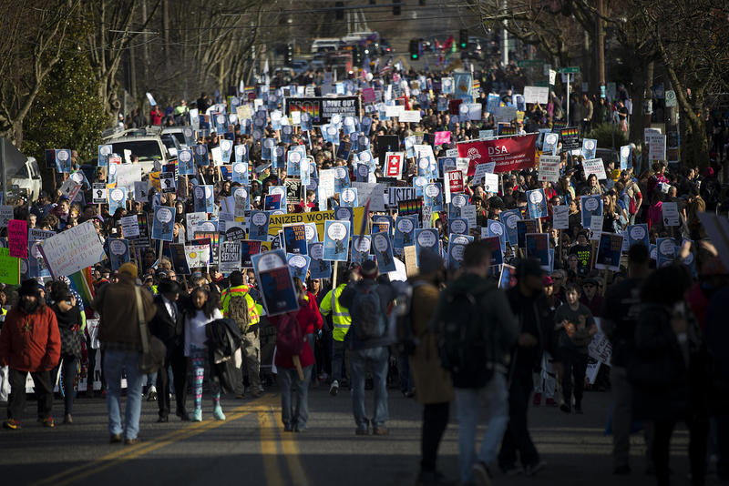
Seattle voters Love Their Parks
Civic Engagement
Seattle has long history of voter-approved ballot measures to support parks and recreation
We are supported by an array of partners: Seattle Parks Foundation, Woodland Park Zoo, Seattle Aquarium, Associated Recreation Council, over 300,000 volunteer hours annually

Slide 7

What Changed
  The time was right after years of cuts
  Seattle Park Foundation laid groundwork and had organizational capacity to campaign
  Newly elected Mayor

Slide 8
Upside Downside
Required a one-time vote
Provided taxing authority up to 75 cents of assessed value (started at 29 cents/$1,000 A.V.)
Dedicated fund source for parks
Stabilized the department budget
Additional funding supports M&O and Capital
Addressed $270M in deferred maintenance
The general public was accustomed to time-limited levies - Park District was a new concept
Distrust of elected leaders
Blank check
Perceived lack of accountability
Perceived track record of poor maintenance, based on levies that paid for new stuff but did not include M&O

Slide 9
Steps Taken to Address Concerns
Department completed an 18-month Strategic Plan process to determine needs
Established the first 6-year spending plan
Established a Community Oversight Committee
Ensured current level of General Fund support plus inflation
Developed an Interlocal Agreement
All funds go to Seattle Parks and Recreation
The City Council serves as the Governing Board

Slide 10
Financial Context: Operating Budget
Operating Budget | 2017 Adopted | % of Total
General Fund | $ 103,217,174 | 63.1%
Charges for Services and Facility Fees | $ 44,360,789 | 27.1%
Other Revenue | $ 3,225,210 | 2.0%
Park District Revenue | $ 12,677,147 | 7.8%
Total Operating Budget | $163,480,320 | 100.0%
Notes:
This slide and the next show how the Park District funds fit into the overall context of the Parks and Recreation budget
On the operating side, the Park District accounts for about 8% of our funding

Slide 11
Financial Context: Capital Budget
Capital Budget | 2017 Adopted | % of Total
Cumulative Reserve Subfund (REET and Unrestricted) | $ 35,842,000 | 46.2%
2013 King County Levy | $ 1,660,000 | 2.1%
Community Development Block Grant | $ 808,000 | 1.0%
Central Waterfront Improvement Fund | $ 1,050,000 | 1.4%
Alaskan Way Seawall Construction Fund | $ 1,053,000 | 1.4%
Other Revenue | $ 25,000 | 0.0%
Park District Revenue | $ 37,166,703 | 47.9%
Total CIP | $ 77,604,703 | 100.0%
Notes:
It’s a different picture on the capital side
The Park District funding accounts for about 48% of the Parks and Recreation capital budget

Slide 12
2017 Park District Budget by Program Categories
Program Category | 2017 Adopted Budget
Fix it First | $28,093,856
Maintaining Parks and Facilities | $4,157,622
Programs for People | $4,485,360
Building for the Future | $11,619,420
Debt service | $1,487,592
TOTAL 2017 APPROPRIATIONS | $49,843,850
Notes:
The Park District’s 6-year financial plan is divided into four major categories of projects
Fix it first
Maintaining Parks and Facilities
Programs for People
Building for the Future
I’ll explain them in the following slides

