Slide 1
The Trust for Public Land
Conservation Finance
NRPA Innovation Lab
August 9, 2018

Slide 2
Innovation Lab overview
Who does new, external public funding come from
Where does it happen – trends & track record
What elements lead to success
How does it happen – TPL best practices
Crucial ingredients to assess readiness
What do you want to do in your city? Discussion!

Slide 3
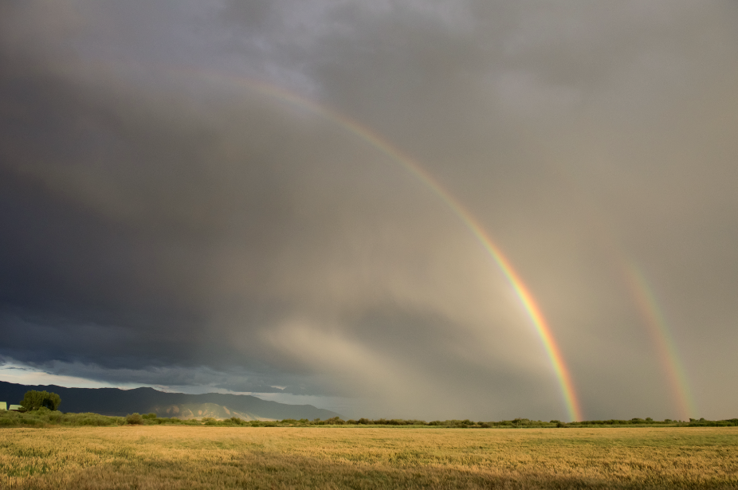
Public Funding Break Down
Public Funding for Land Conservation in the United States (1998-2015)
 | Amount | Annual Average
Local | $25,829,049,100 | $1,434,947,172
State | $17,715,694,051 | $984,205,225
Federal | $12,121,644,312 | $673,424,684
Total | $55,666,387,462 | $3,092,577,081
Local: Spending authorizations via local ballot measures. Source: TPL's LandVote Database
State and Federal: Actual spending. Data not complete for all 50 states. Source: TPL's Conservation Almanac Database
Gallatin Valley Land Trust

Slide 4
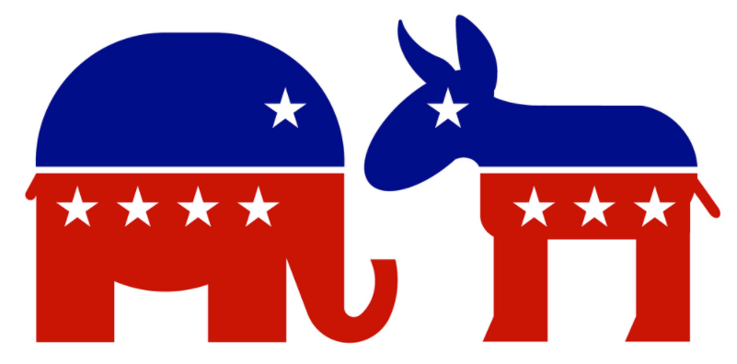
Partisan Divide? Let’s Look at 2016

Slide 5
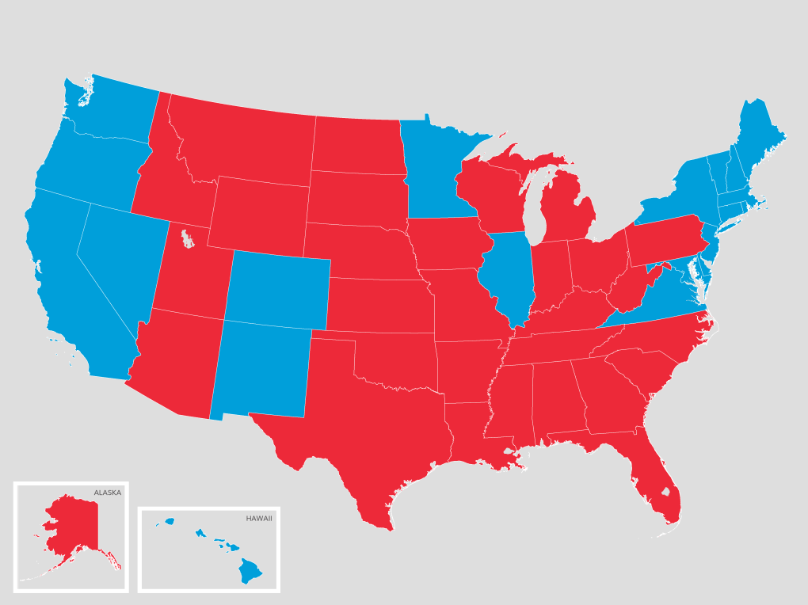
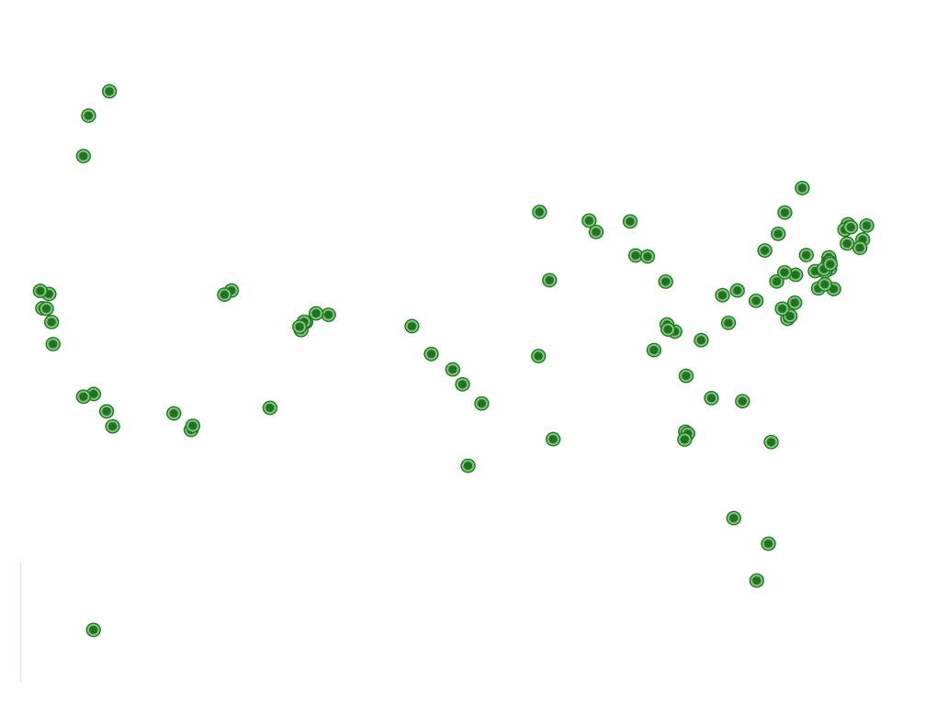
104 measures -- 84 passed -- generated over $11B in funds for land conservation, parks and restoration

Slide 6
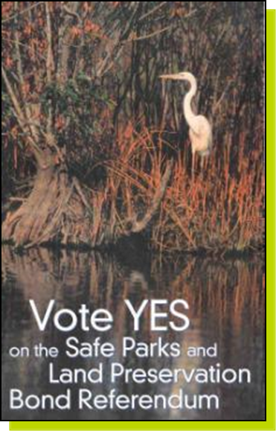
November 8, 2016 Election – All Park and Conservation Ballot Measures
87 measures in 21 states
70 were approved by the voters
80 percent passage rate
$6.9 billion in funds for conservation,
parks, and restoration
TPL involved in nearly half of all measures
Notes:
This is higher than the historic passage rate of 75 percent.
Returning to pre-Recession levels of ballot measure activity.
If we look at measures that were voted on prior to Nov. 8, the total for the year for all ballot measures in 103.
This is the first time since 2008 that there have been this many measures on the ballot.

Slide 7
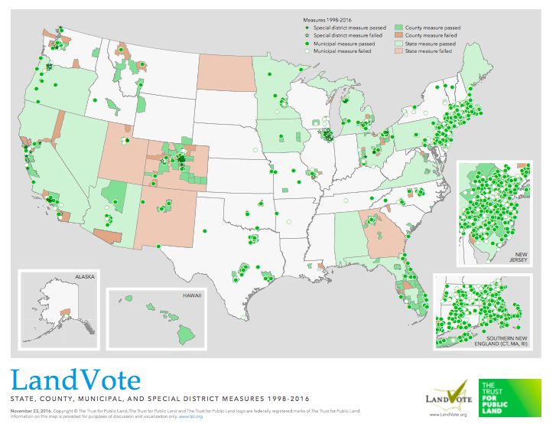
Notes:
This is higher than the historic passage rate of 75 percent
Returning to pre-Recession levels of ballot measure activity
If we look at measure that were voted on prior to Nov. 8, the total for the year for all ballot measures in 108
This is the first time since 2007 that there have nee that many measure

Slide 8
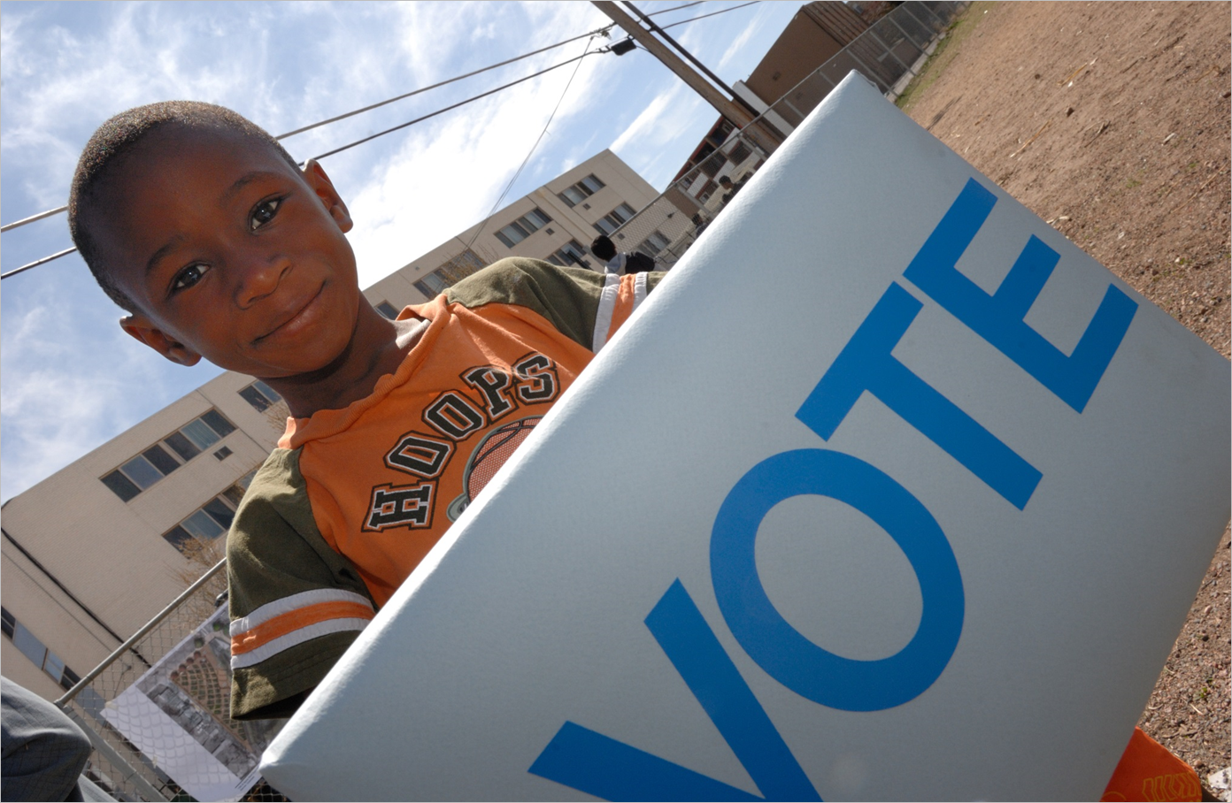
Conservation Finance for over 20 years
534 wins, 81% Yes, $68 billion created

Slide 9
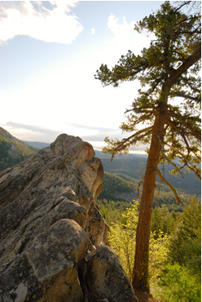
Key questions for funding success
Jurisdiction
Funding Mechanism
Amount (and duration)
Voter Support/Tax Tolerance
Purposes/Uses of Funds
Timing (choice of election date)
Accountability elements

Slide 10
Critical Steps for a Successful Ballot Measure
Feasibility Research
Public Opinion Survey
Program Recommendations
Ballot Language
Campaign

Slide 11
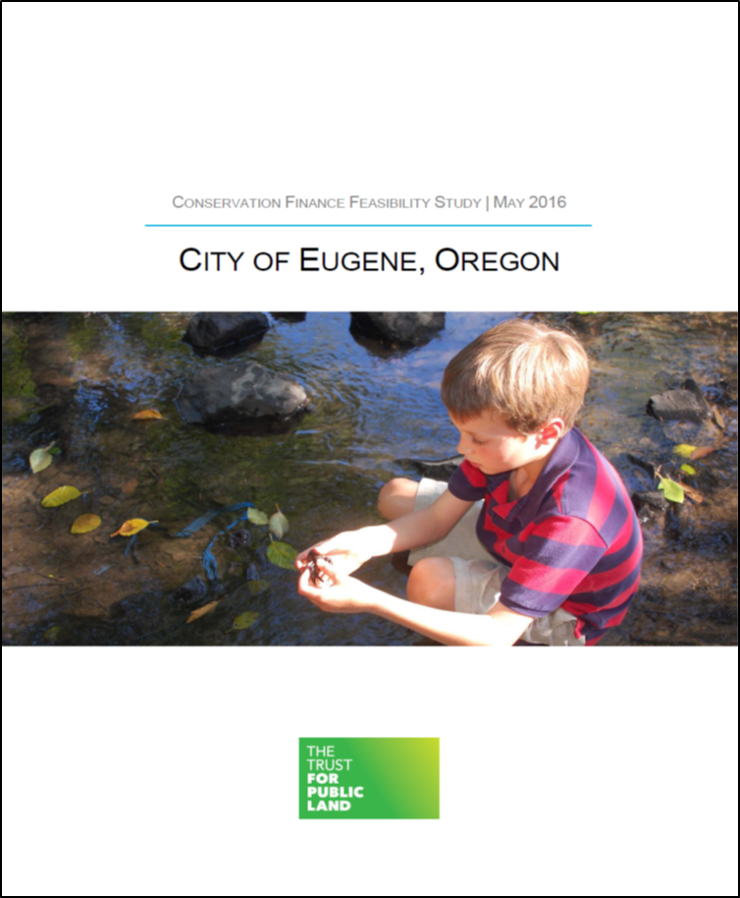
Feasibility Research
Finance options
Conservation priorities
Fiscal capacity restraints
Election requirements
Ballot language requirements
Timeline to ballot
Election history on pocketbook measures

Slide 12
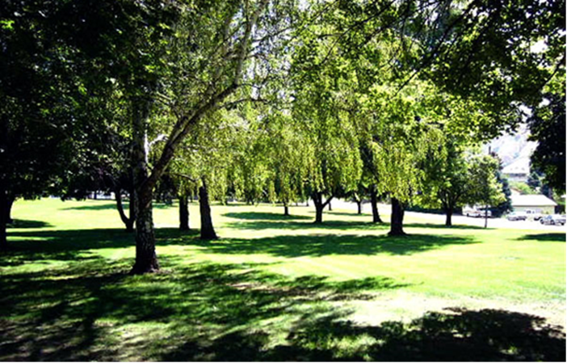
Public opinion survey
Determine support for increased funding
Test voter priorities/benefits/specific places
Sample ballot language
Fiscal safeguards, accountability elements
Find out best messengers & messages
Understand other community priorities

Slide 13
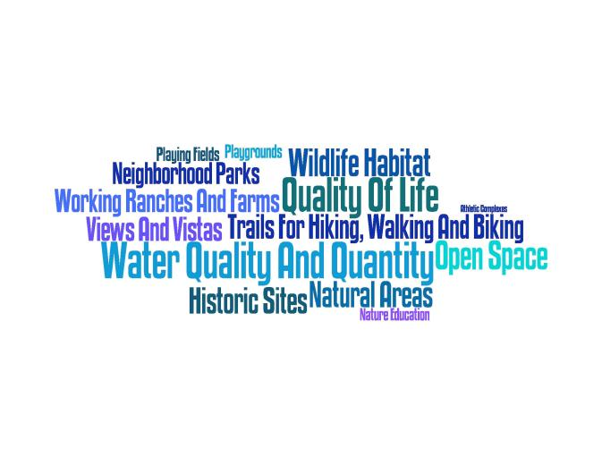
We translate the public interest…

Slide 14
Program Recommendations
Funding source
Amount (and duration)
Purposes/Uses of funds
Timing (choice of election date)
Management/Accountability

Slide 15
Ballot Language
Legal constraints
Best practices
Integrate survey findings
Negotiate with public attorney, bond counsel
Interpretation/ballot pamphlet arguments

Slide 16

Campaign
Coalition building
Strategy/campaign plan
Campaign committee
Campaign finance registration and reporting
Fundraising
Endorsements
Communications (media)
• Earned media
• Paid media: TV, radio, direct mail, digital
• Phones
Grassroots/Field (GOTV)

Slide 17
Key Ingredients for Conservation Funding
Basic electoral support
Elected Leadership
Demonstrable Need and/or Risk
Boots-on-the-ground coalition

Slide 18
Questions? Let’s talk about your experiences!
For further information, please contact:
  Dee Frankfourth, National Associate Conservation Finance Director
    (206) 274-2920
    Dee.frankfourth@tpl.org
www.tpl.org

