Slide 1
Park Programming and Better Health
Neighborhood parks function as a nucleus of neighborhood activity, where residents can gather for social events, recreational activities and meetings about community issues.
Park and recreation agencies currently provide millions of Americans access to healthy and nutritious food. More than 50 percent administer community garden programs. Nearly 25 percent of agencies manage farmers’ markets, and 63 percent permit space for gardens.
Today, 70 percent of park and recreation agencies offer programs for senior citizens, and the average agency serves over 160 seniors annually.
When Boston made park programming highly visible by hiring veterans to teach free health classes in 18 city parks a year, park attendance dramatically increased during summer months.
Having events at the park, including sports competitions and other attractions, appears to be the strongest correlate of park use and community-level physical activity.
Notes:
References:
Quantifying the Contribution of Public Parks to Physical Activity and Health: Introducing SOPARC, Deborah A. Cohen
^{NRPA infographic}
^{NRPA infographic}
NRPA’s 2015 Field Report, NRPA, 2015
Parks and Physical Activity: Why Are Some Parks Used More Than Others?, Deborah A. Cohen, 2010

Slide 2
Park and recreation agencies currently provide millions of Americans access to healthy and nutritious food. More than 50 percent administer community garden programs. Nearly 25 percent of agencies manage farmers’ markets, and 63 percent permit space for gardens.
Notes:
^{NRPA infographic}

Slide 3
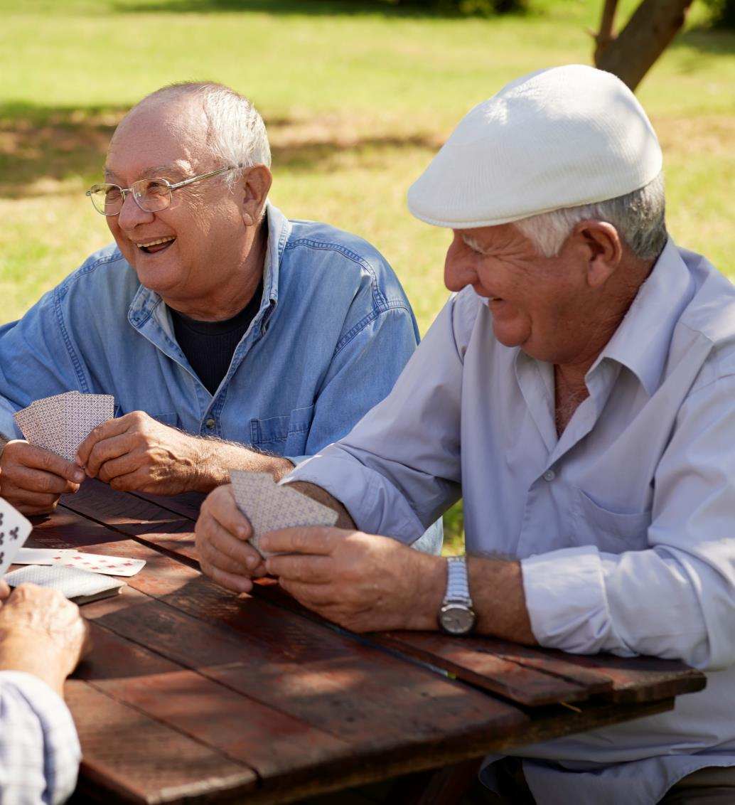
Today, 70 percent of park and recreation agencies offer programs for senior citizens, and the average agency serves over 160 seniors annually.
Notes:
^{NRPA infographic}

Slide 4
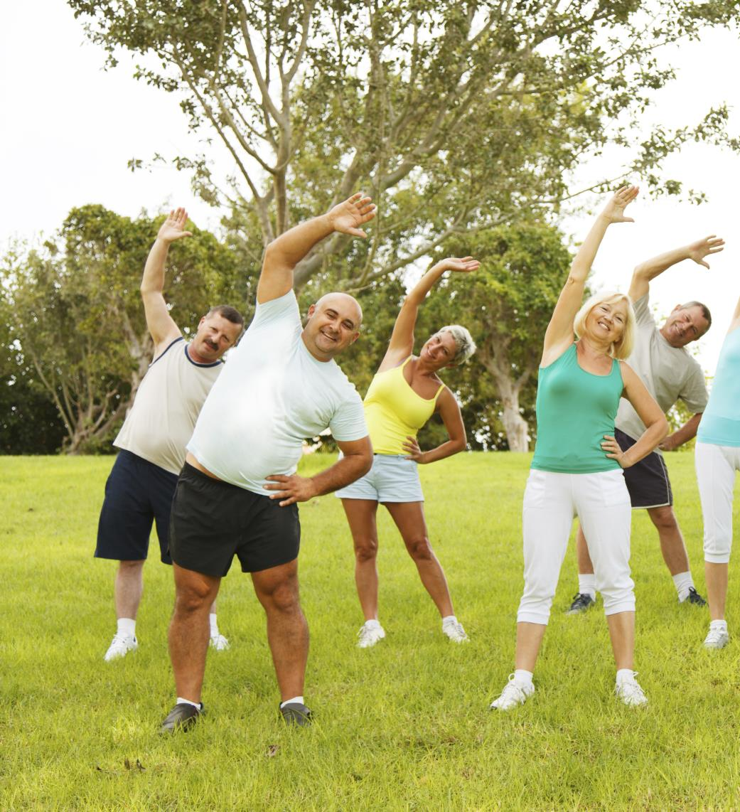
When Boston made park programming highly visible by hiring veterans to teach free health classes in 18 city parks a year, park attendance dramatically increased during summer months.
Notes:
NRPA’s 2015 Field Report, NRPA, 2015

Slide 5
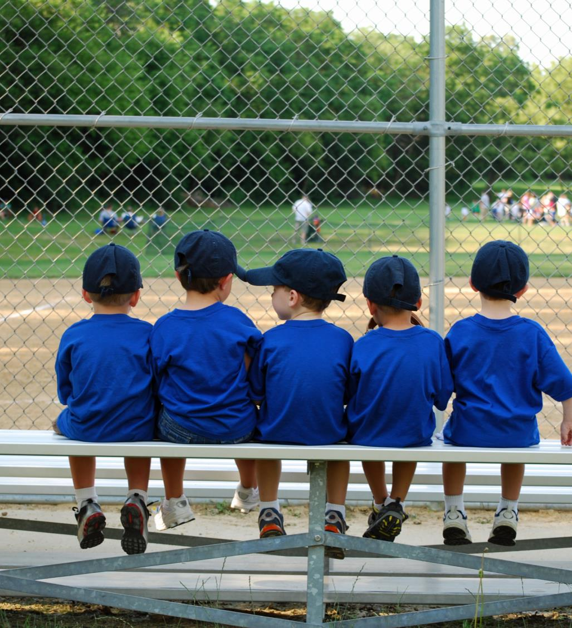
Having events at the park, including sports competitions and other attractions, appears to be the strongest correlate of park use and community-level physical activity.
Notes:
Parks and Physical Activity: Why Are Some Parks Used More Than Others?, Deborah A. Cohen, 2010

Slide 6
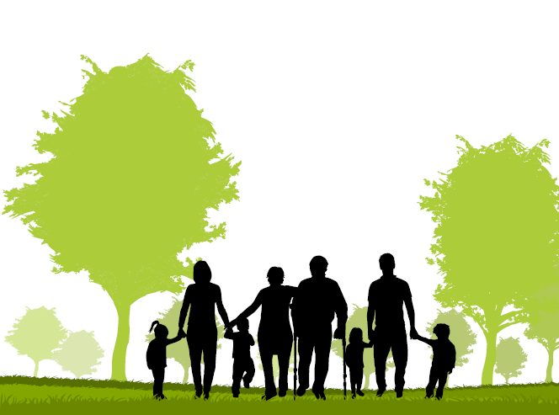
Neighborhood parks function as a nucleus of neighborhood activity, where residents can gather for social events, recreational activities and meetings about community issues.
Notes:
Quantifying the Contribution of Public Parks to Physical Activity and Health: Introducing SOPARC, Deborah A. Cohen

