Slide 1
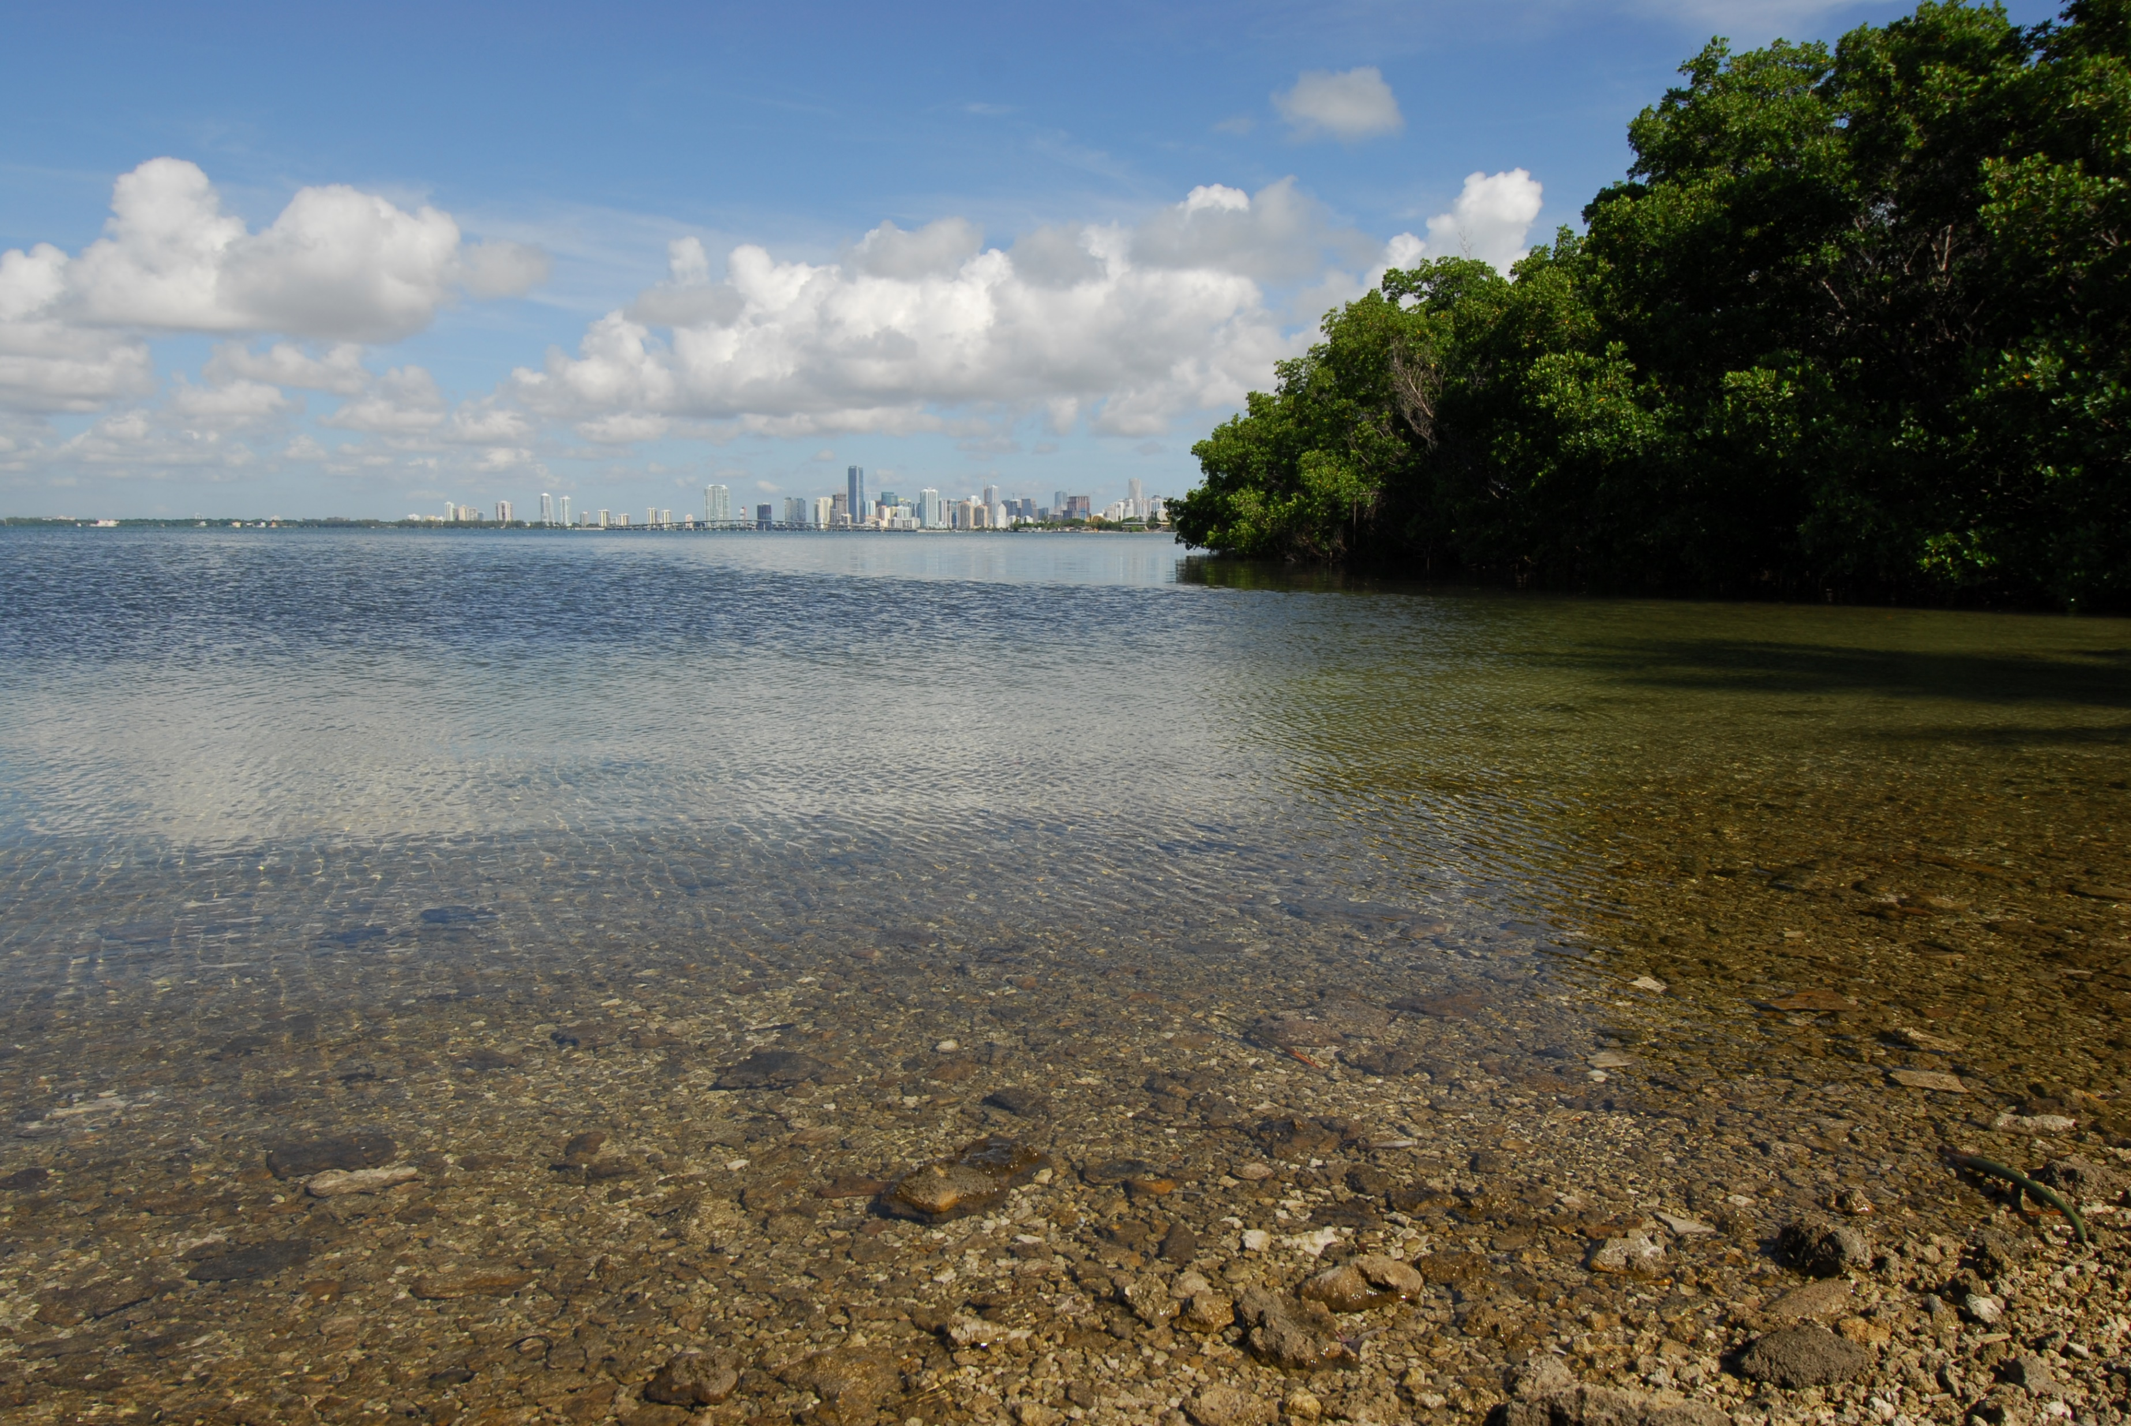
Dimensions of Resilience
Miami-Dade County Office of Resilience and Parks
NRPA Innovation Lab
January 19, 2019
Miami-Dade County
Office of Resilience
Jim Murley, Chief Resilience Officer

Slide 2
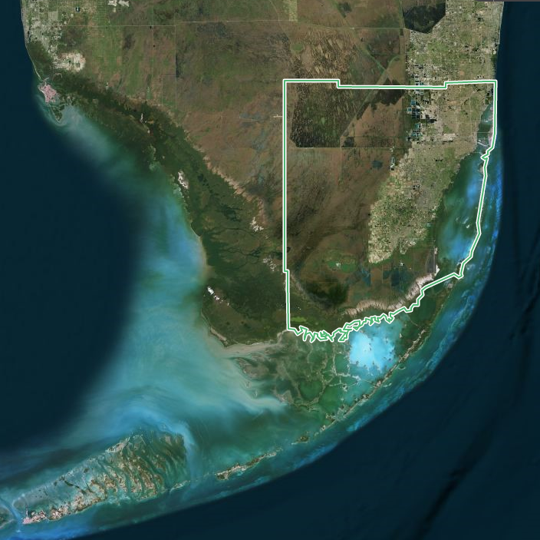

Slide 3
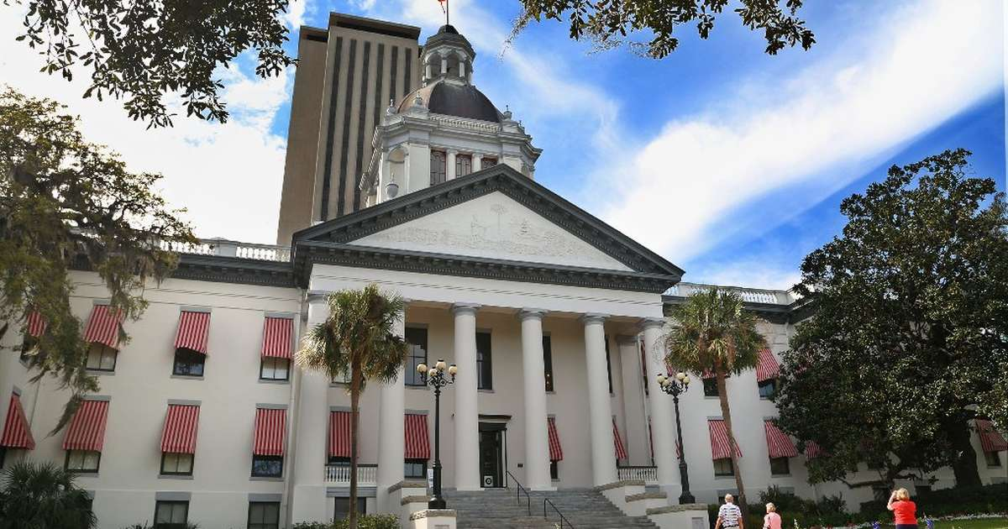


Slide 4
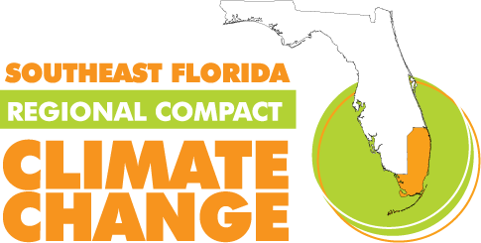
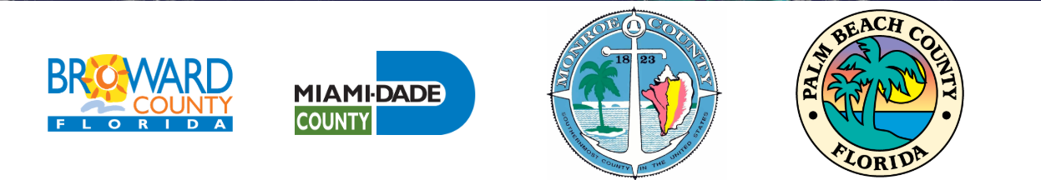

Slide 5
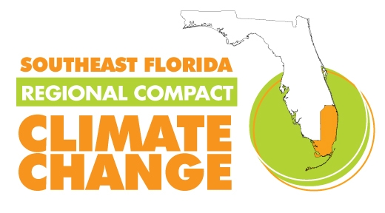

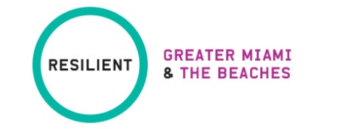
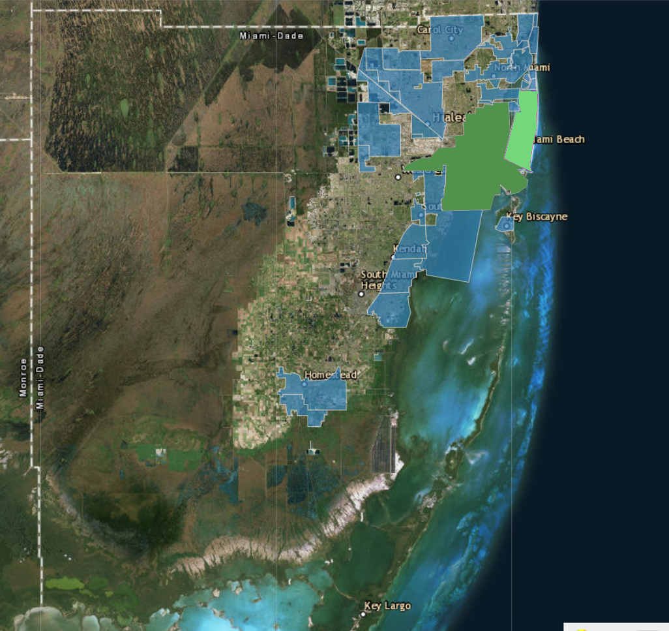
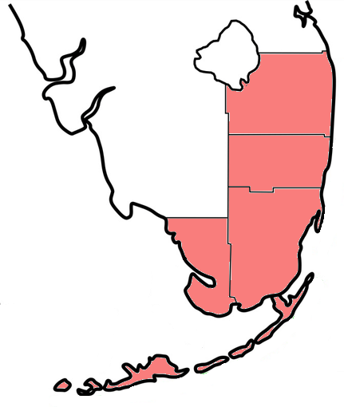
Miami Beach
Palm Beach
Miami
Broward
Unincorporated
Miami-Dade
County
Miami-Dade
Monroe

Slide 6
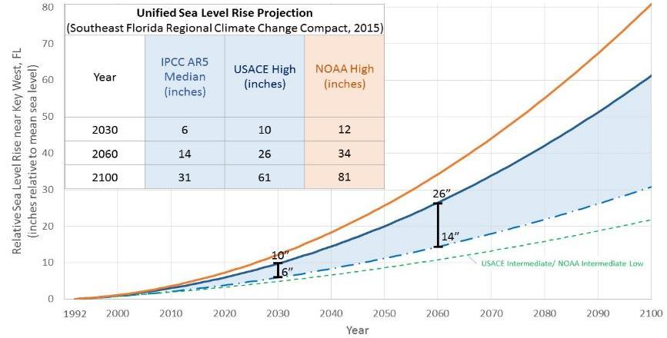
How do we adapt?
Sea level will be 1 foot higher 14 years – 40 years
Notes:
But we do have estimates of how these different contributions will change based on different emissions scenarios
This includes peripherial glaciers surrounding Greenland & Antarctic ice sheets )

Slide 7
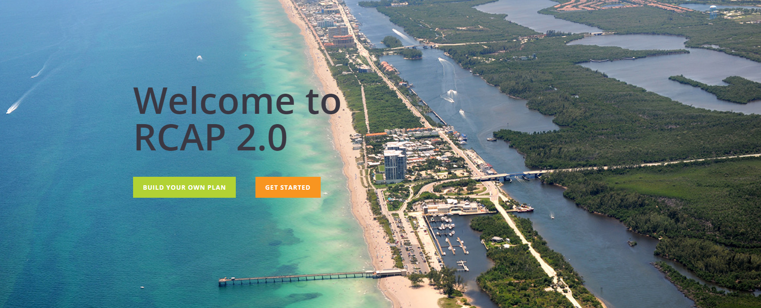

Slide 8

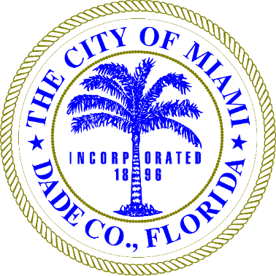
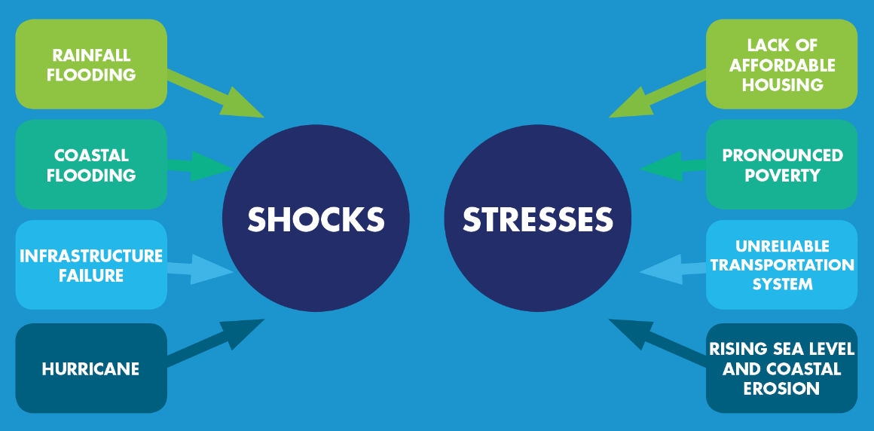

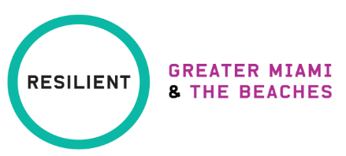
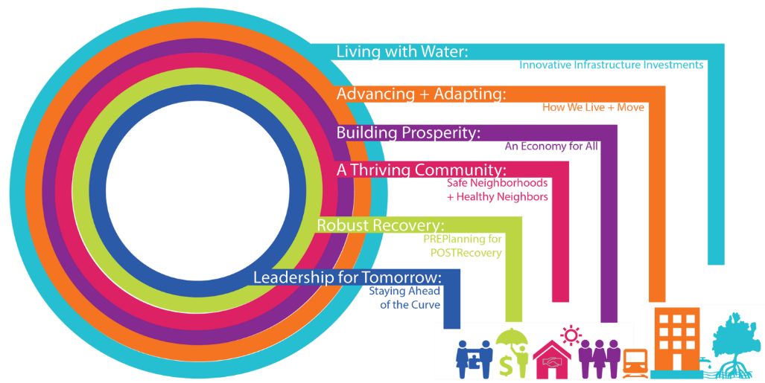
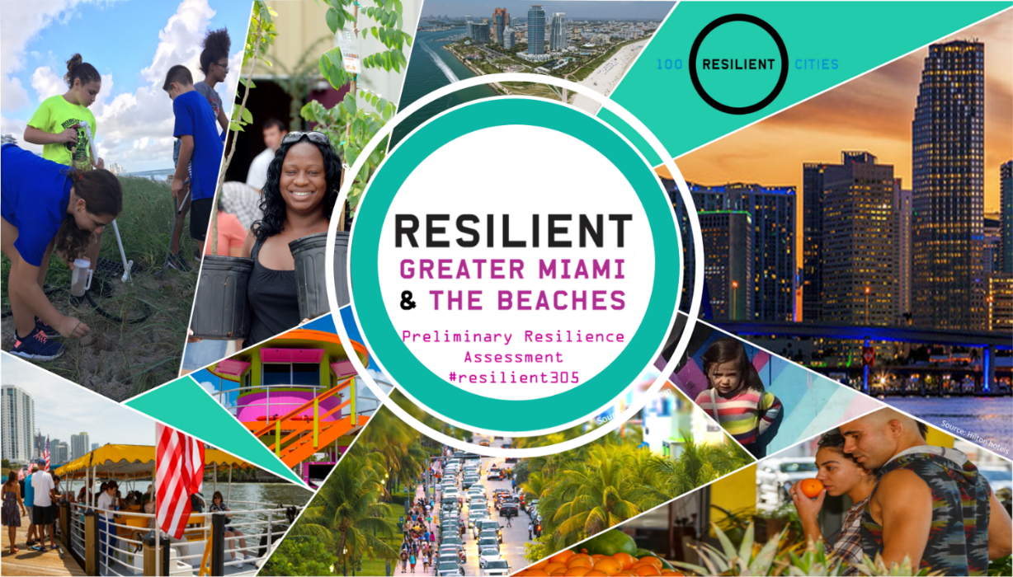
100 RESILIENT CITIES PROGRAM
GREATER MIAMI & THE BEACHES 100 RESILIENT CITIES PROGRAM
SIX
DISCOVERY
AREAS
LINK TO GM&B PRA: https://100rc.app.box.com/s/soo5trb05x922vk5jl41jo0xaqzlejxv
Notes:
Greater Miami & the Beaches is a unique collaboration among Miami-Dade County and the Cities of Miami and Miami Beach, created to respond to global trends major cities face: urbanization, globalization and climate change. We want to discuss this important endeavor with you as a lot of the focus are on issues that are applicable County-wide.
100 Resilient Cities, also referred to as 100RC, is an organization pioneered by the Rockefeller Foundation.
100RC is dedicated to helping cities around the world become more resilient to the physical, social and economic challenges that are a growing part of the 21st century. 100RC will provide expert consultant support to develop a Resilience Strategy for Greater Miami and the Beaches. 100RC Cities will have access to $200 million in solutions through consultant services over the next two-years, as well as access to the network of peer cities.
The Resilience Strategy will be designed to address Greater Miami and the Beaches' key shocks and stresses. Acute shocks are sudden and sharp events that threaten a city, such as hurricanes. Chronic stresses weaken the fabric of a city on a day-to-day or cyclical basis, such as infrastructure failure.
A Chief Resilience Officer (CRO) is a top-level advisor to the city’s mayor or chief executive. His/her task is to bring in stakeholders from across silos of government and sectors of society, and to access all available resilience building tools and experts to develop a resilience strategy.
Our 100RC strategy partner is AECOM.
Shocks & Stresses
Coastal/tidal flooding
Hurricane/typhoon/cyclone
Inadequate public transportation systems
Infrastructure failure
Lack of affordable housing
Poverty
Rainfall flooding
Sea level rise/coastal erosion
The six discovery areas are subject to three cross-cutting themes of social equity, innovation + technology, and intergovernmental coordination.

Slide 9
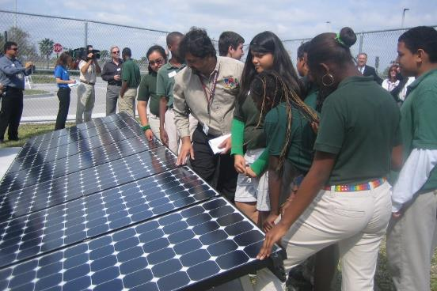
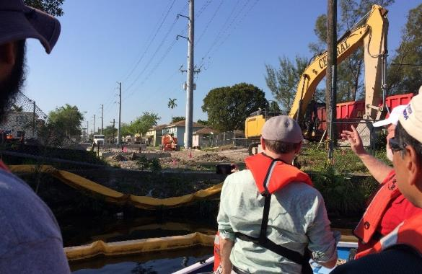
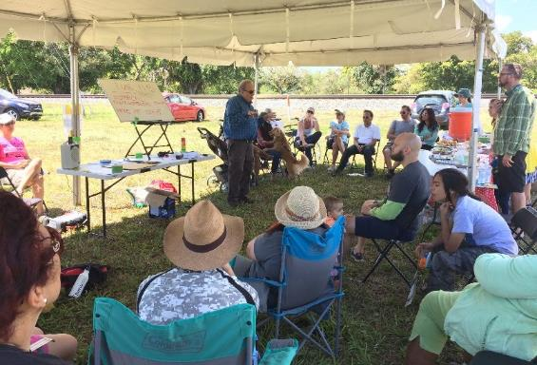
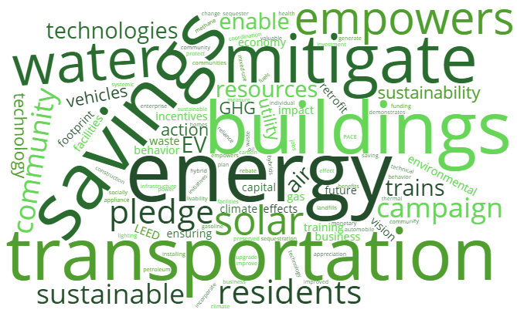
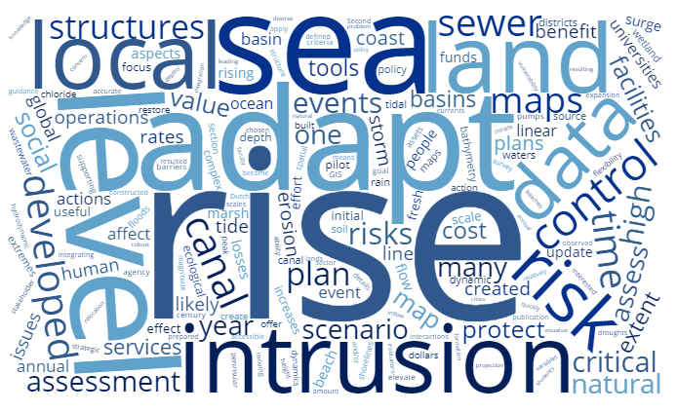
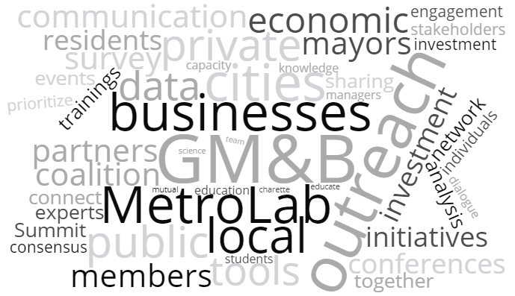
MITIGATION
ADAPTATION
COMMUNICATION
combating climate change by reducing climate pollution
identifying climate risks + taking action to reduce vulnerabilities
engaging governments, academia, businesses + community groups

Slide 10
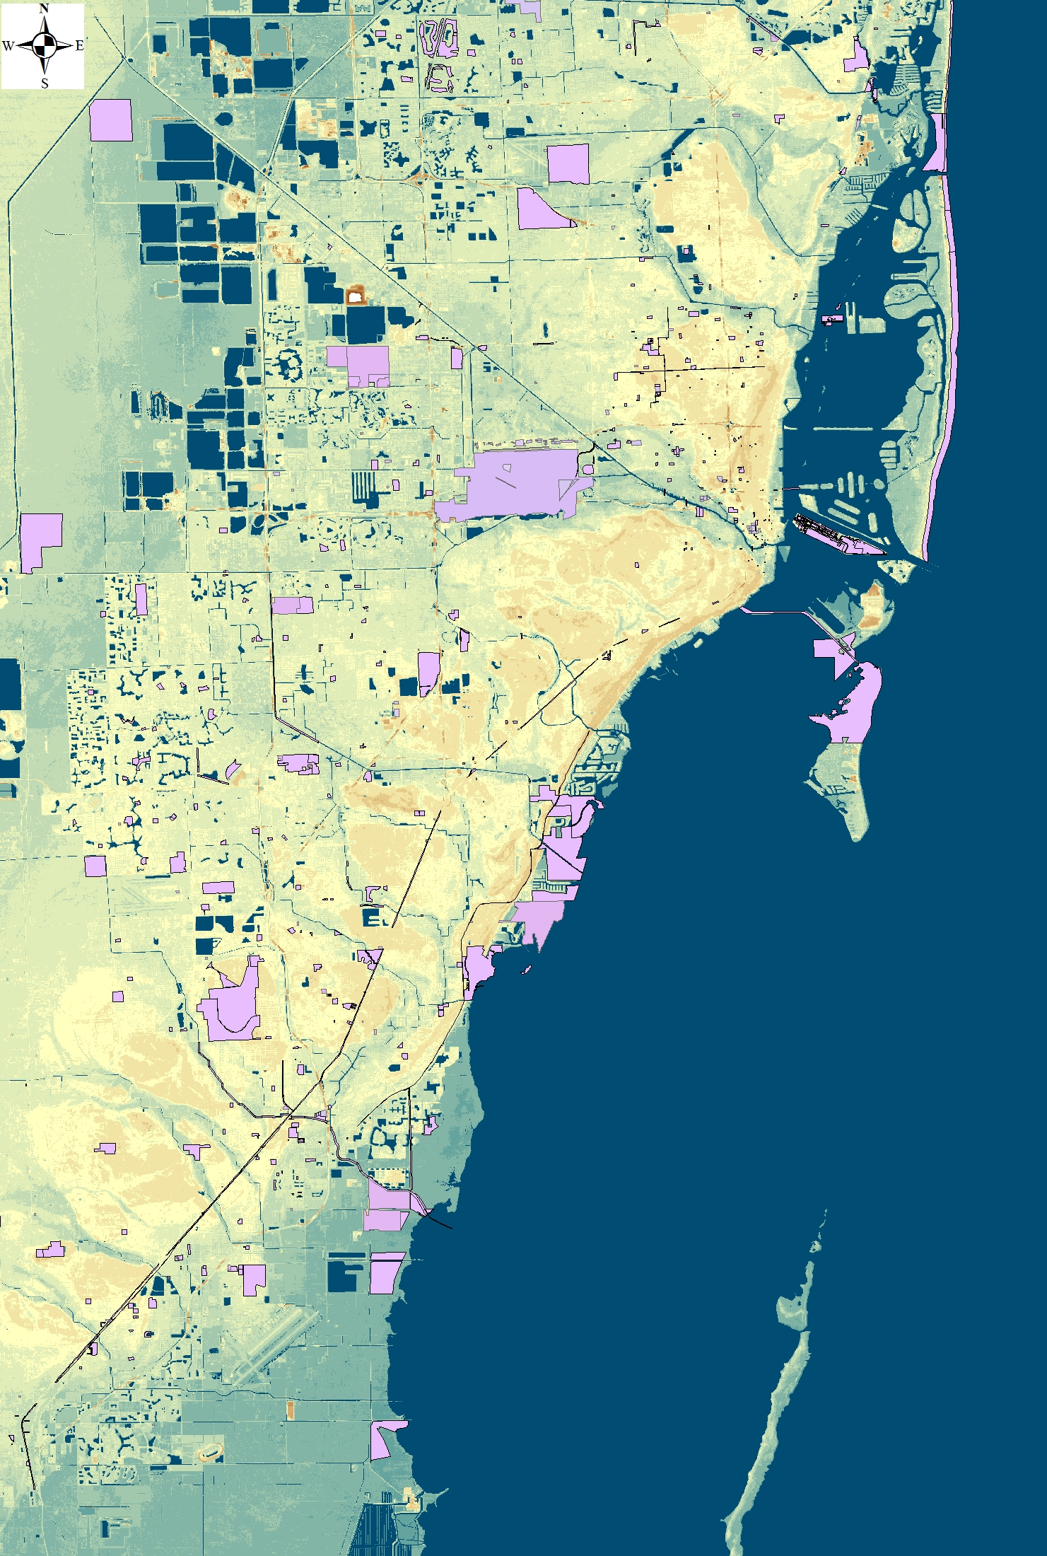
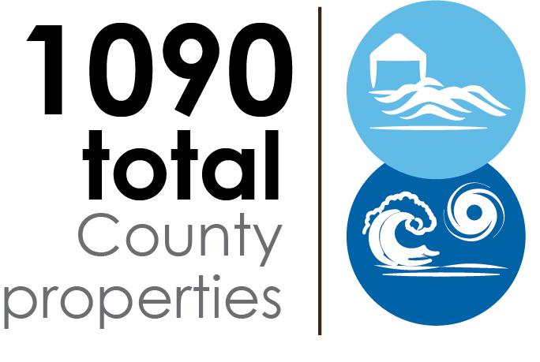
The Rapid action plan considered properties and projects countywide
Properties:
Projects:

Slide 11
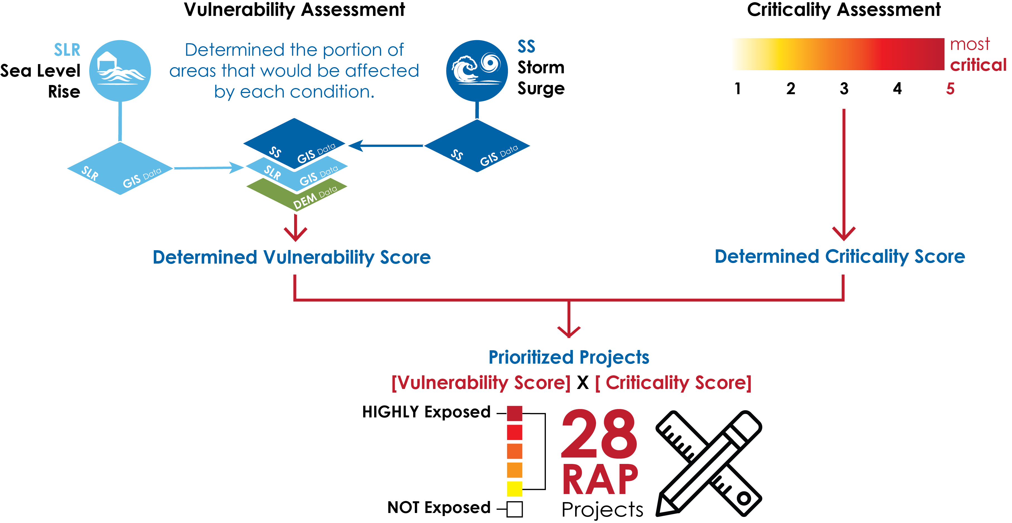
Projects were prioritized based on their combined vulnerability and criticality
Notes:
-Could we show maps of the top 5 most vulnerable assets/projects, or use the 3-D map to explore 1 or 2 of them in presentatios? -MG

Slide 12
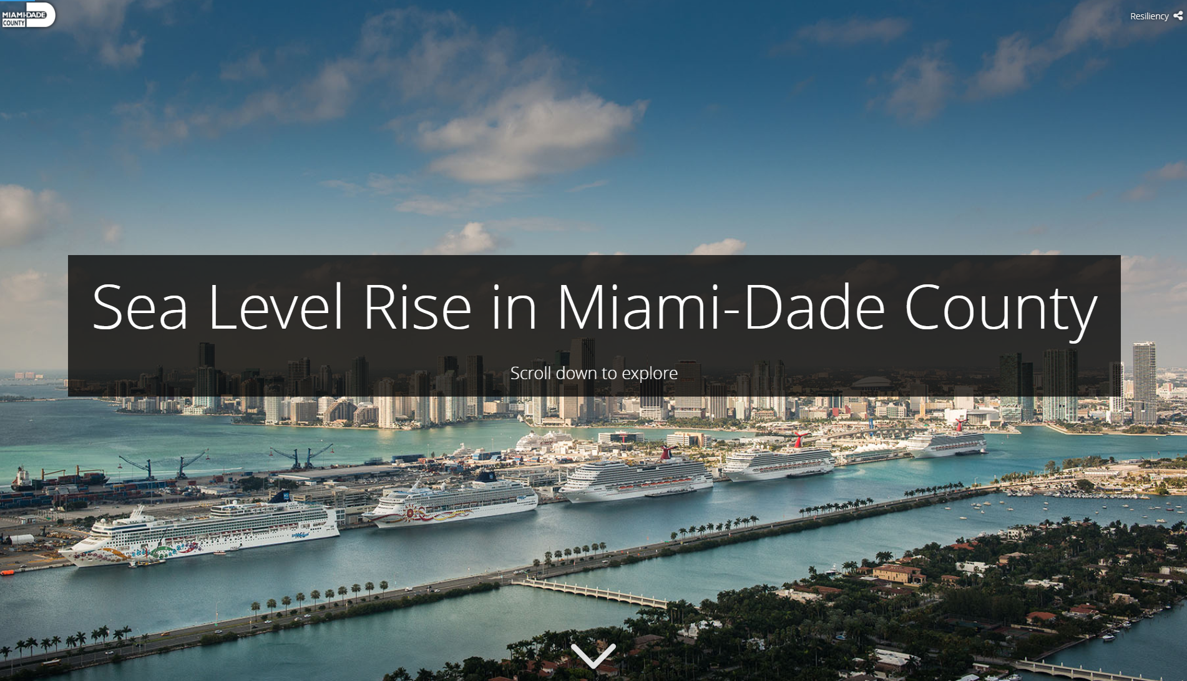

Slide 13
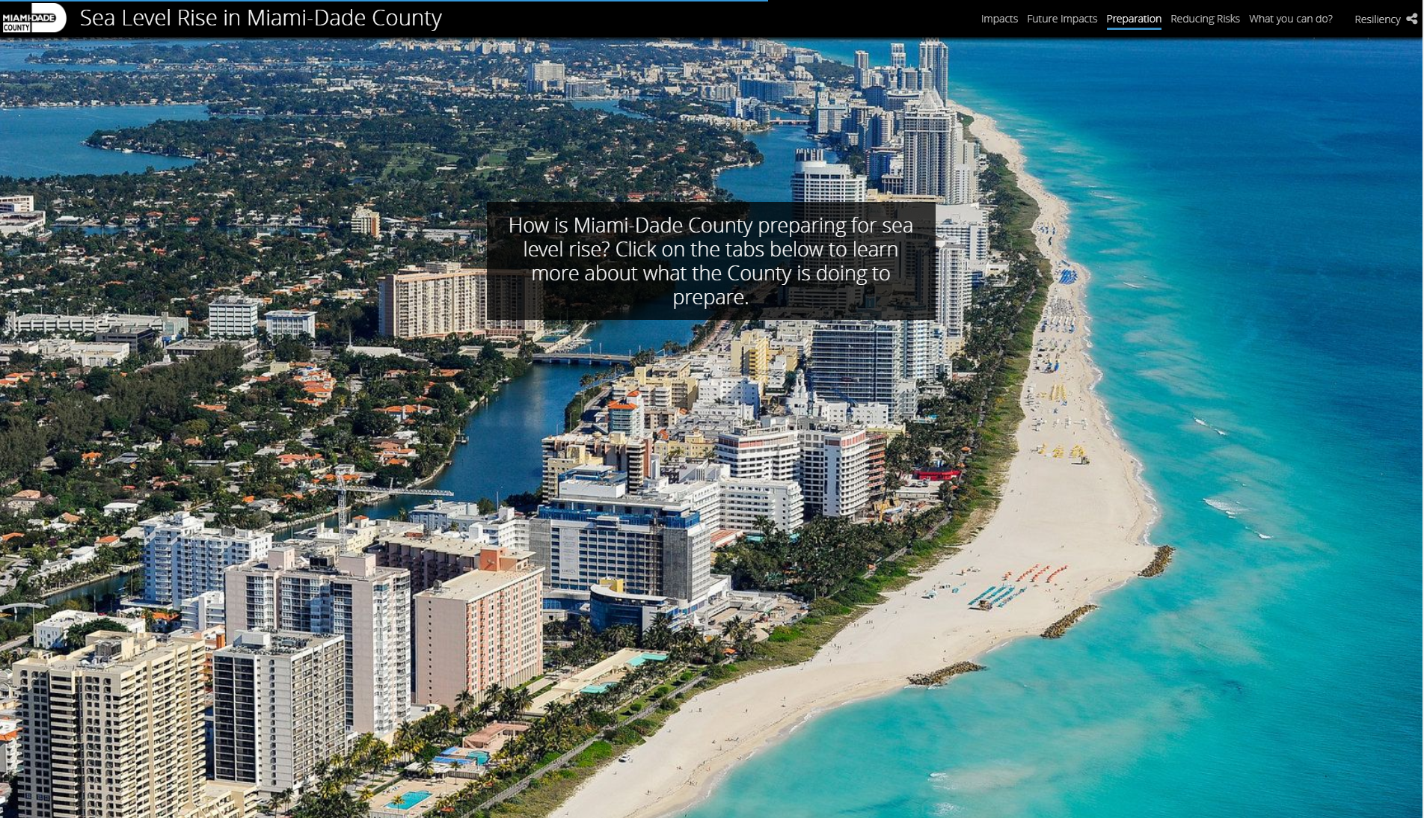

Slide 14
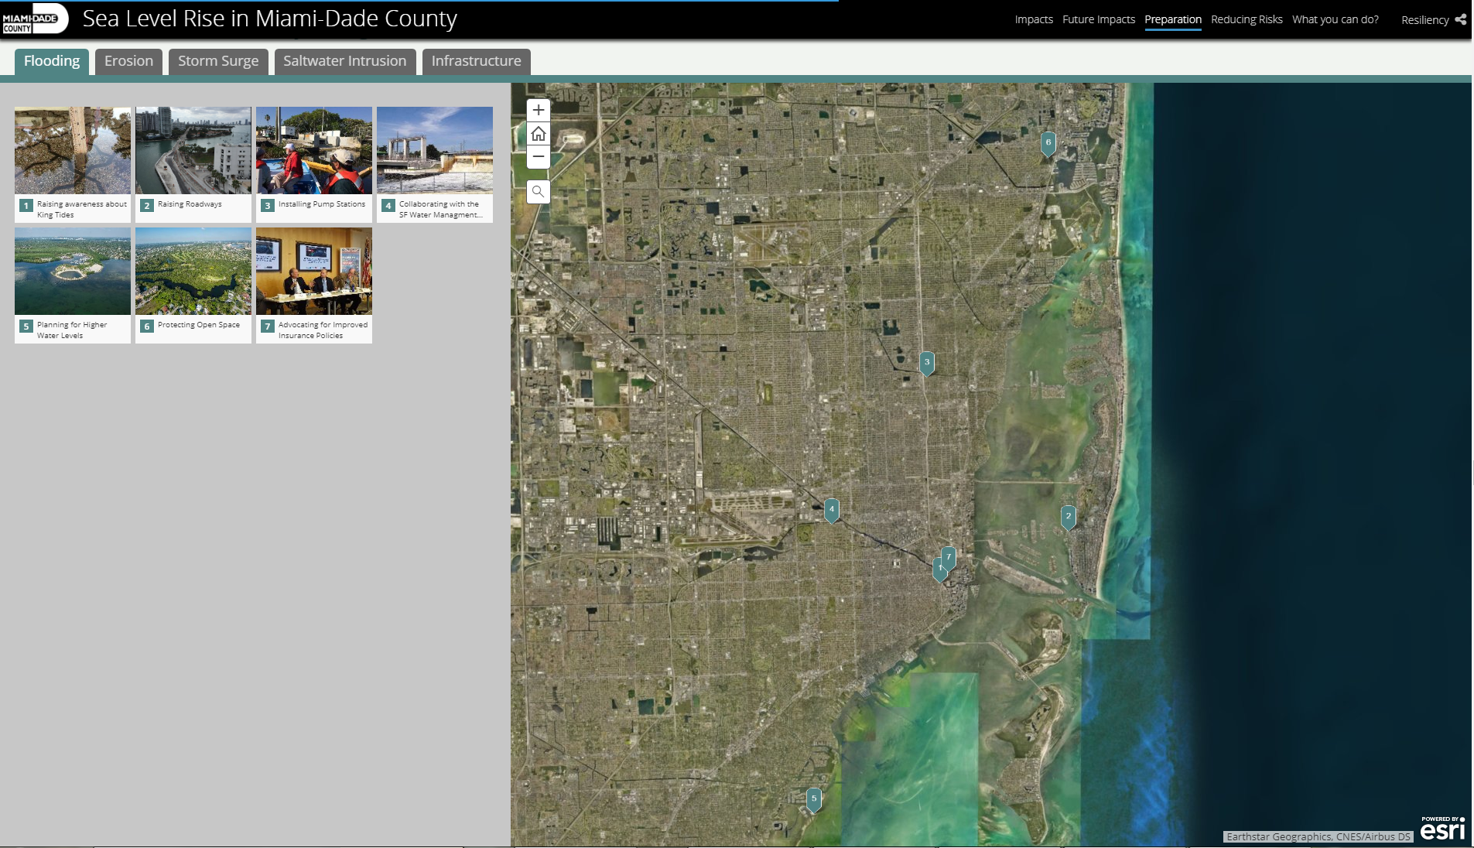

Slide 15
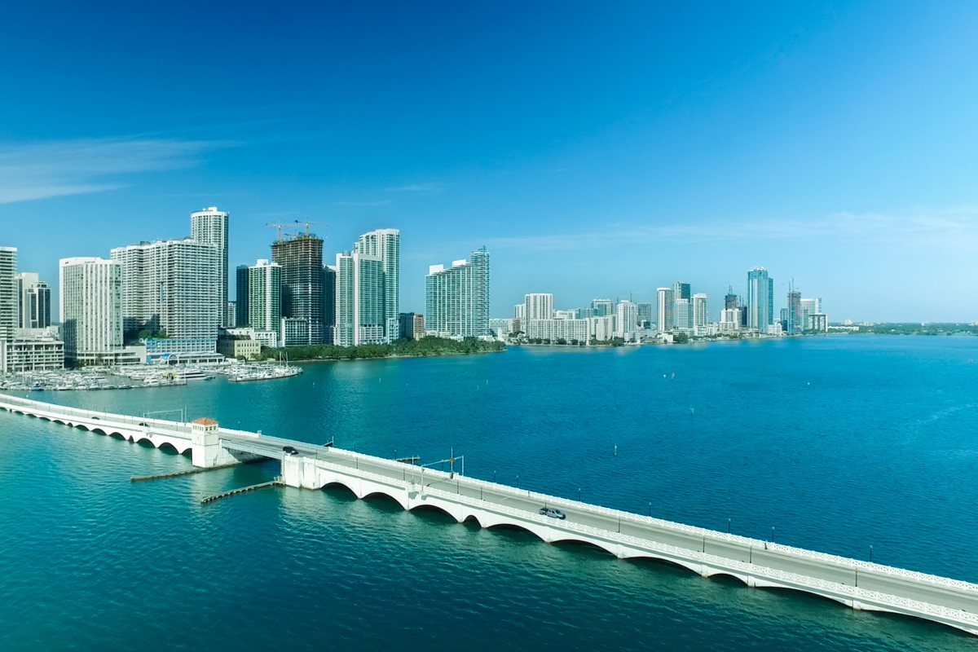
New projects: U.S. ACE projects
  “Beach” study (The Miami-Dade County Coastal Storm Risk Management Feasibility Study) – DERM lead
  “Back Bay” study(The Miami-Dade County Back Bay Coastal Storm Risk Management Feasibility Study) – OOR lead
  Others: Harbor deepening (Sea Port) &
    S. Atlantic Comprehensive (not started)

Slide 16
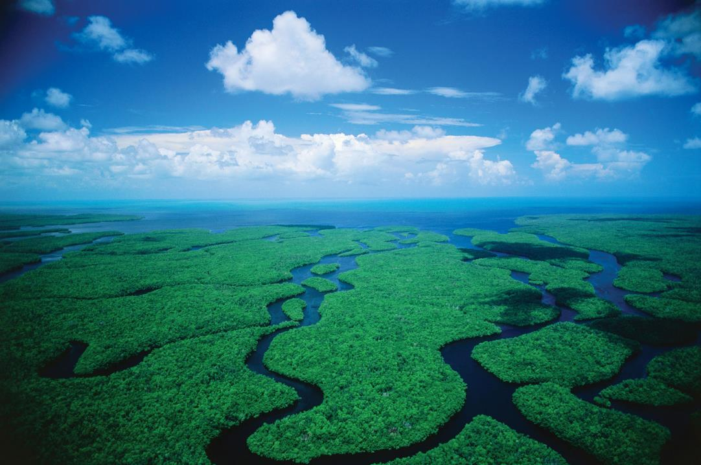
Miami-Dade County Sea Level Rise Action Plan
Miami-Dade OOR working with Arcadis to create a sea level rise action plan – suite of options for adaptation to SLR.

Slide 17
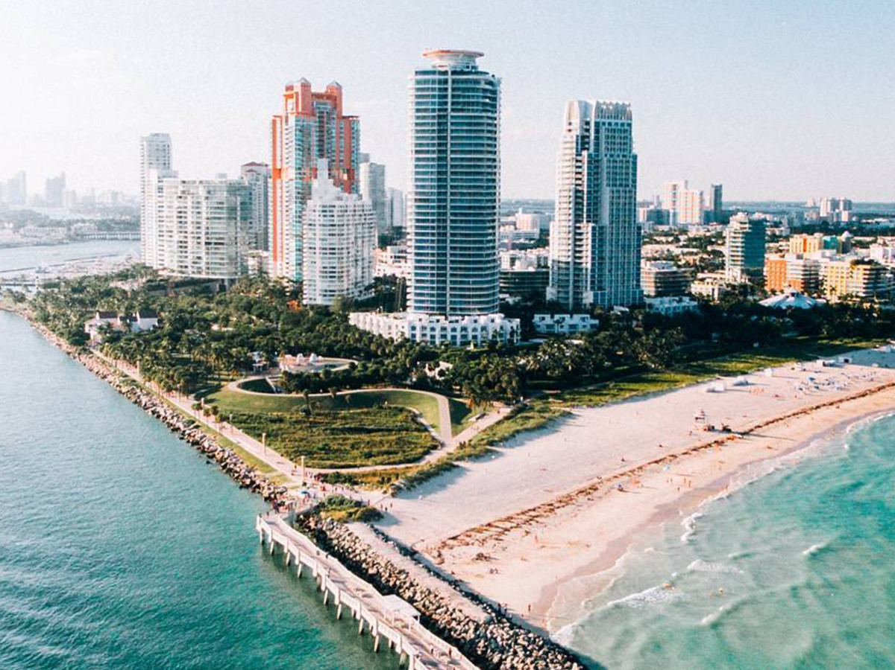
How can parks play a greater role in resilience?

Slide 18
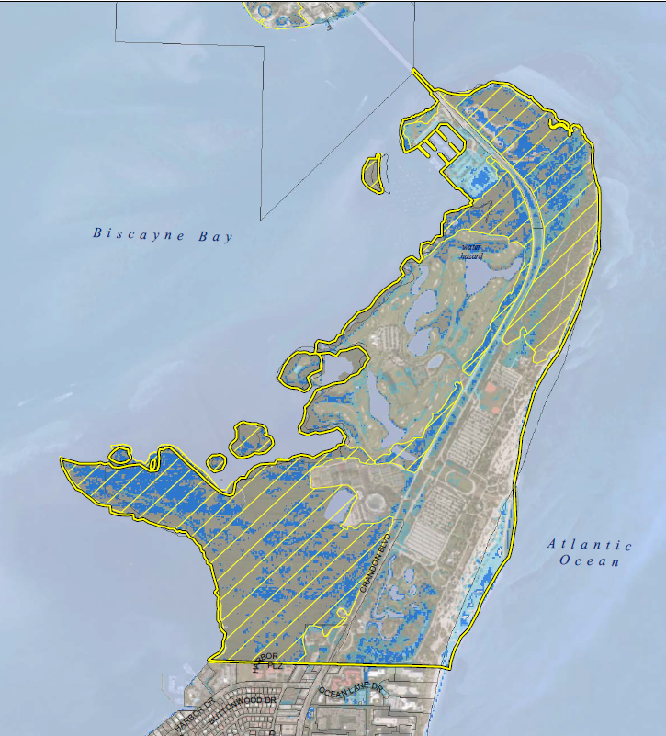
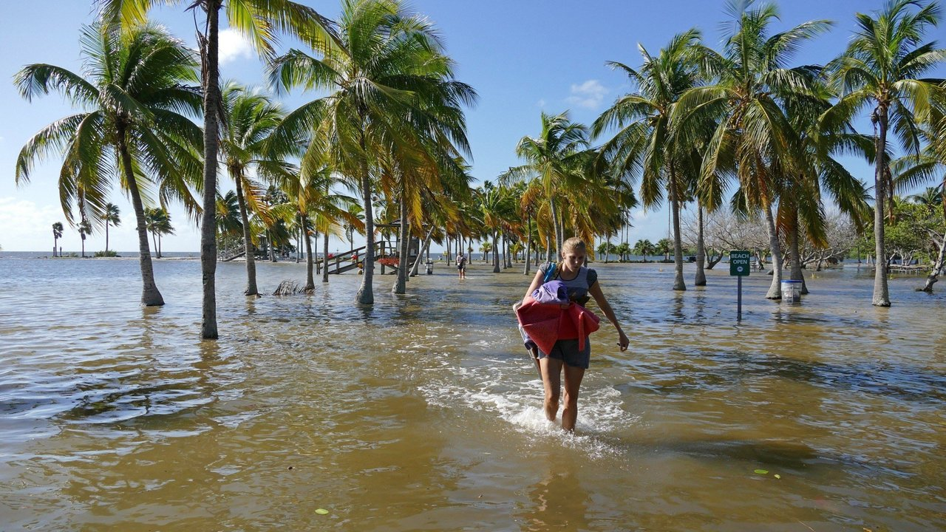
Miami-Dade PROS Sea Level Rise Maps

Slide 19
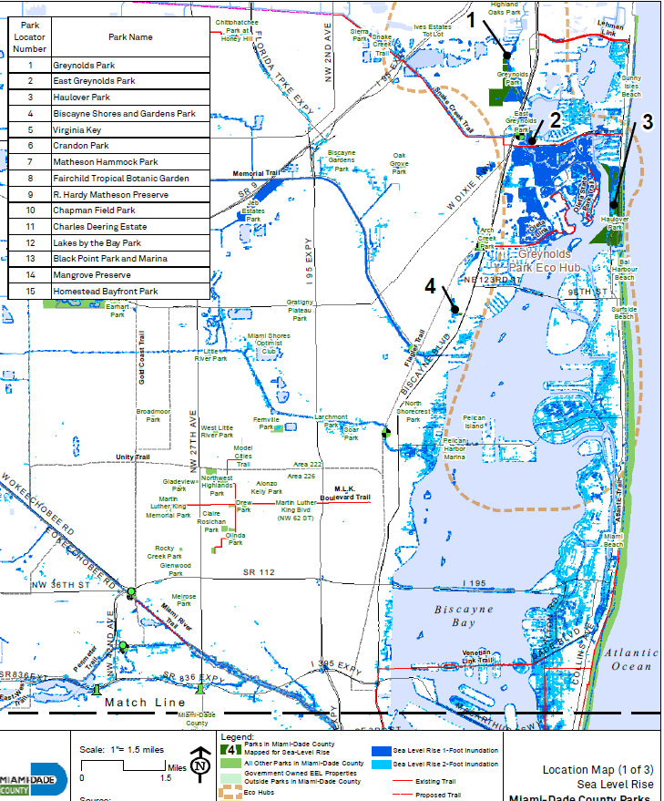
1 foot SLR inundation
2 feet SLR inundation

Slide 20
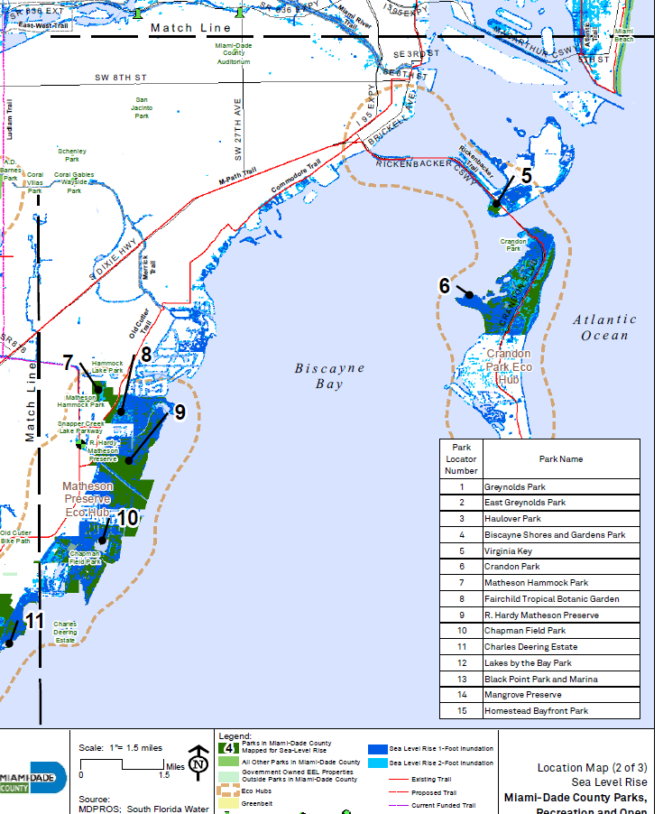
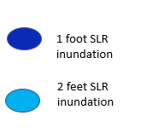

Slide 21
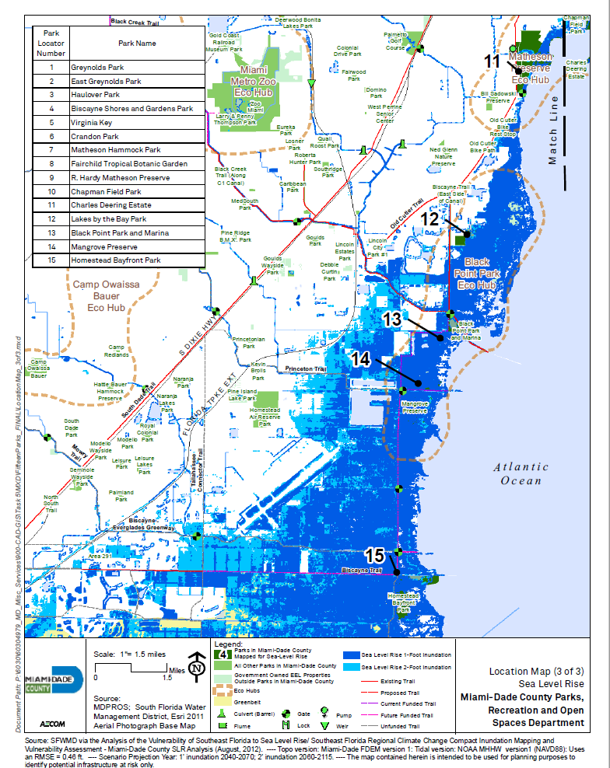

Slide 22
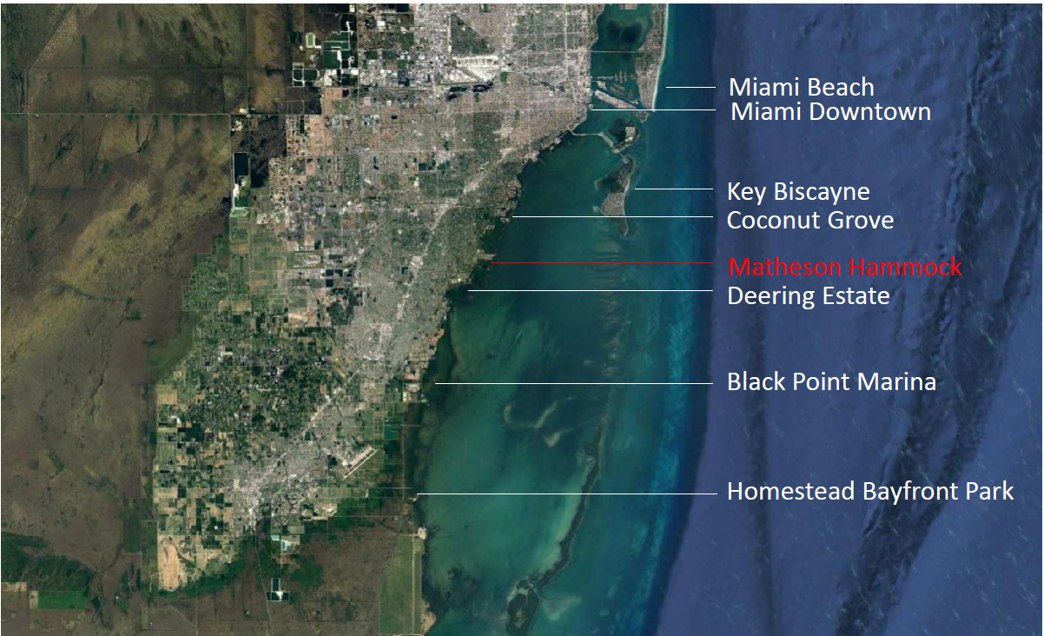

Slide 23
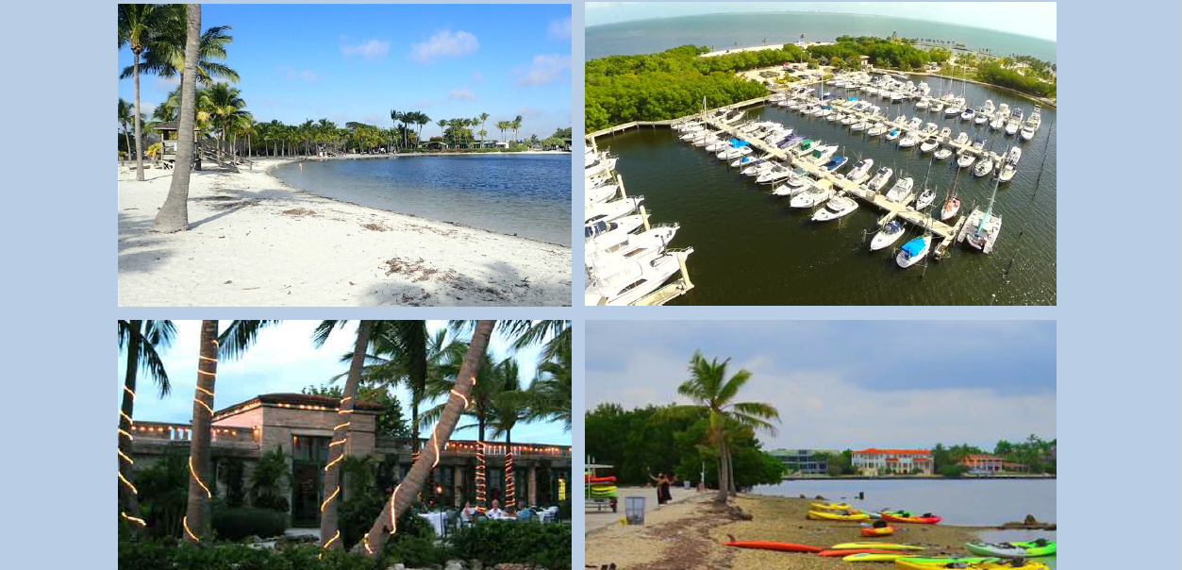
Matheson Hammock Park Sea Level Rise Mitigation Study

Slide 24
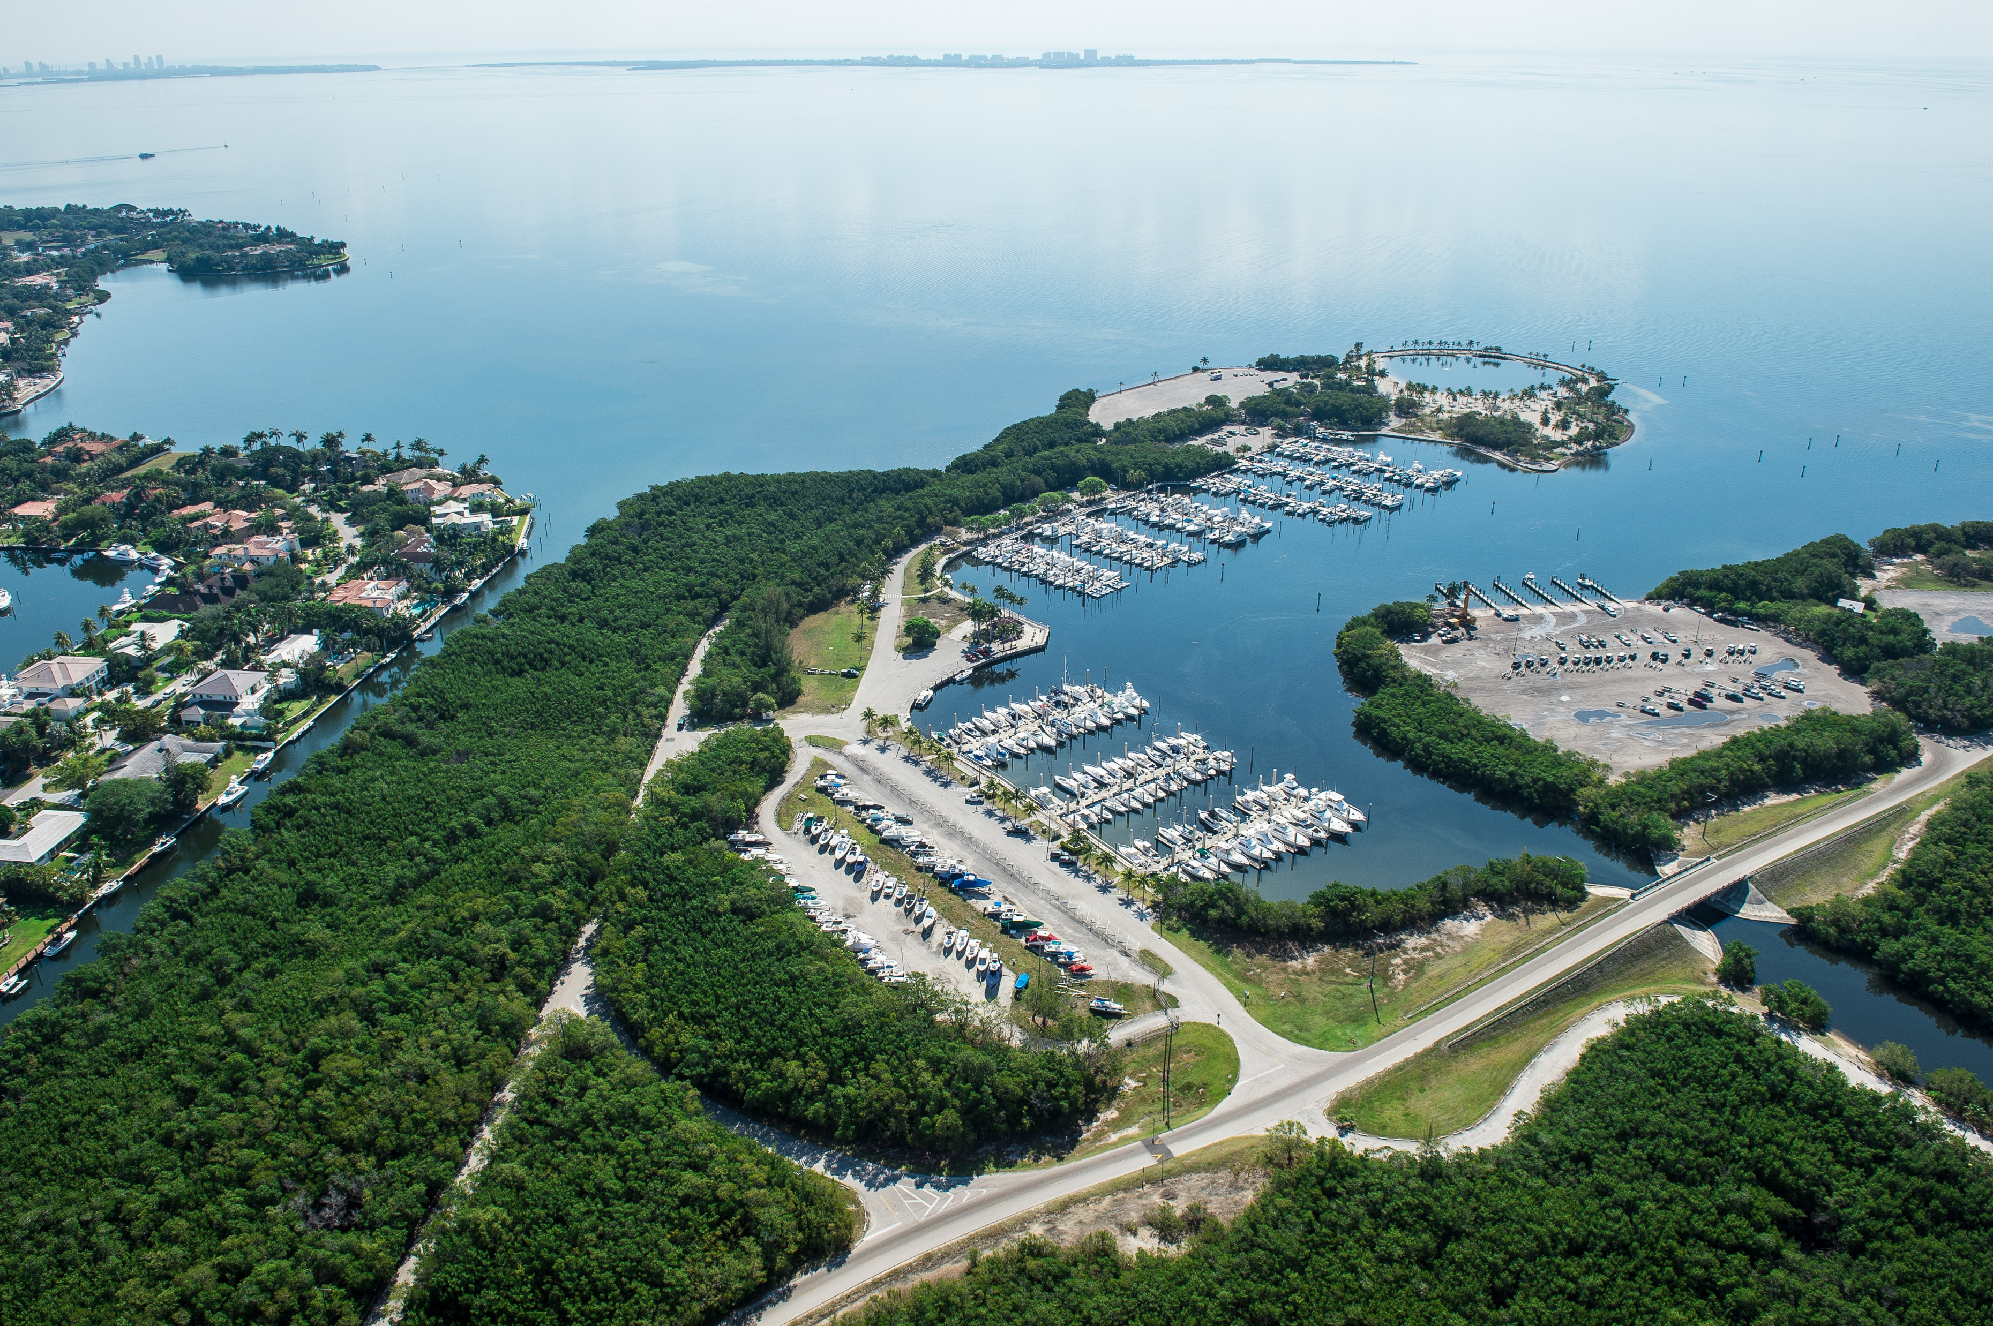

Slide 25
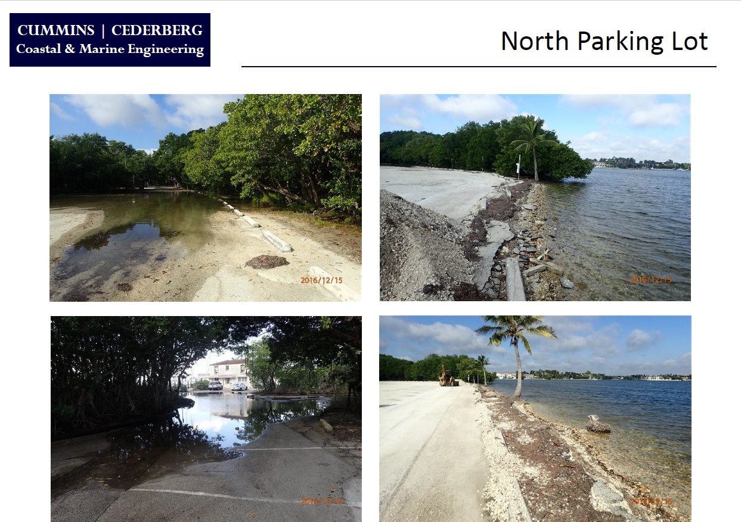

Slide 26
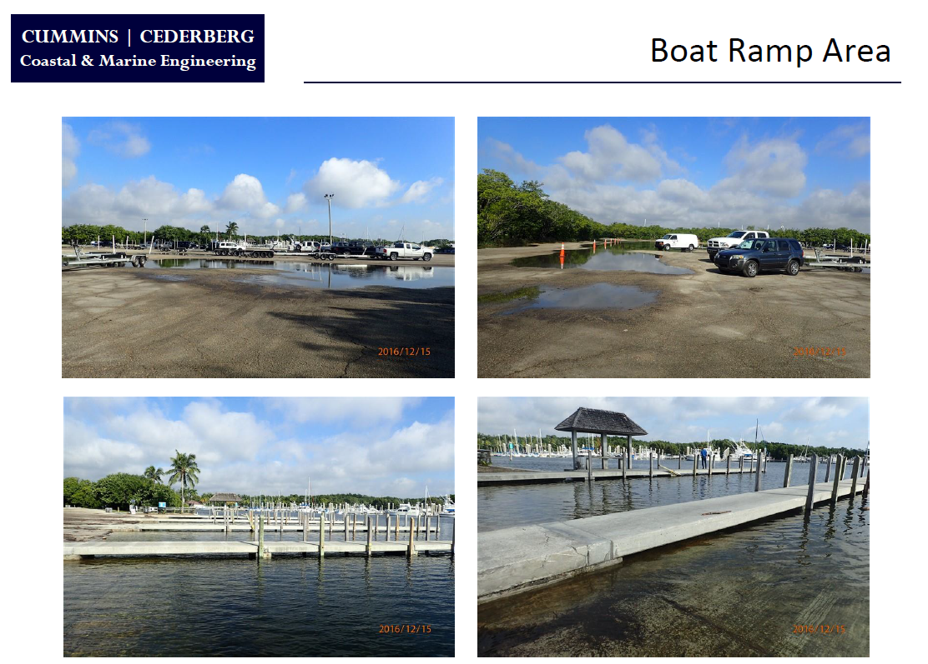

Slide 27
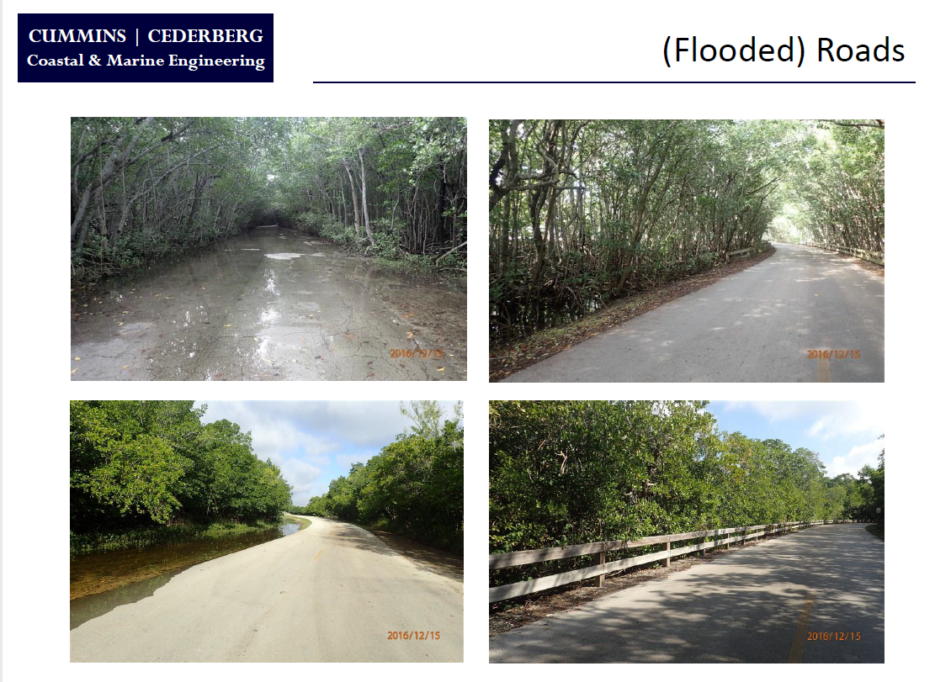

Slide 28
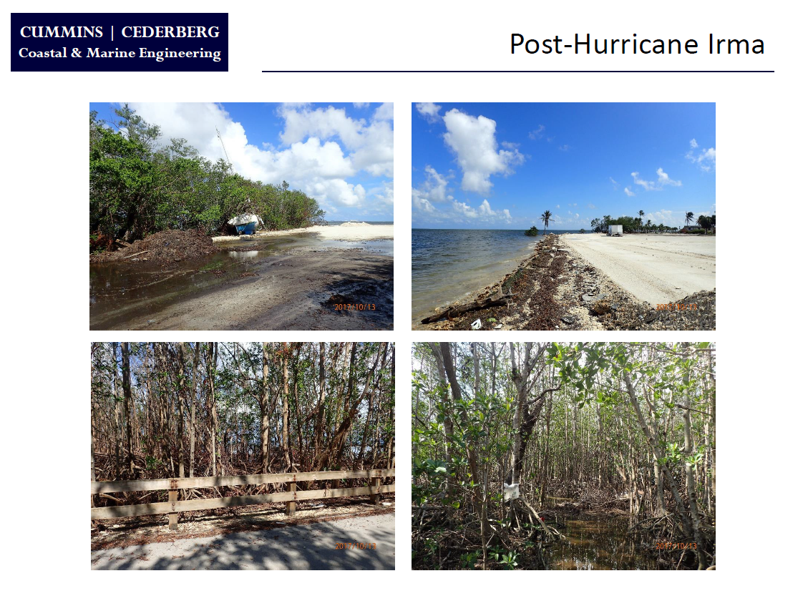

Slide 29
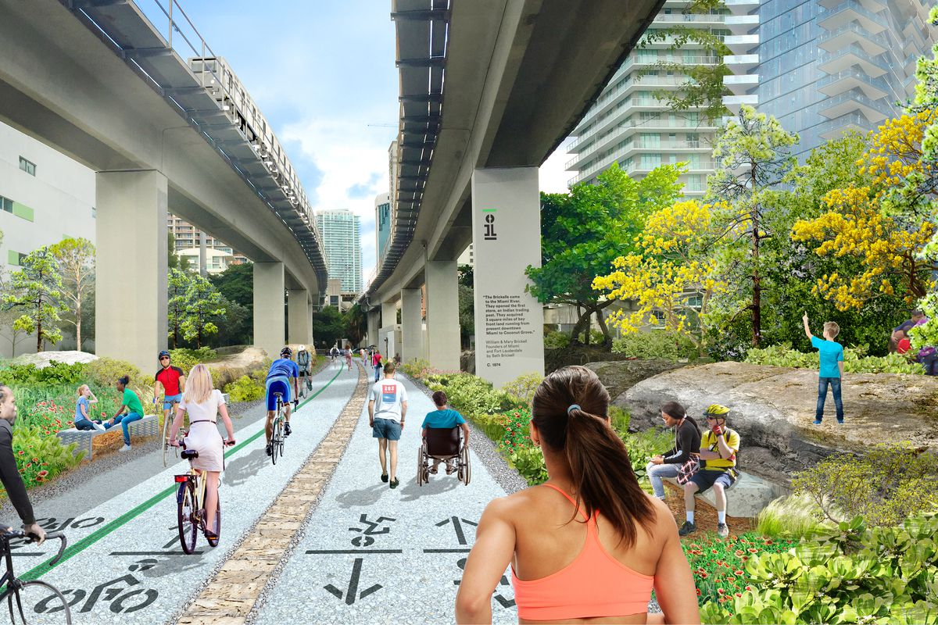
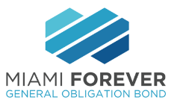
In November, 2017, City of Miami passed the Miami Forever Bond which included $58 million of “Quality of Life” projects to combat sea level rise, create new affordable housing projects, improve four miles of roadways, upgrade public playgrounds and enhance city owned parks.

Slide 30
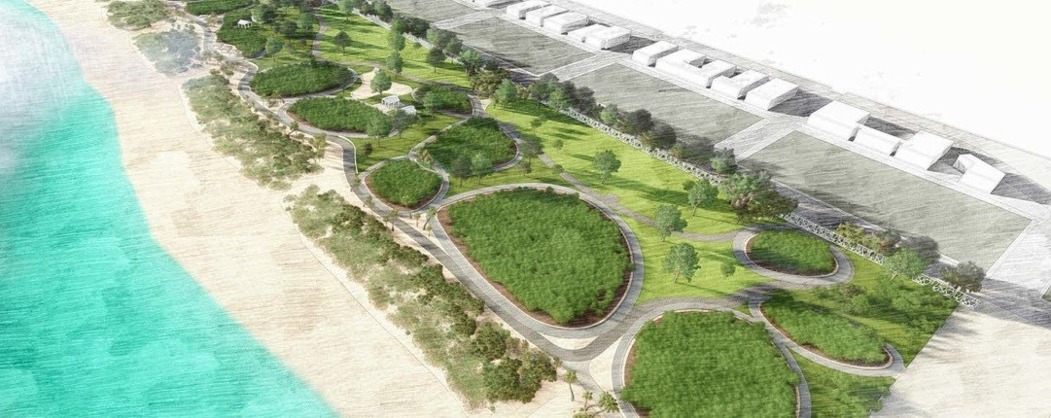
In November, 2018, City of Miami Beach passed a general obligation bond that included $169 million for parks, recreational facilities and cultural facilities

Slide 31
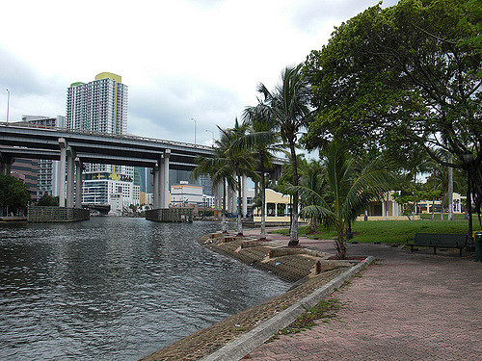
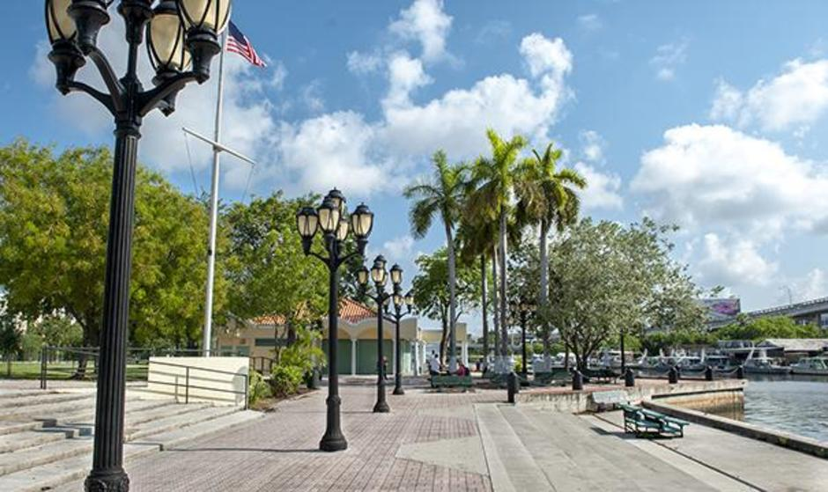
Building social equity, connections and access for all with parks
Jose Marti Park
City of Miami

Slide 32
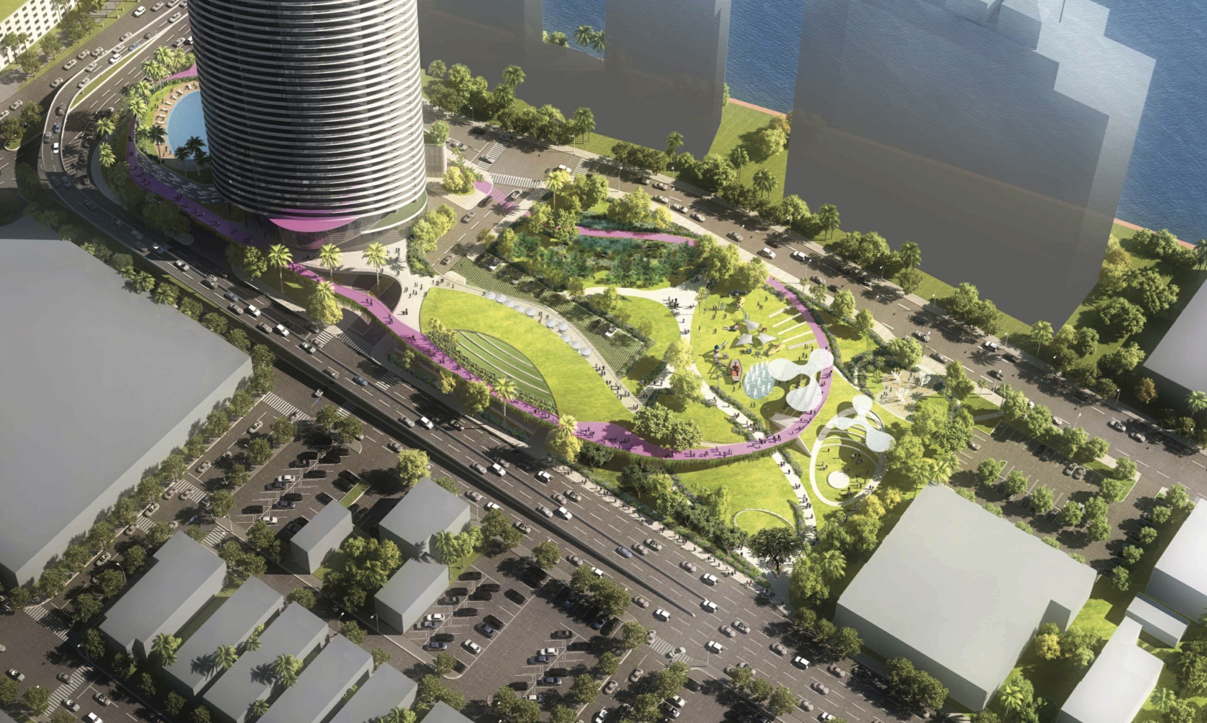
Miami Beach commissioners approve for a plan that will bring a new park and high-rise condo tower to Alton Road.
As part of the deal, the developer will pay for and oversee construction of a 3 acre park.
The development is designed with maximum resiliency in mind. There will be a green roof on the retail space in the 600 block, a bioswale for water retention, and other permeable space

Slide 33


Slide 34

Thank you
James Murley
Chief Resilience Officer
Miami-Dade County
James.Murley@miamidade.gov

